Slide 1
Why Transit? The Need for Transit System Improvements in Middle Tennessee Summer 2016

Slide 2
Introduction
Notes:
This presentation will provide an overview of the transit situation in Middle Tennessee and what organizations like the Transit Alliance of Tennessee and Nashville’s MTA/RTA are doing to find a solution.
The Transit Alliance is a nonprofit organization that works with contributors, community officials and regional leaders to build support for funding regional transit in Tennessee.
Their purpose is to educate, empower and mobilize policy that serves our entire region.
The Transit Alliance has a lot going on in 2016. We organized community meetings in Middle Tennessee to gather feedback on future transit scenarios. In addition, they are communicating regularly to an email list with over 4,000 subscribers, they are raising critical support from businesses and organizations, and they are organizing the Transit Citizen Leadership Academy.
Graduates undergo an intense transit immersion, and graduate as community advocates.
In addition to the Transit Citizen Leadership Academy, the Transit Alliance introduced the Transit Government Leaders Conference this spring. This is a one-night, one-topic leadership event for elected and appointed officials. We are excited to take this to other counties.

Slide 3
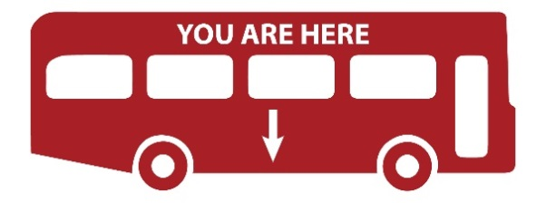
nMotion Planning Process Schedule
Notes:
Thanks to the Transit Alliance and our work gathering community engagement in the region, the ongoing strategic transit planning process known as nMotion is moving along in the timeline. We have been working closely with RTA to accomplish this timeline.
Right now, three future transit scenario options have been shared publicly, and MTA/RTA has received feedback.
The next steps include creating a recommended plan, and we should see updates in 2016.
Building a transit plan is a long-term vision. This is important to remember because most transit projects take 10 years to plan.

Slide 4
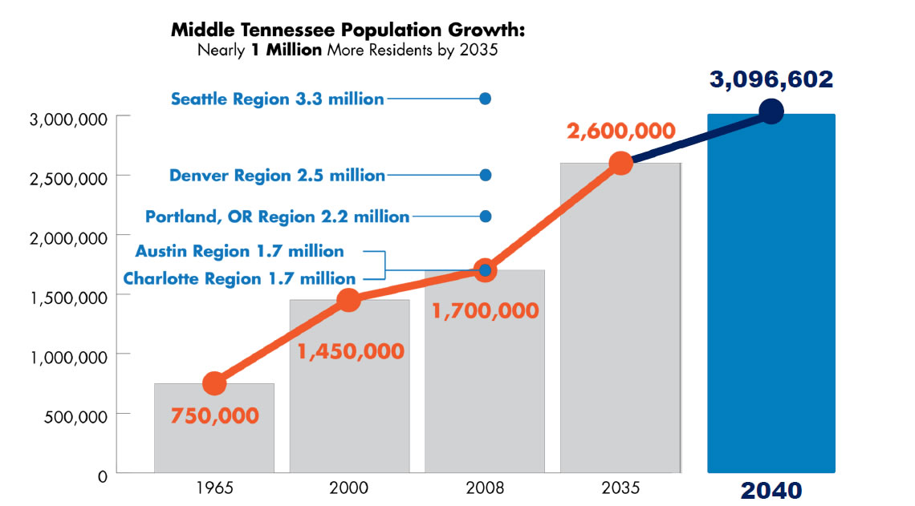
Where We’re Headed
Based on current projections, by 2035, the Greater Nashville Metropolitan Region will be larger than the Denver region is today. Source: Nashville Area Metropolitan Planning Organization.
Notes:
Our region is growing. Middle Tennessee is expected to grow by 1 million people, which will take our population to over 3 million people, by 2040. That is the size of cities like Denver today, and they have a transit system.
This graph shows that, at this rate, Middle Tennessee is on track to grow larger than Portland and Denver and be comparable to cities like Seattle.
All of these cities have made big investments in transit to accommodate their population growth. These cities are comparable with, and competitors to, Nashville and Middle Tennessee for new business growth.

Slide 5
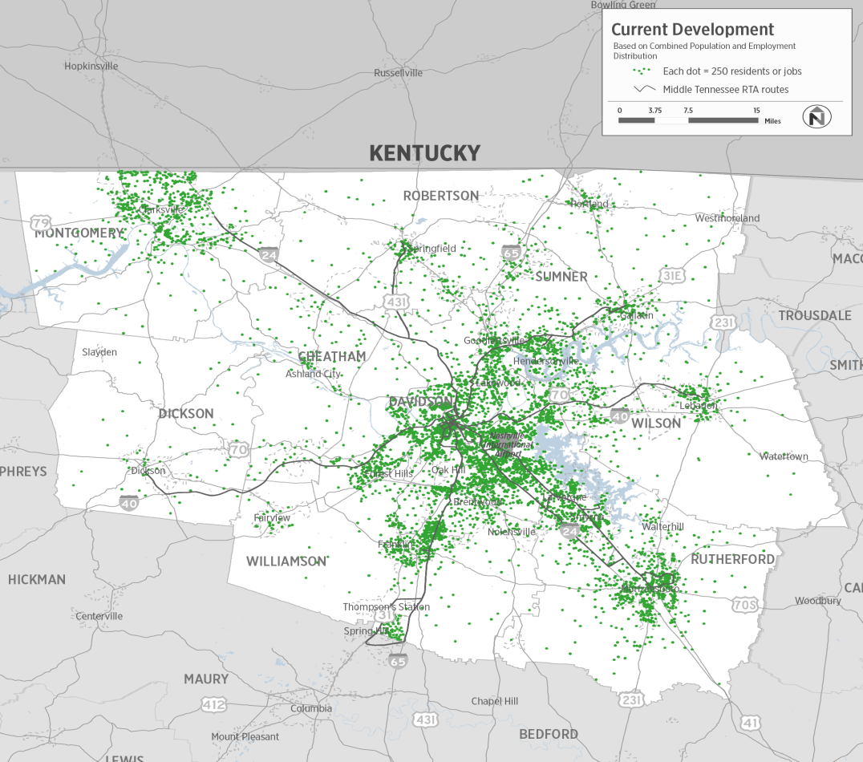
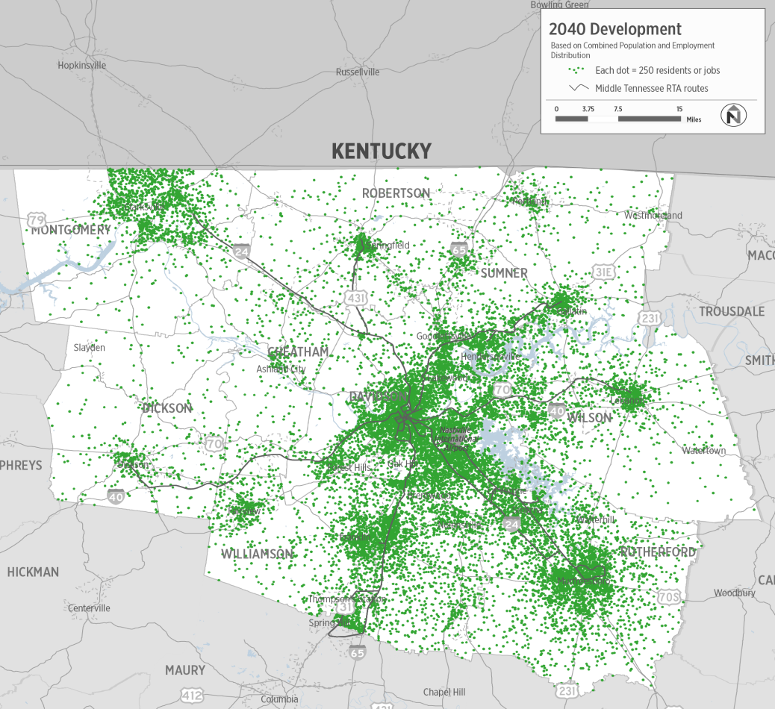
Where We’re Headed
PRESENT
2040
Notes:
If projections of development over the next 25 years bear any resemblance to reality, we haven’t seen anything yet.
Existing congested corridors will become impossibly congested, and new corridors of congestion will emerge and grow rapidly.
Just keeping pace with our current freeway lane miles per capita will require more than an additional 1,000 new lane miles of expressways throughout the region.
In already congested corridors like the I-65 corridor and downtown Nashville, the billions required to construct this capacity will be matched by additional billions necessary to acquire land, demolish private property and surrender the accompanying tax base of these parcels to accommodate that construction.
While roads, highways and autos will be the dominant travel mode for most people on most trips for the foreseeable future, where transit can play a key role in this debate is to add capacity in high-volume corridors in more limited space.
But what do we have to change to accomplish this?

Slide 6
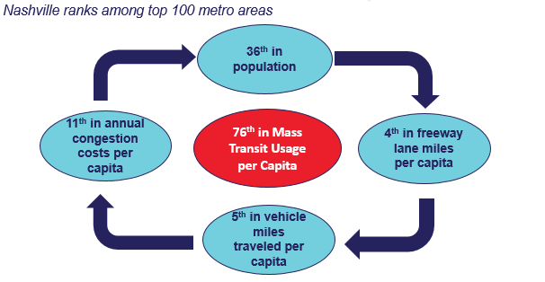
Why Mass Transit Is a Missing Link
Notes:
Here’s where Nashville ranks compared to top metro areas.
Essentially, this graph shows what we already know:
Residents are growing, but continue to experience congestion and traffic and use their personal vehicles daily. It also shows that people are not really using mass transit based on the current transit modes we have.

Slide 7
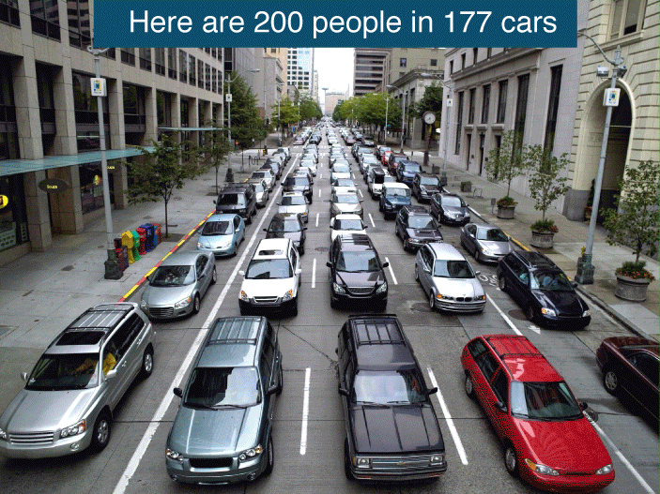
Why Mass Transit Is a Missing Link
Notes:
Remember: A goal of mass transit is to move people efficiently.
Every person on the bus is one less car on the road.
This slide shows 200 people in cars versus other modes of transit options such as buses or light rail trains.

Slide 8
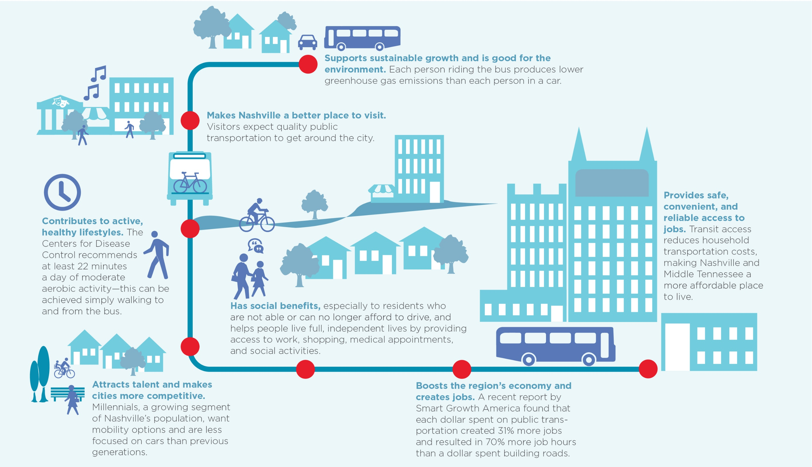
Benefits of Transit
Notes:
There are many benefits to transit:
Supports sustainable growth.
Good for the environment.
Makes Nashville and Middle Tennessee a better place to visit.
Contributes to active, healthy lifestyles.
Has social benefits.
Attracts talent and makes cities more competitive.
Boosts the region’s economy and creates jobs.
Provides safe, convenient and reliable access to jobs.

Slide 9
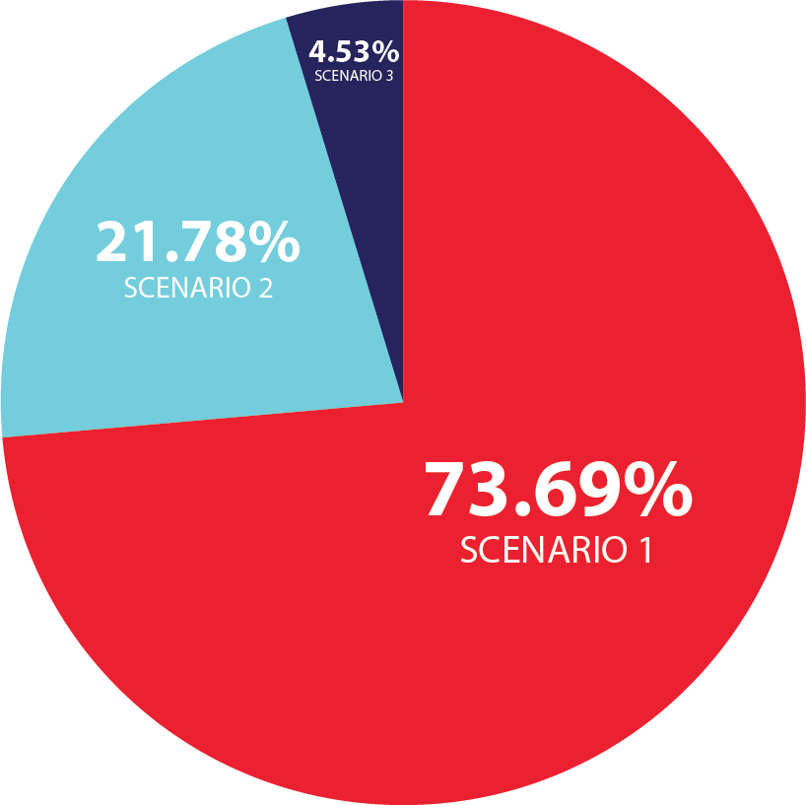
Invest in Transit
Significant investment in a regional
transit system
Bus-focused expansion
Modest improvements
Notes:
Middle Tennessee is at a critical decision point in the strategic planning process this spring and summer.
Nashville MTA/RTA has developed three future scenarios for the region’s transit system, and the public provided feedback about what they want and value in a transit system.
All three scenarios would improve the experience for current riders, but vary in their impact on attracting new riders to transit.
They also include different levels of spending on transit services over 25 years from $0.8 billion to $5.4 billion.
As of May 2016, 74 percent of survey responders voted for Scenario 1, which is the biggest investment in transit.

Slide 10
Get Involved!
Visit our website: www.TheTransitAlliance.org.
Apply for the Transit Citizen Leadership Academy.
Become a Friend of the Transit Alliance.
Sign up for our e-newsletter.
Connect with us on social media.
Check out other resources and organizations on our website.
Stay up to date with the nMotion planning process: www.nMotion2016.org.

Slide 11
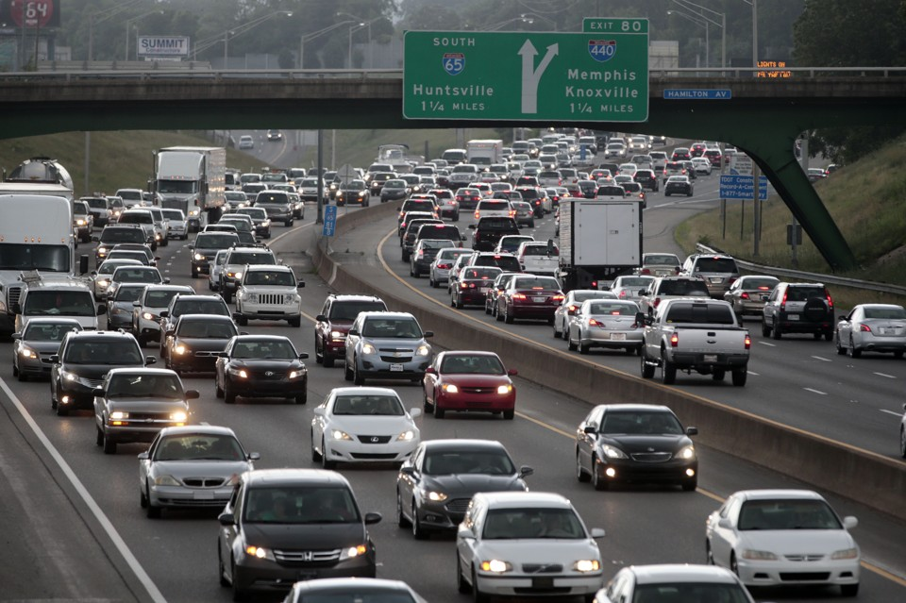
What the Future Will Look Like
If we keep doing the same thing …
Notes:
Mass transit is not “the solution”; but it is an important tool, and any rapidly growing city that ignores it will severely limit the mobility choices of its residents.

