Slide 1
#movingforwardmidtn

Slide 2
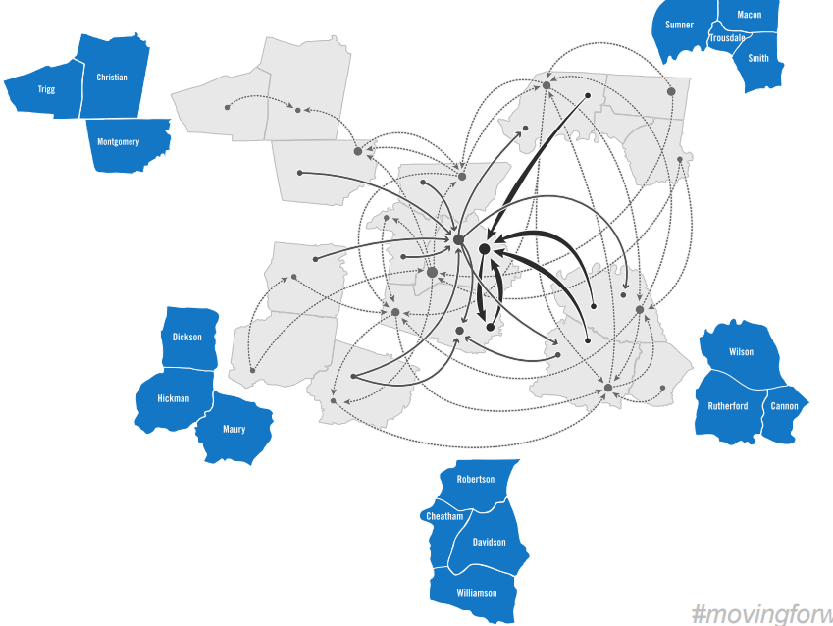
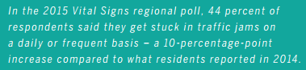
Notes:
A vibrant region comprises talent and opportunity that is diverse and growing. Some 50% of the workforce across our region travel from one county to another to their jobs. Mobility is key to delivering opportunity to workers and employers alike. Each year, Vital Signs conducts a telephone survey poll of residents throughout the region. The 2015 poll finds that more than 4 in 10 residents report getting stuck in traffic on a daily or frequent basis, a 10 point jump over the 2014 poll results.

Slide 3
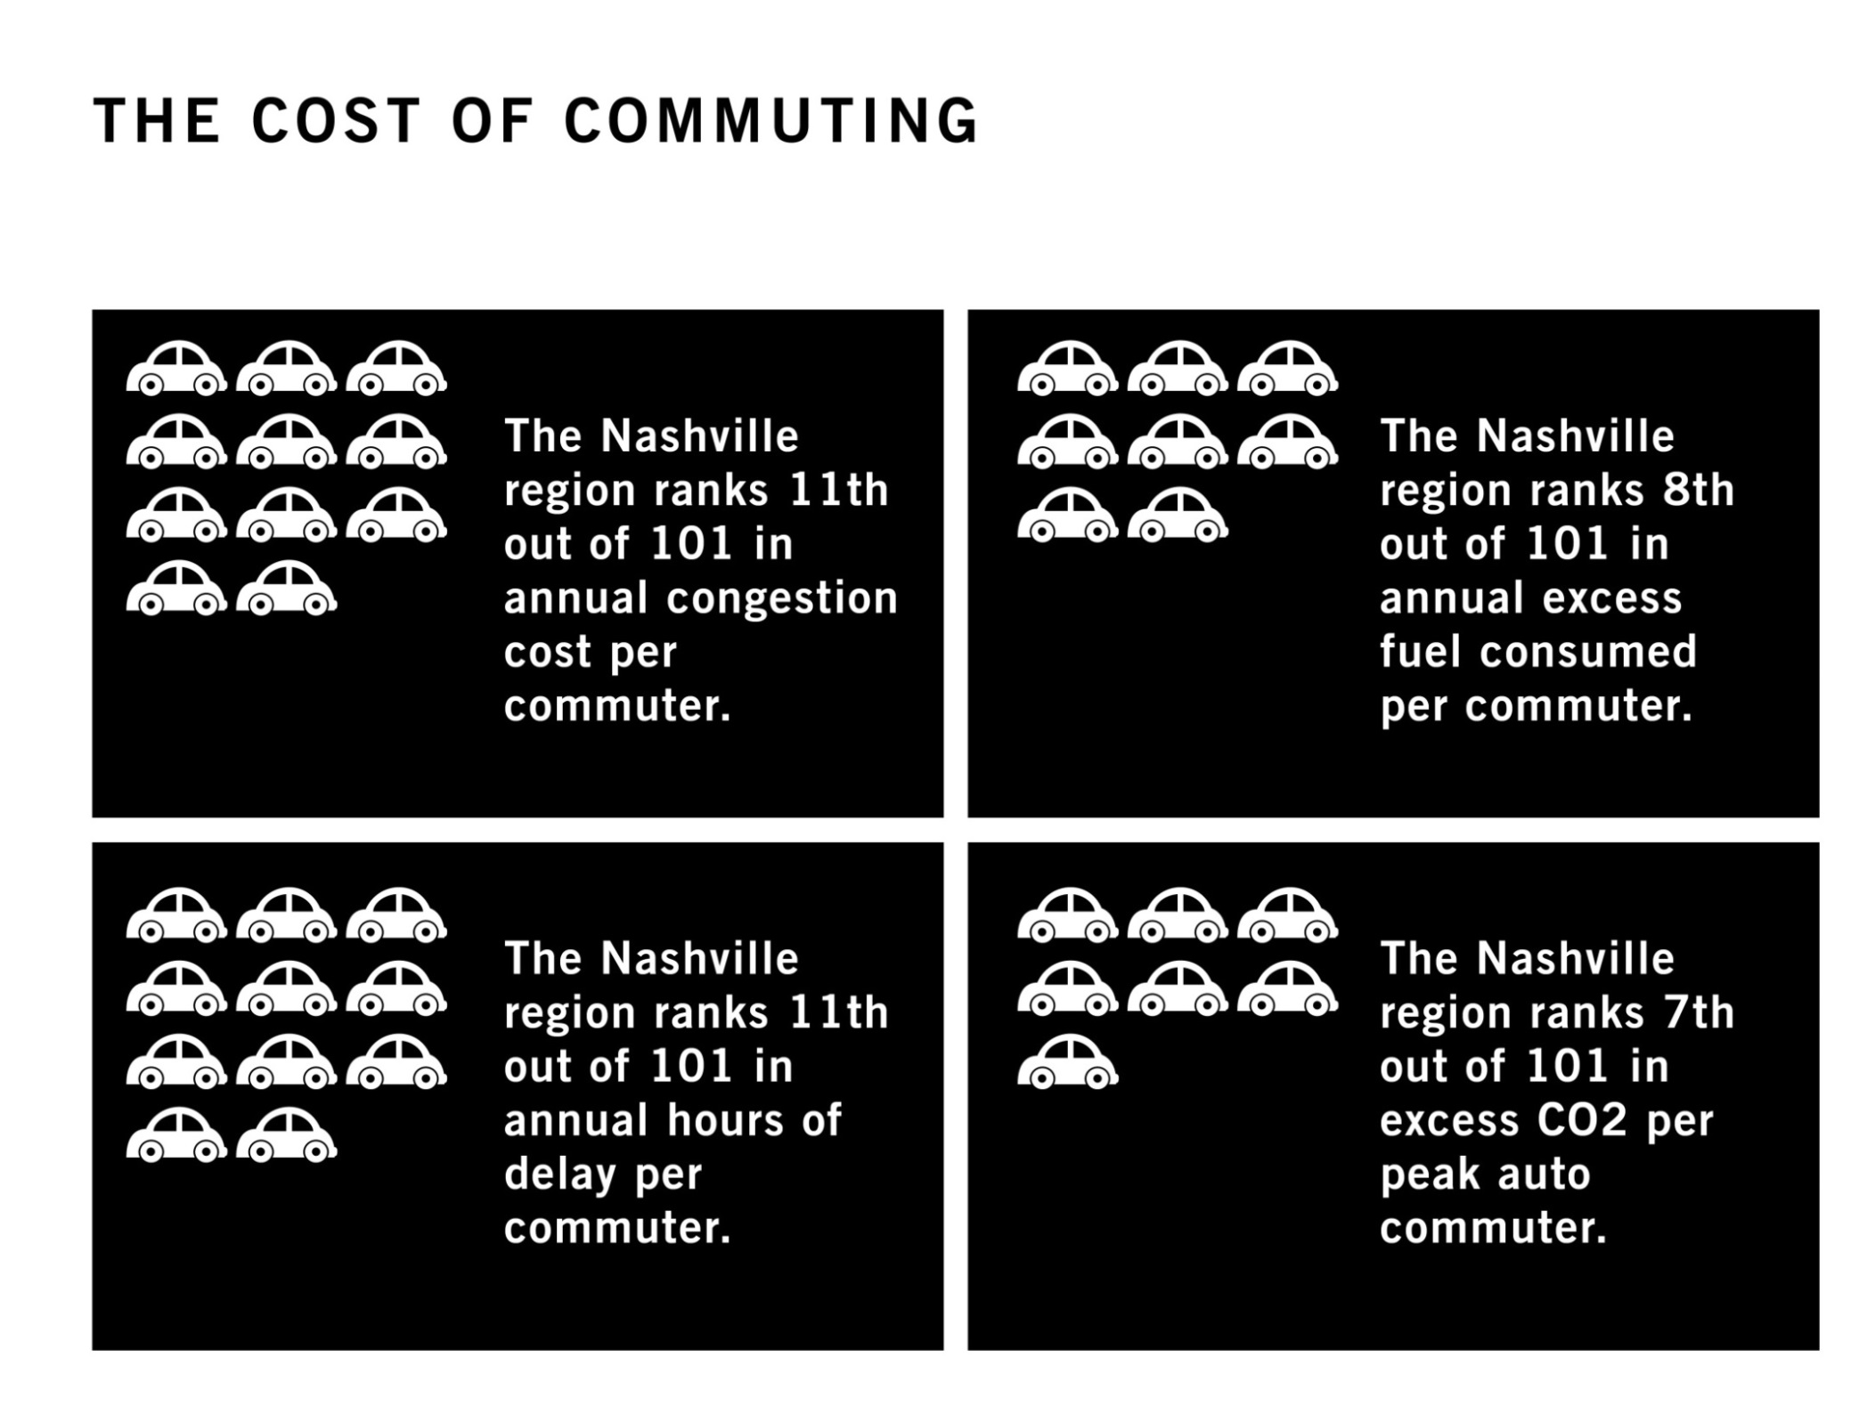
#movingforwardmidtn
Source: Texas Transportation Institute, 2011

Slide 4
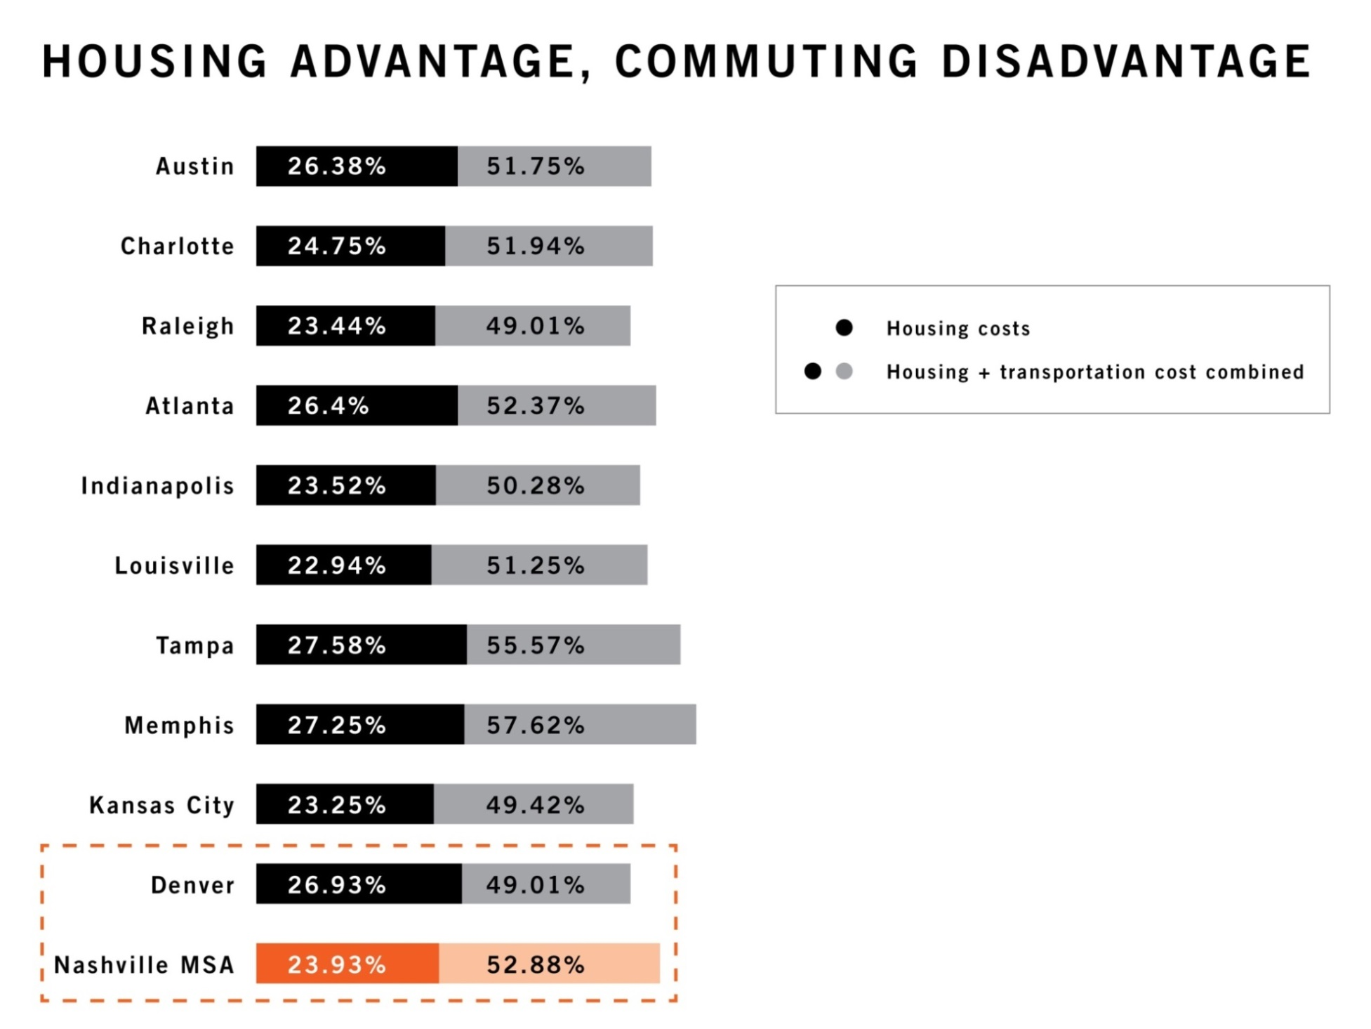
#movingforwardmidtn
Source: Center for Neighborhood Technology, 2011

Slide 5
“If it meant that the region could significantly expand mass transit choices, I would be willing to pay slightly more in some type of tax or fee to help pay for it.”
Source: Regional Attitudinal Survey, Nashville Area MPO, 2014
Nashville MTA spends $96.61 per capita on funding, falling behind many peer cities.
Per capita spending
Charlotte $113.38
Denver $162.79
Austin $179.88
Notes:
No doubt a key component of our region’s efficiency is the ability of all persons to move about the region. Also in the 2015 Vital Signs poll, nearly two third of respondents said they somewhat or strongly agree that they would be willing to pay slightly more in taxes or fees to expand mass transit. Meanwhile, as an example, the Nashville MTA, spends only $96 per capita on funding, falling far behind many peer cities, including those shown here.

Slide 6
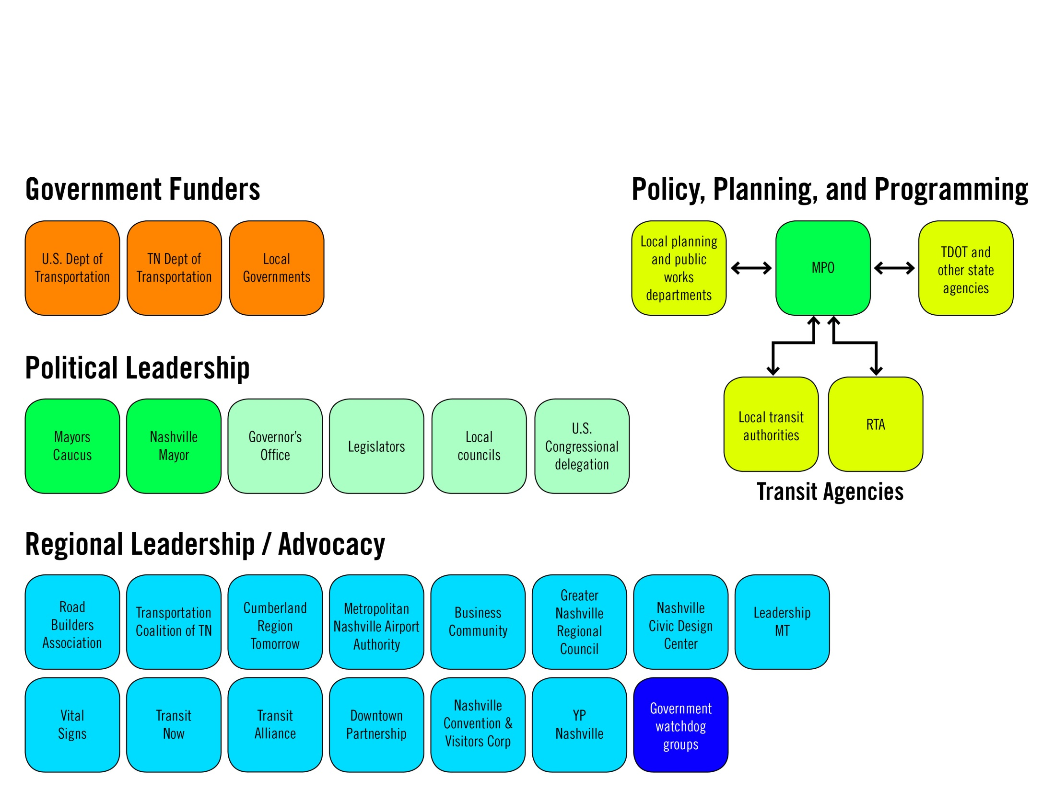
#movingforwardmidtn

Slide 7
purpose
The purpose of Moving Forward is to ensure the creation of a regional transportation solution through a cohesive community effort.
#movingforwardmidtn

Slide 8
values
Regionalism
Accountability
Urgency
Collaboration
#movingforwardmidtn

Slide 9
Support the completion of an RTA and MTA Strategic Plan update within one year (‘16)
Support the identification and passage of state and federal government revenue enhancements for transit within two years (‘17)
Support the engagement of at least 30,000 unique individuals in transit discussion within 2 years (‘17)
  20,000 Davidson
  10,000 in the region
Identify and secure local dedicated funding source for transit in region within 3 years (‘18)
Support breaking ground on first rapid transit project in region within 5 years (‘20)
#movingforwardmidtn

Slide 10
structure
Revenue and finance task force
(approximately 25 members)
Moving Forward Coordinating Committee
(12-15 members, including chairs of subcommittees)
Routes/network and modes task force
(approximately 25 members)
Advisory Forum
Public engagement task force
(approximately 25 members)
#movingforwardmidtn

Slide 11
structure
Purpose: To ensure the creation of a regional transportation solution through a cohesive community effort.
Gary Garfield, Chair
President and CEO, Bridgestone Americas
Pete Wooten, Vice Chair
Executive Vice President, Commercial Bank Executive, Avenue Bank
Bi-monthly meetings
Moving Forward Coordinating Committee
(12-20 members, including chairs of subcommittees)
#movingforwardmidtn

Slide 12
structure
Purpose: To expand transit in our region by investigating funding sources.
Don Abel, Chair
President and CEO, Fifth-Third Bank Tennessee
Corinne Bergeron, Vice Chair
Corporate Social Responsibility Manager, Jackson National
Monthly Meetings
Revenue and finance task force
(approximately 25 members)
Routes/network and modes task force
(approximately 25 members)
Public engagement task force
(approximately 25 members)
#movingforwardmidtn

Slide 13
structure
Purpose: To help all people move about this prosperous region by envisioning the transportation system we need.
Bert Mathews, Chair
President, The Mathews Company
Rev. Judy Cummings, Vice Chair
President, Interdenominational Ministers Fellowship
Monthly Meetings
Revenue and finance task force
(approximately 25 members)
Routes/network and modes task force
(approximately 25 members)
Public engagement task force
(approximately 25 members)
#movingforwardmidtn

Slide 14
structure
Purpose: To support forward-thinking transit solutions in Middle Tennessee by educating and engaging people throughout the region.
Hannah Paramore , Chair
President, Paramore. the digital agency
Gini Pupo-Walker, Vice Chair
Senior Director of Education Policy & Strategic Growth, Conexión Américas
Monthly Meetings
Revenue and finance task force
(approximately 25 members)
Routes/network and modes task force
(approximately 25 members)
Public engagement task force
(approximately 25 members)
#movingforwardmidtn

Slide 15
structure
Revenue and finance task force
(approximately 25 members)
Purpose: To provide informed feedback on Moving Forward task force findings and recommendations.
Rob McCabe, Chair
Chairman, Pinnacle Financial Partners
Routes/network and modes task force
(approximately 25 members)
Advisory Forum
#movingforwardmidtn

Slide 16
Recommendation values
Comprehensive: The plan should be regional, multimodal, and have projects we can implement in the next 1-3 years, the next 3-10 years, and longer-term projects and initiatives beyond the next 10 years.
User-friendly: Transit should be attractive, safe, convenient and easy to navigate.
Inclusive: The plan should provide affordable mobility options for riders who depend on public transportation, and choice riders, to equitably connect communities to work, education, recreation and commerce.
Fiscally responsible: Plan implementation should be guided by performance metrics, such as ridership, system efficiency and travel times through a transparent, public process.
Investment-focused: The plan should maximize transit’s potential to spur economic activity, development and jobs, with corridors prioritized based on the surrounding community’s willingness to encourage density and transit-oriented land use.
Innovative: The plan should be creative and future-ready, using the latest advances in technology, as well as being able to adapt and connect to new service models from the private and public sectors.

Slide 17
recommendation 1
The Regional Transit Authority (RTA) and the Metropolitan Transit Authority (MTA) should begin with nMotion’s “comprehensive regional transit system” (scenario 1) as the starting point for developing a bold, regional transit plan.
#movingforwardmidtn

Slide 18
recommendation 2
MTA/RTA’s long-term plan for regional transit should include high-capacity transit service, such as rail, between Nashville and the cities of Clarksville, Franklin/Spring Hill, Gallatin, Lebanon and Murfreesboro by engineering transit projects to be convertible to a higher-capacity service in the future.
#movingforwardmidtn

Slide 19
recommendation 3
The Nashville/Davidson County Mayor’s Office should develop a plan for downtown access and mobility across all modes by the end of the 2016 calendar year.
#movingforwardmidtn

Slide 20
recommendation 4
Public agencies should prioritize transit projects based upon a community’s expected density level and land use policy, support of which are critical to the viability of transit infrastructure investment.
#movingforwardmidtn

Slide 21
recommendation 5
MTA should include a direct connection to the Nashville International Airport to the proposed light rail line on Murfreesboro Road between downtown Nashville and Bell Road.
#movingforwardmidtn

Slide 22
recommendation 6
The Middle Tennessee Mayors' Caucus, the State of Tennessee and other regional stakeholders should explore the feasibility of moving the Radnor Yard rail facility from South Nashville near Interstate 65 to a location in an outlying county.
#movingforwardmidtn

Slide 23
recommendation 7
The State of Tennessee should develop and staff an Office of Public-Private Partnerships within the next year to ensure that governments in our state are ready to accept future P3 proposals.
#movingforwardmidtn

Slide 24
recommendation 8
RTA and the Transit Alliance of Middle Tennessee should host public conversations on transit regularly in the future, at least twice per year, within each of the counties adjacent to Davidson County.
#movingforwardmidtn

Slide 25
recommendation 9
The upcoming MPO technology study should quantify the capital investment required to implement a modern intelligent transportation system (ITS) in each city and county in the region, as well as the number of trained staff needed to properly operate and maintain the system, in time for the 2017 budget process.
#movingforwardmidtn

Slide 26
recommendation 10
MTA/RTA should incorporate into the completed nMotion plan a reference to how future autonomous vehicle technologies could potentially be integrated into the overall transit service strategy for the region.
#movingforwardmidtn

Slide 27
structure
2016
2017
2018
The Plan
Funding
Start the work
#movingforwardmidtn

Slide 28
#movingforwardmidtn

