Slide 1
MOVING CITIES FORWARD
Uber Transportation Partnerships
Tom Maguire
General Manager
Southeast
October 2016

Slide 2
OUR MISSION
OUR MISSION

Slide 3
“Reliable transportation, everywhere for everyone”

Slide 4
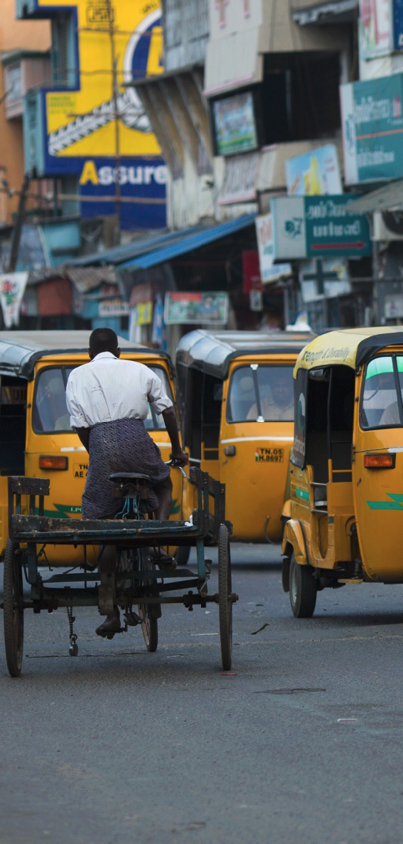
Our trip history
Smarter cities of the future
Transportation is idiosyncratic. We have yellow taxis in New York and red ones in Hong Kong; double decker buses in London and single-story ones in most other cities. But there’s increasing agreement in one area: smartphone apps that connect riders and drivers at the push of a button can improve everyone’s quality of life.
400
70
1M+
Cities
Countries
Driver partners

Slide 5
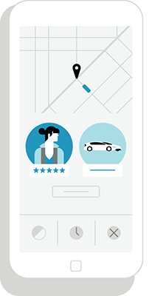
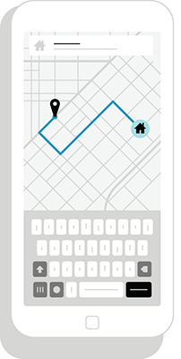
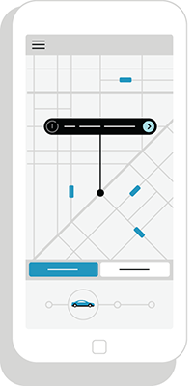
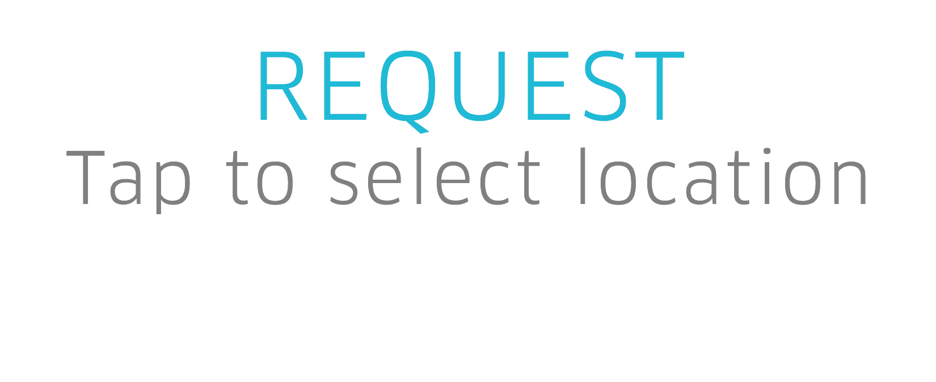
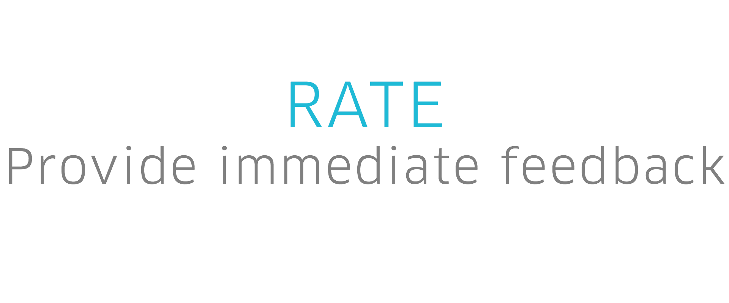
PUSH A BUTTON, GET A RIDE
Uber is a technology platform that connects riders with drivers

Slide 6
RIDERS
Push a button, get a ride
Riders enjoy using Uber:
Reliable transportation option
Safe alternative
Affordable
Customer experience

Slide 7
DRIVERS
DRIVERS
Earning opportunities on-demand
Earning opportunities on-demand
Drivers enjoy using Uber:
Flexible schedule
Economic opportunity
Safety and accountability
Transparency
Drivers enjoy using Uber:
Flexible schedule
Economic opportunity
Safety and accountability
Transparency

Slide 8
SAFETY FEATURES
Through our technology, safety is built into every trip - before, during and after the ride
Uber is committed to the safety of everyone using Uber. We have strict safety standards and provide end-to-end insurance coverage on all of our trips. Our innovative technology features ensure comfort and security for both the rider and driver.

Slide 11
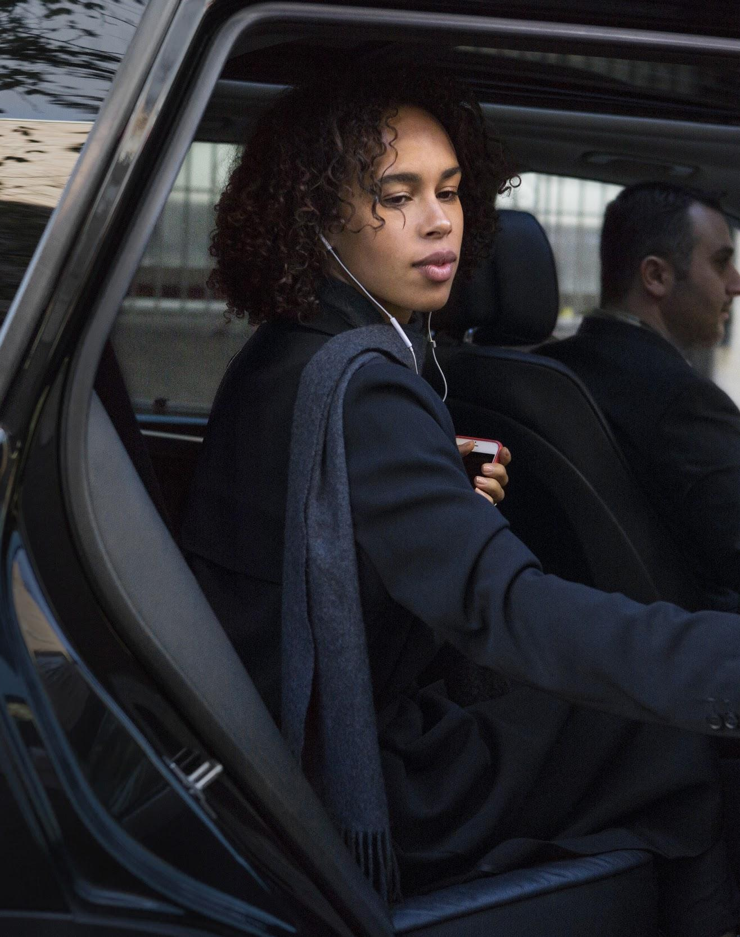

Slide 12
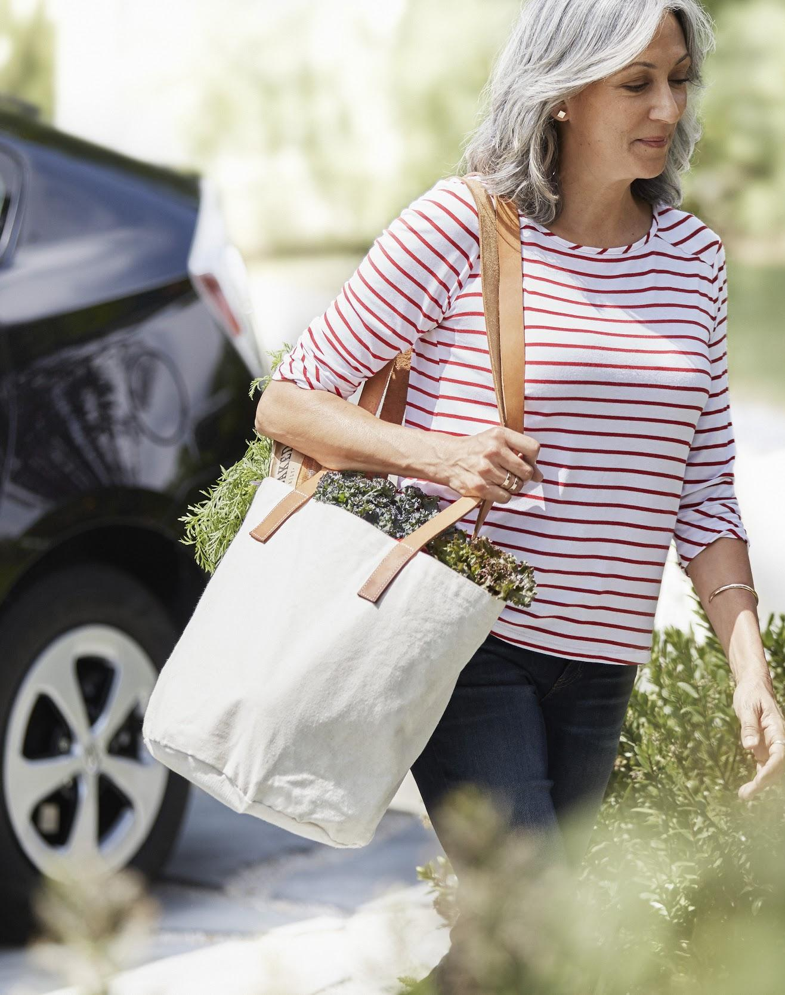

Slide 13
COMPLEMENTING PUBLIC TRANSIT
Notes:
After we look at all of the data and statistics about seniors, we have to remember one thing: this is about taking care of our communities -- our mothers, grandmothers, uncles, cousins, neighbors -- who may be aging but who do not need lose their independence along the way. And technology can help them do that.
While Uber won’t be the best solution for everyone, it’s something that can work for a majority of seniors, particularly when you include our full suite of products and offerings. That’s why we are committed to taking the time to introduce more seniors to our technology and ensure they feel comfortable with it.
Here are a few ways we are making an impact in FL and the world

Slide 14
UBER AND TRANSIT
Uber is dedicated to working with cities and transit agencies to complement transportation options and create seamless journeys.
We believe our services can be used to complement existing public transit, making it more accessible and efficient for people to use.
By partnering with local transit systems, we can help ensure reliable transportation is available throughout the city.
Filling First / Last Mile Gap
Safe Transportation Options at Any Time of the Day
Alleviating Parking Demand
Serving Transportation Deserts

Slide 15
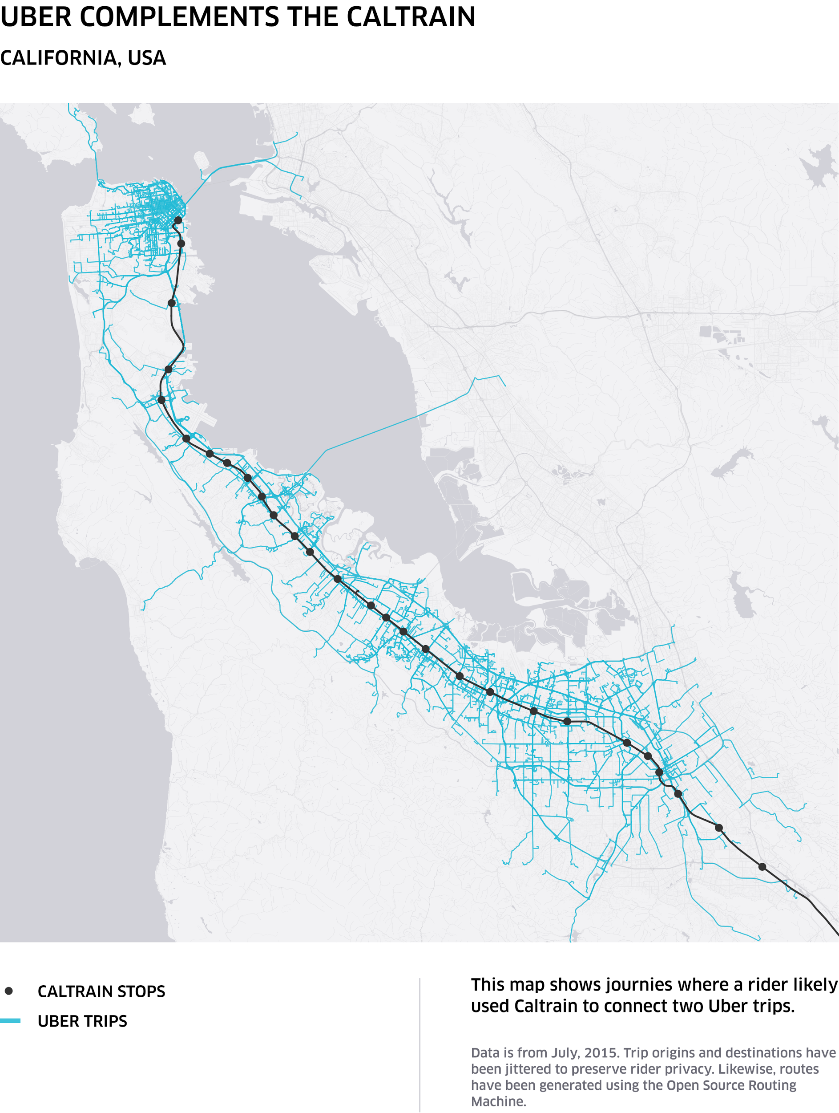
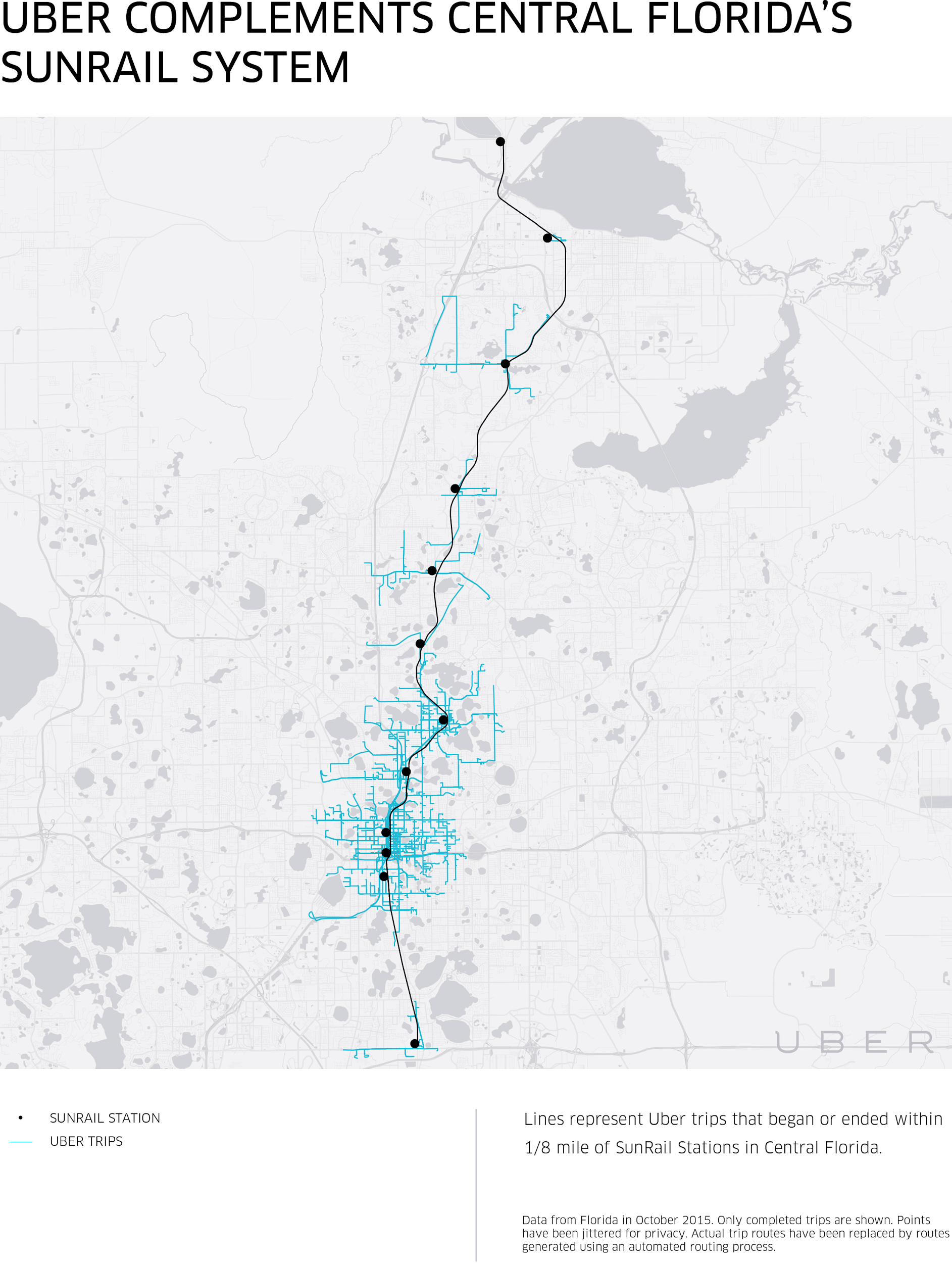
EXTENDING PUBLIC TRANSIT

Slide 16
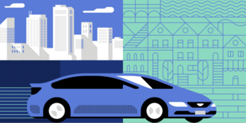
FILLING FIRST / LAST MILE GAP
Despite the improvements transit has seen in the U.S. over the years, its reach still has limitations. Many homes and jobs are within proximity but farther than an easy walk to transit, creating the first/last mile problem.
Uber is working with cities and local transit systems to solve the first/last mile problem, ensuring travelers complete their trip covered with affordable and reliable options.

Slide 17
Transit Partnerships
Entities across the country partner with Uber to solve transit challenges
Notes:
Reliability: Uber is available 24/7, every day of the year, and services many neighborhoods lacking nearby public transit. For many in the senior community, it is not an option to walk 20 minutes to a bus stop, or to wait 45 minutes for a taxi, unsure of when it will arrive. Uber gives senior riders freedom and peace of mind that is not possible with options requiring pre-arrangement.

Slide 18
“I work events late at night, and with Uber, I feel safer knowing I don’t have to go wait outside and hope I can flag down a ride.”
Brittany, Rider from Portland

Slide 19
SAFE TRANSPORTATION AT ALL TIMES
Working together to combat drunk driving
Uber makes it easier for commuters who work odd hours to get around and presents an important alternative to driving after drinking.
Uber works closely with Mothers Against Drunk Driving to:
Raise funds to fight drunk driving
Conduct research on the impact of ridesharing on drunk driving rates
Raise awareness about options like Uber to get home safely after a night out
The right choice at the right time
Alcohol-related crash fatalities in Texas
Requested Uber rides
8am
Noon
4pm
8pm
Midnight
4am
Notes:
A study by the American Public Transportation Association found that ridesharing services are most frequently used for social trips between 10pm and 4am - times when transit runs less frequently or is not available. By providing a late night transportation option when the transit systems is closed, Uber makes it easier for commuters who work odd hours to get around and presents an important alternative to driving after drinking.

Slide 20
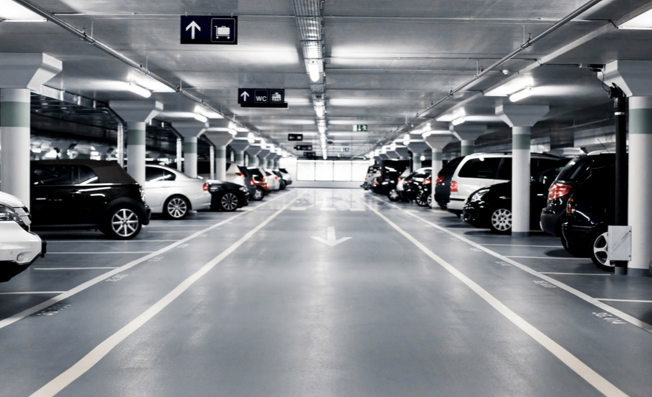
ALLEVIATING PARKING DEMAND
Parking inefficiencies can create wasted time, excess and increased expenses. Highly congested areas see large proportions of cars in traffic circling for a parking spot - up to 30% in some cases.
Uber is helping riders get to transit hubs without needing to find a parking spot once they get there, thus reducing their need to “cruise” for parking, and saving them money.
Notes:
SUMMIT, NEW JERSEY PARTNERSHIP: In a 6-month pilot program beginning October 3, 2016, the city of Summit is providing New Jersey residents with weekday Uber rides to and from the Summit train station. With this program, we hope to reduce the number of commuter cars left in parking lots during the workweek. These rides will be included in the cost of a resident parking pass.

Slide 21
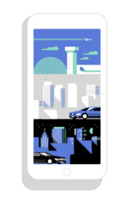
SERVING TRANSPORTATION DESERTS
City transit systems provide important mobility options, but often aren’t able to cover all areas, which leaves many neighborhoods underserved by affordable, reliable transportation.
Uber extends the reach of public transportation and provides reliable services for areas traditionally underserved; in fact, over 75% of the US population lives in a county where they have access to Uber.

Slide 22
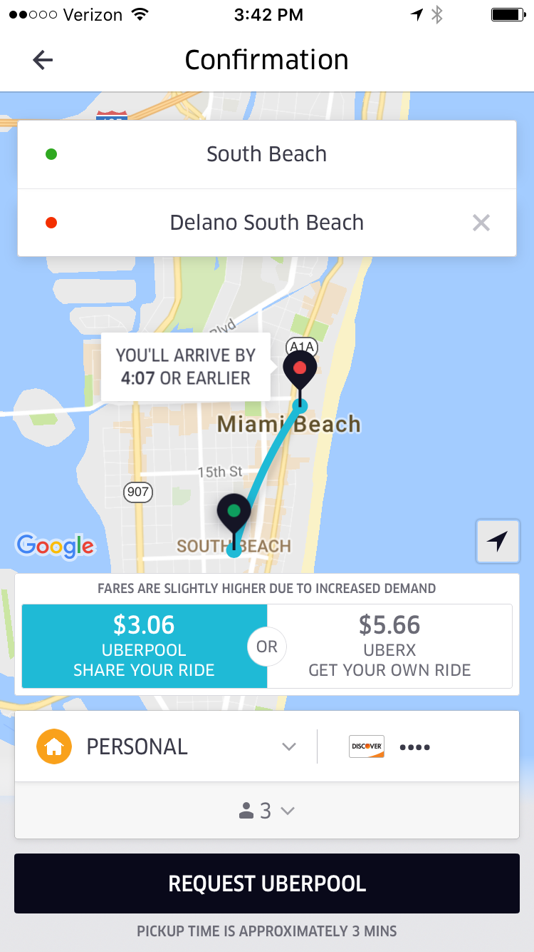
UberPOOL
Sharing the way to sustainable cities
UberPOOL is more efficient than personal cars or taxis. It can move the same number of people while reducing congestion and cars on the road.
From February 20 - March 20, 2015 UberPOOL trips in San Francisco accounted for 674,000 miles!
120
13,500
metric tons of CO2 submissions prevented
gallons of gasoline saved

Slide 23
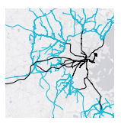
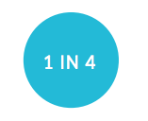
ON THE GROUND
PORTLAND
BOSTON
MIAMI
Examples from cities
One in four trips in Portland suburbs that start or end near MAX and WES stations.
In Boston, the number of trips starting or ending with 1/8 mile of the terminal stations doubled between 2014 and 2015.
Between 2014 and 2015, trips increased 5X in unique Uber riders who were picked up or dropped off near Miami metrorail stations.

Slide 24
QUESTIONS?

Slide 25
First Last Name
Tom Maguire
Uber Southeast

Slide 26
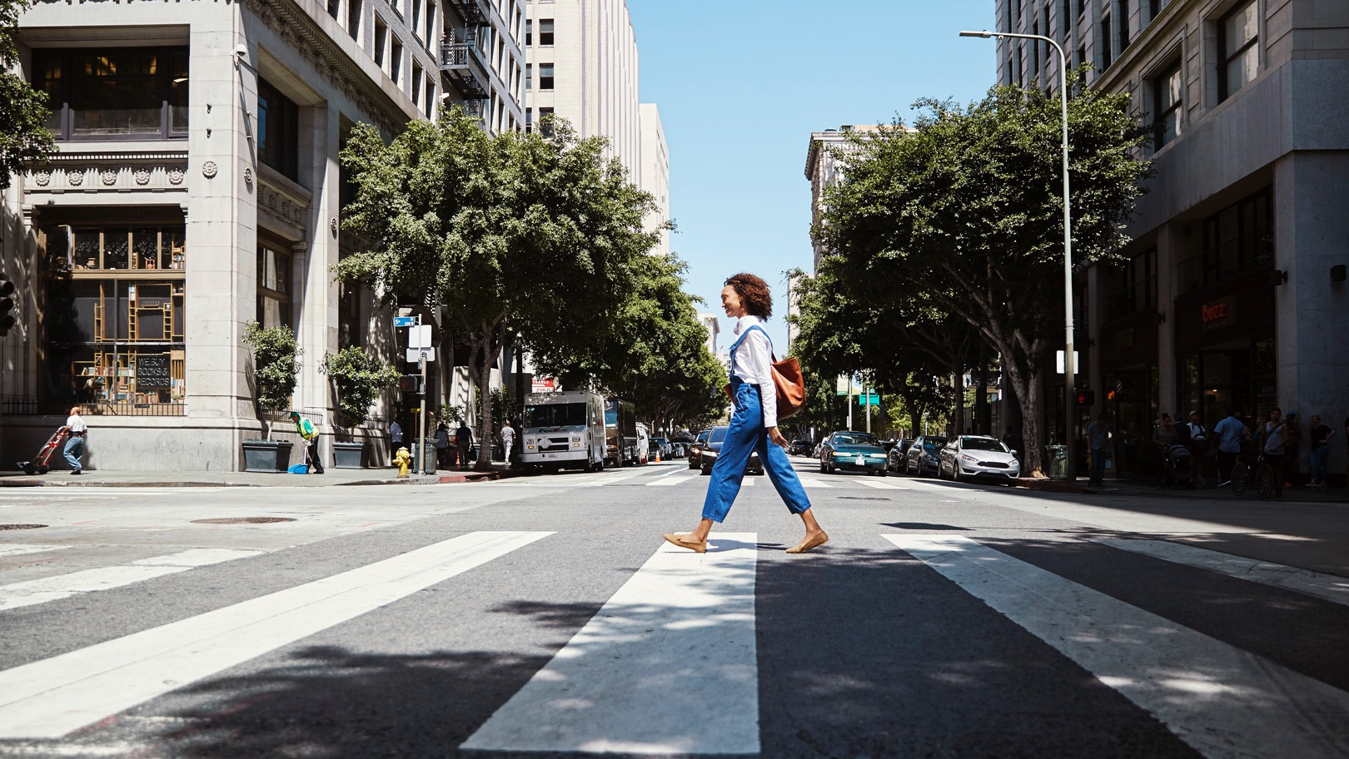

Slide 27
APPENDIX

