Slide 1
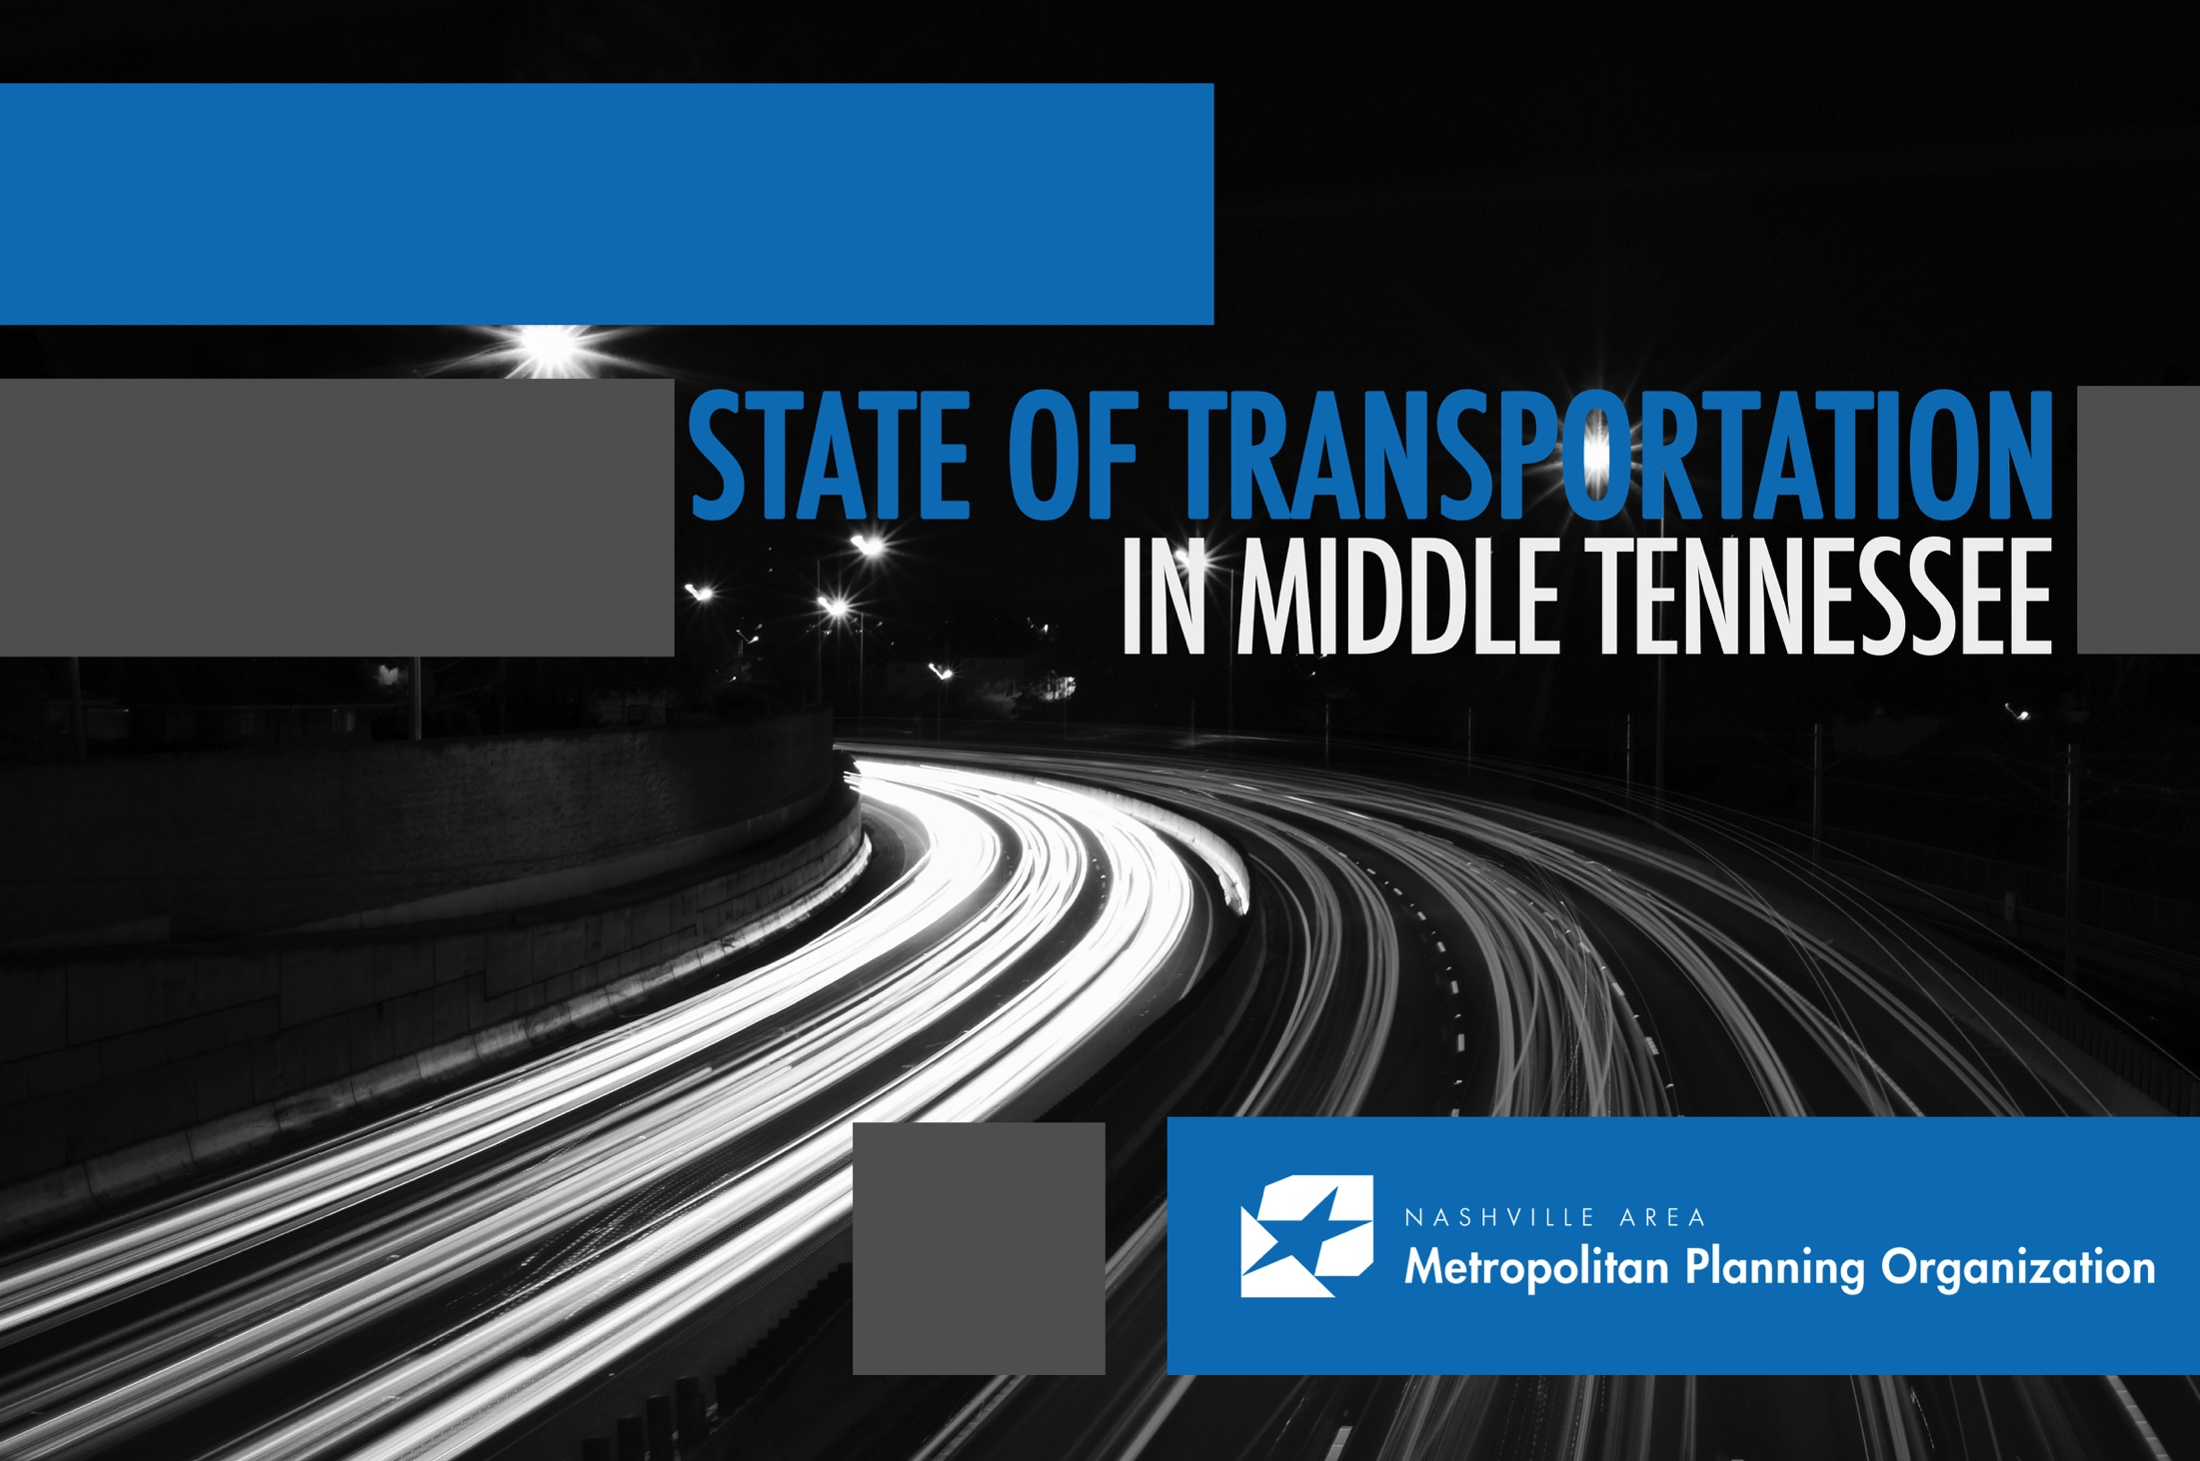
TRANSIT CITIZENS LEADERSHIP ACADEMY
October 12, 2016

Slide 2
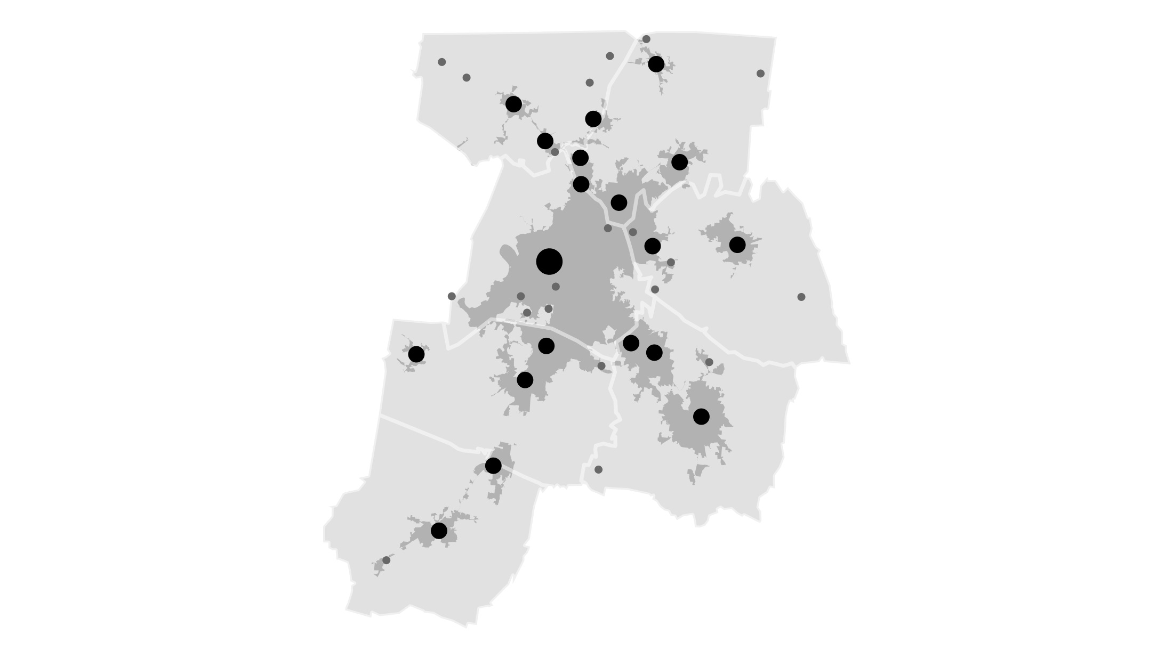

MPO PLANNING AREA
@nashvillempo
Notes:
The MPO’s planning area covers communities across seven counties - Davidson, Maury, Robertson, Rutherford, Sumner, Williamson and Wilson counties.
As a region, we are experiencing many transportation challenges which include:
- Growing cross-county comminuting patterns
- Increasing cost of traffic congestion
- Poor public transit access, and
- Declining health in Tennessee related to physical inactivity

Slide 3
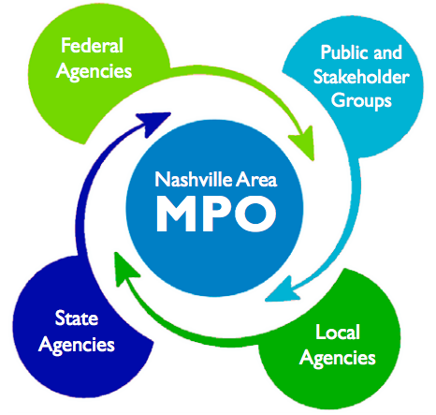
UNIFIED PLANNING EFFORTS
@nashvillempo
Notes:
As the federally-designated transportation planning agency in Middle Tennessee, the Nashville Area MPO represents Davidson, Maury, Robertson, Rutherford, Sumner, Williamson, and Wilson counties through the facilitation of strategic planning for the region’s multi-modal transportation system, and directs federal funds to transportation projects that increases prosperity in the region.
Through our partnerships with the US DOT, TDOT, state and local elected officials, city planners and the business community, the MPO leads in the development of the region’s long-range transportation plan and short-range Transportation Improvement Program and contributes to ongoing conversations about issues such as land use, economic development, climate change and the environment, safety and security, and public health.
The MPO is responsible for….
Monitoring the conditions of the existing transportation network;
Identifying existing capacity or safety problems through detailed planning studies to develop candidate transportation improvements;
Forecasting future population and employment growth for the region;
Evaluating the effects that future land use plans will have on transportation infrastructure within major growth corridors throughout the region;
Developing alternative growth scenarios to evaluate the affects that land use and transportation choices made today will have on the region’s future;
Estimating the impact that an expanding transportation system will have on air quality; and
Developing a financial plan that identifies the costs and revenues associated with the continued operation and maintenance, and future expansion of the region’s transportation system.

Slide 4
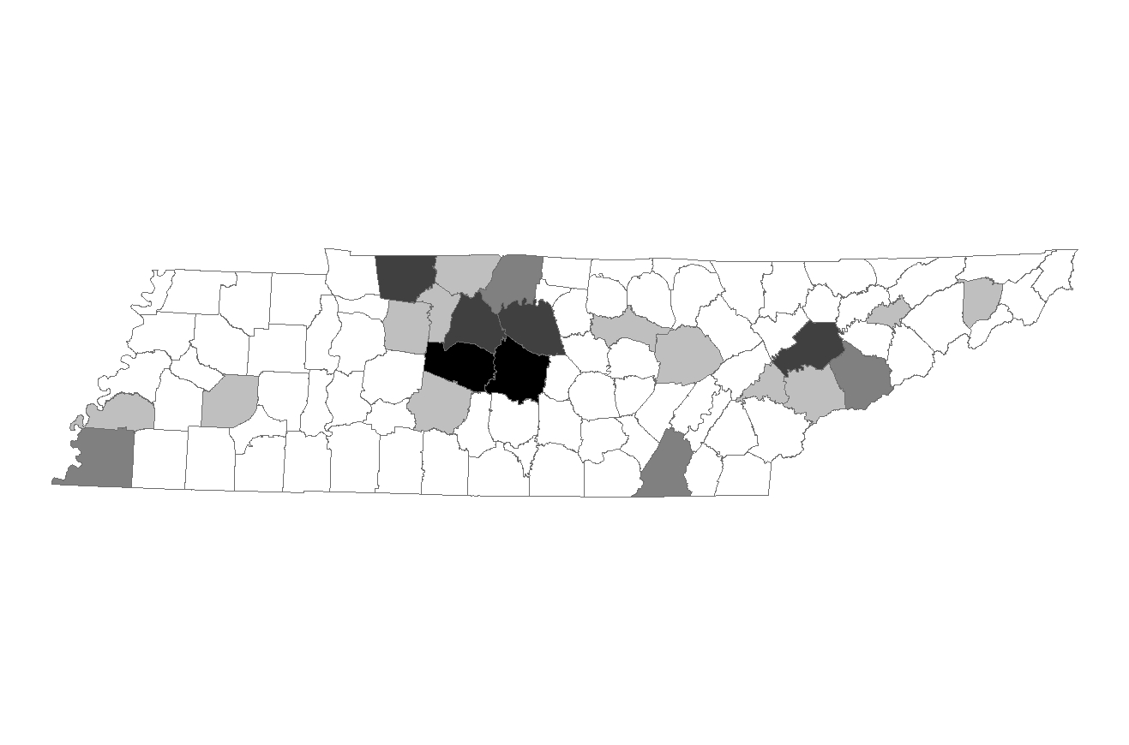
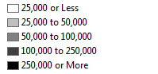
Net Population Growth
NET POPULATION GROWTH
2010 to 2040
2.5 Million Statewide
1.3 Million (52%) in the MIDDLE
Source: U.S. Census Bureau, Woods & Poole Economics
Notes:
Before diving into the summary of the plan’s recommendations, it is important to understand how our communities are growing as we make decisions related to future investments, those are data driven decisions appropriately based on future trends. One of the first thing an MPO does when developing its long rang plan is to get a handle on growth and development.
This side is a quick look at the expected population growth across the state – with the most significant growth anticipated in the Middle Tennessee region. We borrow our population forecast from a national consulting firm – Woods and Poole, through their data we are able to get detailed population and jobs information to create the forecast you see here.
And

Slide 5
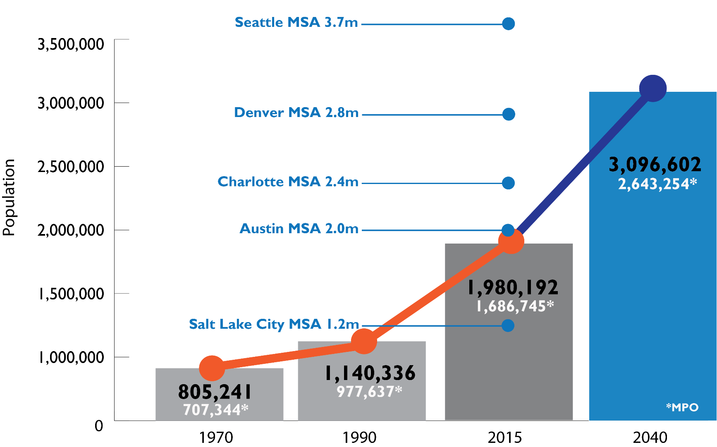
PEER CITY COMPARISONS
Notes:
What are the driving forces behind the challenges facing our region?
Looking at population growth across the state – we currently have roughly 6.5 million in Tennessee – we expect about 9 million people in the state between now and 2040. More than half of the state’s growth is expected to occur in Middle Tennessee, this projection comes from national economists which understand market dynamics, migration shifts across the county as well as the natural growth that is expected to occur.
What this map is showing you is that both Williamson and Rutherford counties are both expect to add more than 250k people of the next 25 years. As you can imagine this growth will have a profound impact on our transportation and economic prosperity. Now, it’s not good enough to just understand the populations projections – part of our job as an MPO is to look ahead and determine where we need to invest in transportation infrastructure to support this growth by drilling down to understand where people will live and work in the future.

Slide 6
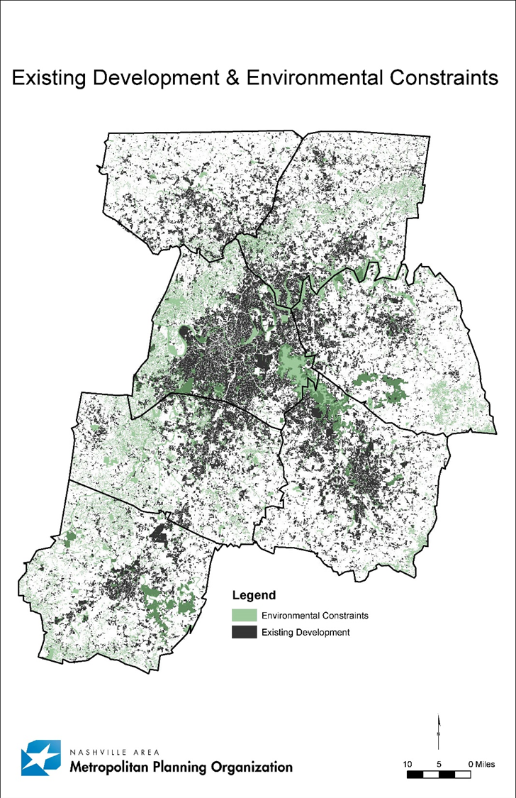
Development and Constraints
DEVELOPMENT CONSTRAINTS
Notes:
Just knowing this growth forecast isn’t enough for us to figure out how and where to best invest in infrastructure. So our folks in the office take the information I just showed you and run that through some land use forecasting tools. That process allows us to basically predict future land development.
So what you are seeing here is our seven county planning area that are currently developed – that’s the black. Or environmentally constrained, which gives us the current footprint of the region.
When you look at this, take note of how much white you see – we’ll talk more about that in a minute.

Slide 7

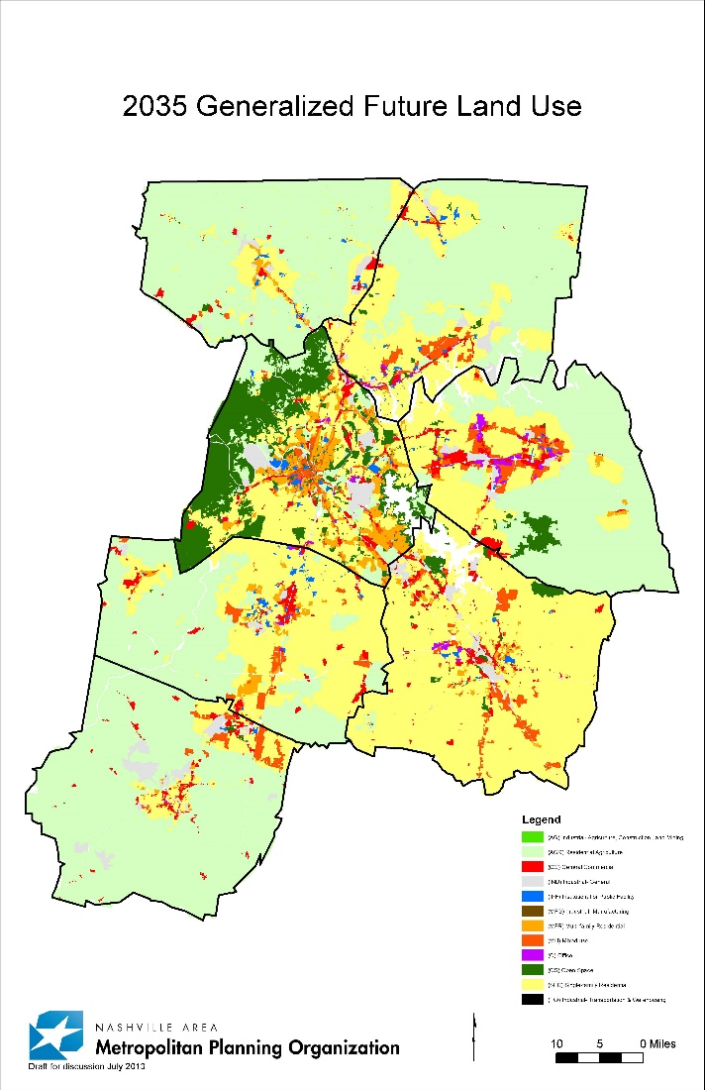
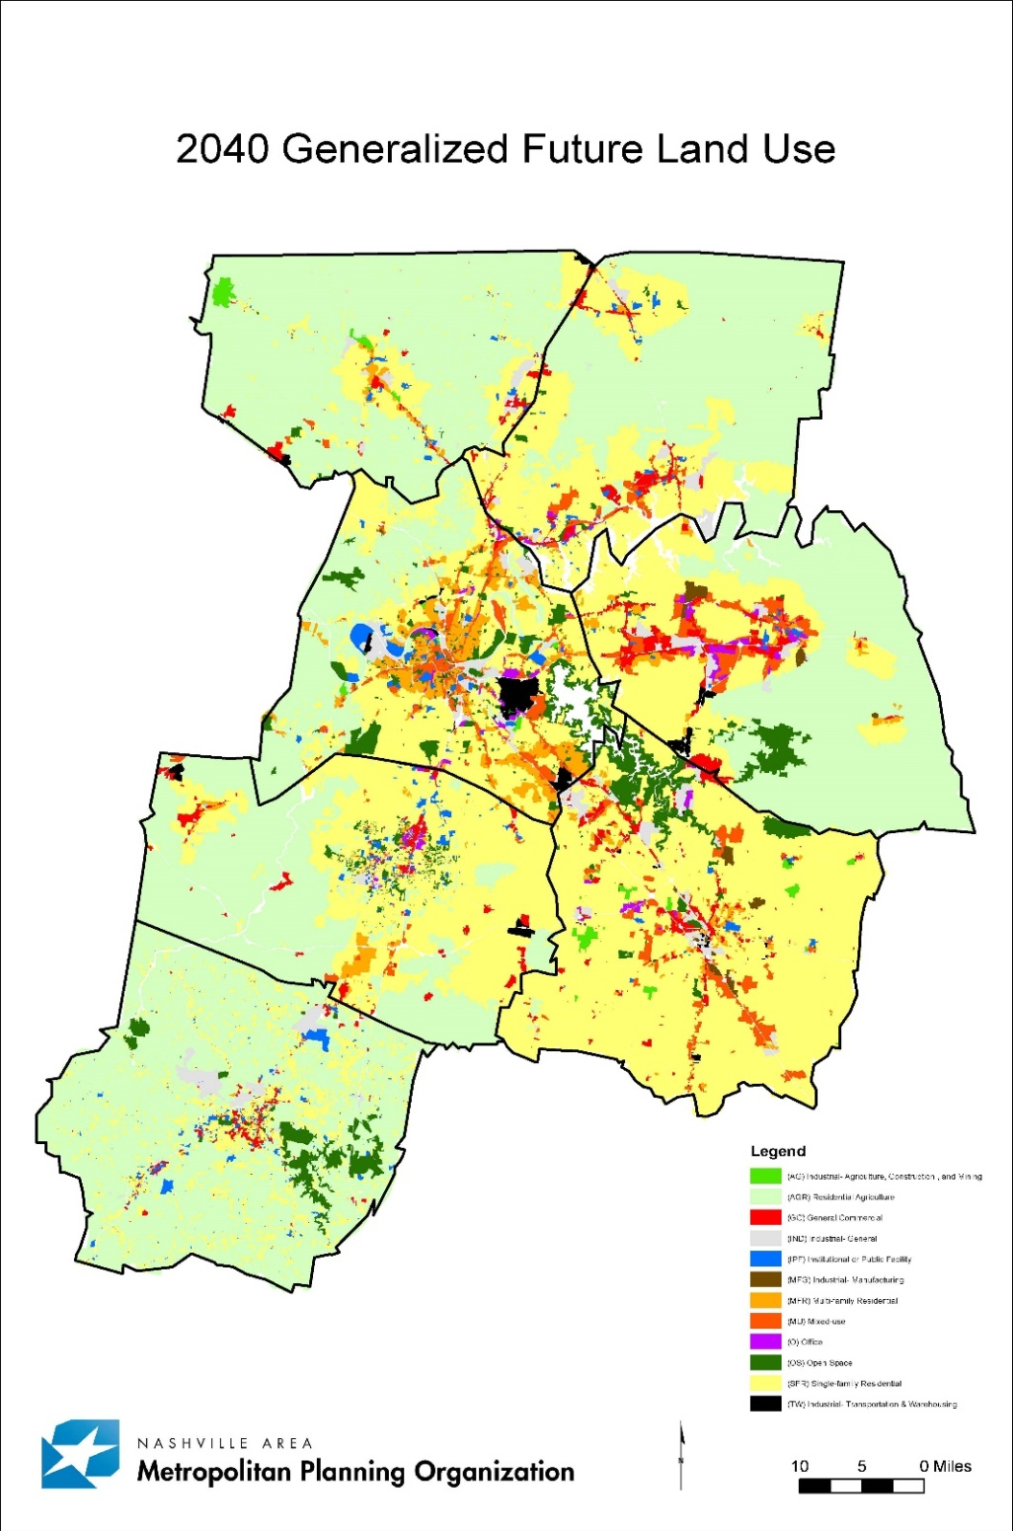
Generalized Future Land Use
GENERALIZED LAND USE
Notes:
Then, we add that to the model which predicts future land use patterns based on generalized land use policy of the local communities.
So here you see – the dark green is open space, the light green is residential AG, and then other categories of industrial commercial, mixed use and residential…notice the significant changes in future land use between 2035 and 2040. The 2035 map was created in 2010 – the 2040 in 2014.

Slide 8
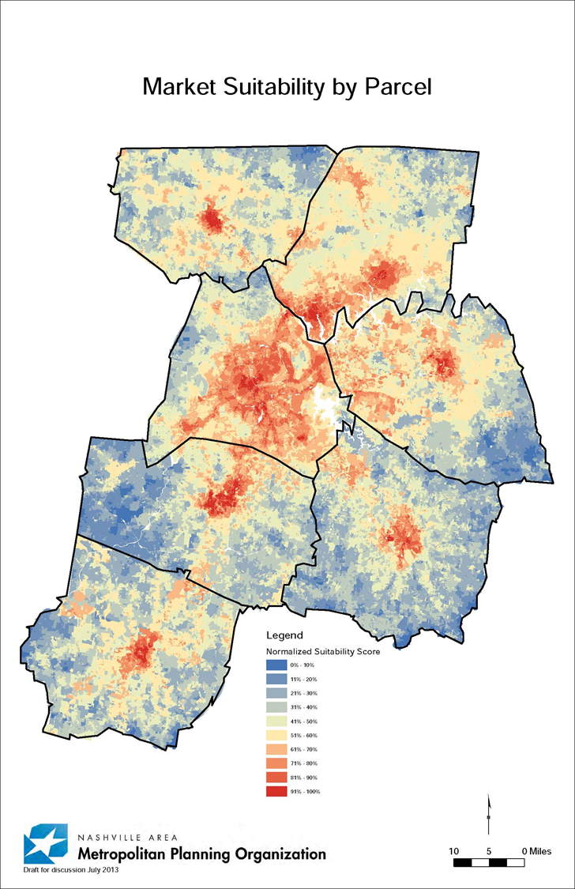

Market Suitability by Parcel
MARKET SUITABILITY
Notes:
The last thing we take into account is market suitability, this submodel is informed by local real estate developers to help us understand what factors move them toward investments

Slide 9
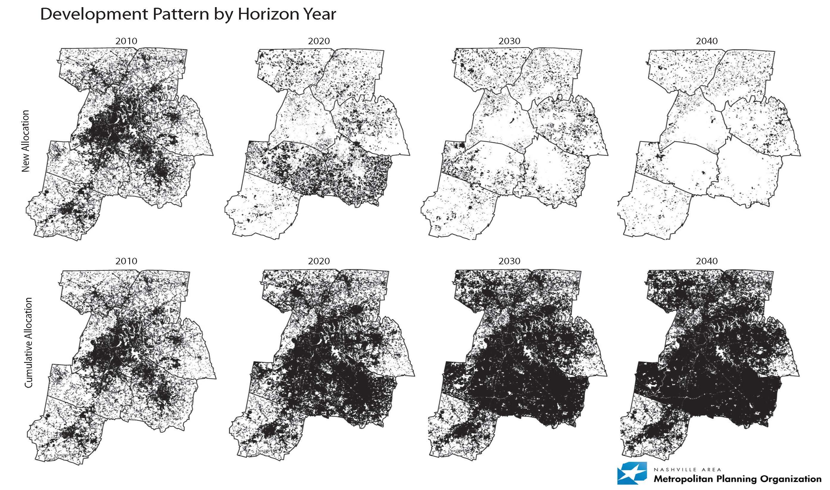
Resulting Forecast
RESULTING FORECATS
Notes:
So lastly, what you see on the far left 2010 – parcels across the region that have some substantial development, then as you look across the screen you see the parcels that are currently undeveloped that we expect to see affected by development by the decade noted.

Slide 11
FORCECAST BY COUNTY*
Population
*2015 census compared to 2040 Woods and Pools forecast
Notes:
Census W&P 2015-2040 Change
2015 2040 # %
Davidson 678,889 819,387 140,498 20.7%
Maury 87,757 114,123 26,366 30.0%
Robertson 68,570 97,625 29,055 42.4%
Rutherford 298,612 498,938 200,326 67.1%
Sumner 175,989 257,360 81,371 46.2%
Williamson 211,672 454,524 242,852 114.7%
Wilson 128,911 225,636 96,725 75.0%
7-county 1,650,400 2,467,593 817,193 49.5%

Slide 12
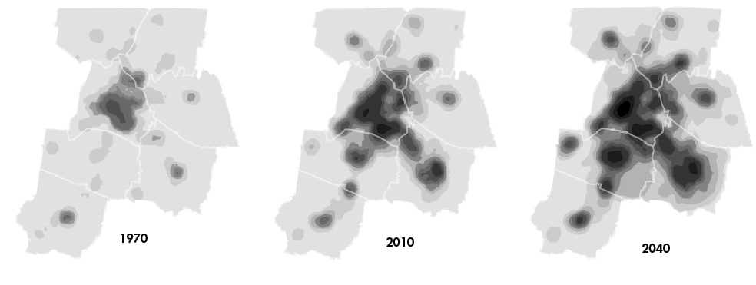
DEVELOPMENT FORECASTS
@nashvillempo
Notes:
Along with population forecasts, the MPO is able to use a land use model to predict future land development patterns based on economic and market forces as well as land use policies, topography, among other factors.
These three images show land use in the region which is expected to be delivered over the coming 25 years. From a transportation perspective, this information allows us to understand where the greatest growth and development is likely and identify where people will live and work in years to come – these forecasts informs our long-term transportation planning and policy work.

Slide 13
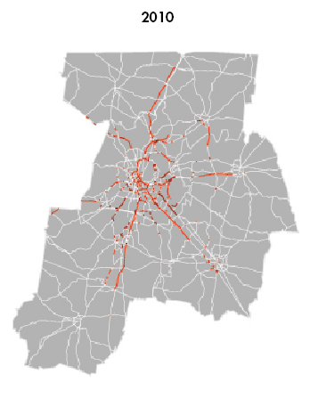
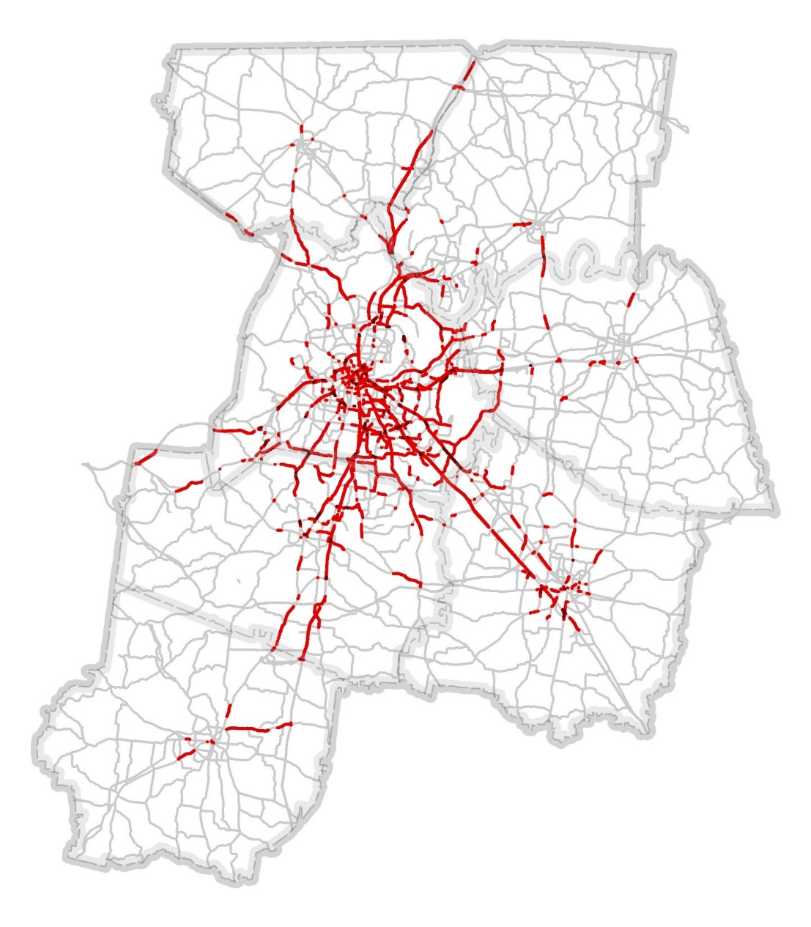
CONGESTION PROJECTIONS
2015
@nashvillempo
Notes:
Due to the growth in population and increased development across the region, the commuting will continue to impact our travel times. The MPO traffic forecasting tools indicate that levels of congestion and the associated costs will continue to rise; even as we implement the transportation improvement identified in the regional transportation plan.
These images show congestion in the region at peak times in 2015 and projected for 2040. The projected congestion takes into account the roadway improvements already slated for completion in the 2035 plan.
Even with dedication to improving development patters and implementing transportation projects from our plan, we risk our quality of life as the Middle Tennessee grows – as you can see - our region is in need of alternatives to driving through a diversified, multi-modal investment strategy.

Slide 14
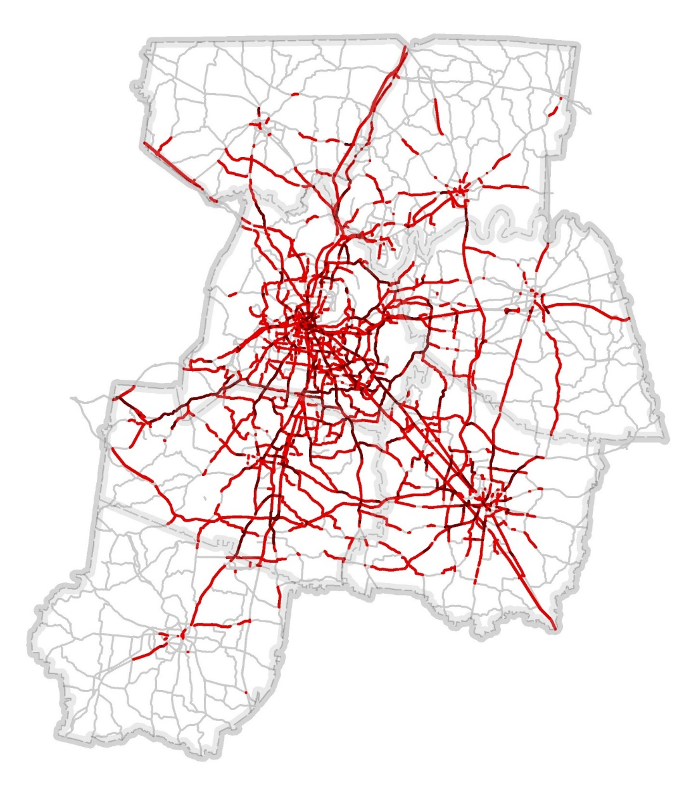
CONGESTION PROJECTIONS
The amount of time we spend in our cars is expected to double by the year 2040.
@nashvillempo
Notes:
Due to the growth in population and increased development across the region, the commuting will continue to impact our travel times. The MPO traffic forecasting tools indicate that levels of congestion and the associated costs will continue to rise; even as we implement the transportation improvement identified in the regional transportation plan.
These images show congestion in the region at peak times in 2010 and projected for 2040. The projected congestion takes into account the roadway improvements already slated for completion in the 2035 plan.
Even with dedication to improving development patters and implementing transportation projects from our plan, we risk our quality of life as the Middle Tennessee grows – as you can see - our region is in need of alternatives to driving through a diversified, multi-modal investment strategy.

Slide 15
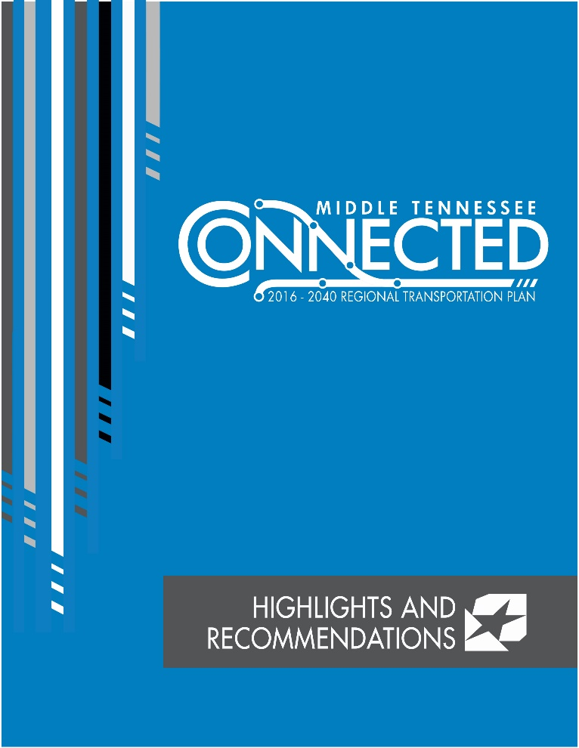
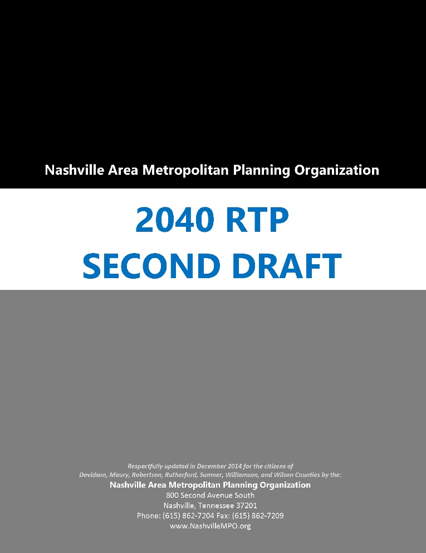
Middle Tennessee Connected
2016-2040 Regional Transportation Plan
Executive Summary
Technical Documentation
Notes:
There are currently two documents available, first the executive summary which you have in your hand and the full document which contains 300 pages of analysis, detailed recommendations and technically documentation. You can find this online at Connected2040.org.

Slide 16
FISCALLY-CONSTRAINED
{
$8.5 Billion
80% Federal Funds
20% State and Local
$1.2 Billion Regional Fixed-Guideway Transit
$916 Million Local and Regional Transit Improvements
$206 Million Active Transportation Projects
$132 Million Technology Upgrades
$2.7 Billion U.S. Interstate Improvements
$396 Million Safety Improvements
Notes:
So – with the projections mentioned, the plan identifies $8.5 billion dollars of the next 25 years to improve our transportation system. Now, 8.5 billion might sound like a lot of money, however when you consider those dollars are for transportation infrastructure – which can be tremendously expense – and spans 25 years. It is not really a large sum of money to meet our needs.
It’s also important to point out that the 8.5 billion is a combination of both federal funds and state and local matching funds.

Slide 17
Recommendations
HIGHLIGHTS
Long Term Vision
Major capital investments in roadways, transit, and walking and bicycling facilities.
Six Core Strategies
For achieving the vision, spanning issues from economic development to heavy truck and rail operations.
Funding Recommendations
$8.5 billion directed to projects and programs between
2016 and 2040.
Illustrative Needs
Identification of unfunded transportation improvements and options for increasing funding availability.
Notes:
The recommendations of the plan include investing in the long term vision – which would reimagine our existing corridors by integrating technology, expanding and modernizing transit options and improving active transportation facilities – walking and biking.
Back on page 21 are the six core strategies which provide direction to achieve the long term vision.
- A few to note, # 2, increase coordination between transportation and economic development decisions. I don’t know if you noticed, but poorly planned development was one of the top five issues to address that was identified in our regional survey.
This is an important strategy to support the goal of spending public funds wisely and enhancing our economic competitiveness. I am sure you have seen instances where an location is sited for a new or expanding company where there is no infrastructure present – to provide that means stealing the funds from another project or area.
#4 relates to improving freight operations throughout the region, this means establishing a truck network to ease heavy truck traffic during peak hours – as well as exploring the feasibility of relocating Radnor Yard which benefit not only truck and train freight, but could lead to better utilizing the rail lines and property.
The funding recommendations on page 25 of the executive summary provide a quick look at where the dollars we are expecting over the next 25 years will be allocated. If you’d like to know more about the programs which fund our transportation needs from the federal level, we offer significant detail on those on page 23. And because what might sound like a lot of money – that $8.5 do not cover all our needs. So the plan identifies illustrative needs, which allows us to have a more realistic conversation about the need for additional revenue at the local and state levels.

Slide 18
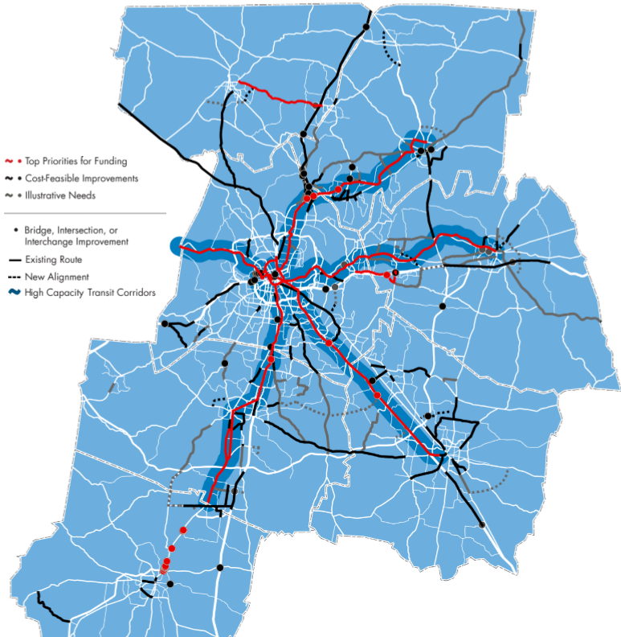
Proposed Projects
PROPOSED PROJECTS
Notes:
This is a map of the proposed projects in the plan. You can find this on page 28, the red lines and dots note the board’s top priorities for funding, the black lines represent additional projects that are recommended for implementation within our available funds for the next 25 years. And lastly, there are grey lines which show the additional 100 or projects which are important but that we were not able to included do to funding limitations.

Slide 19
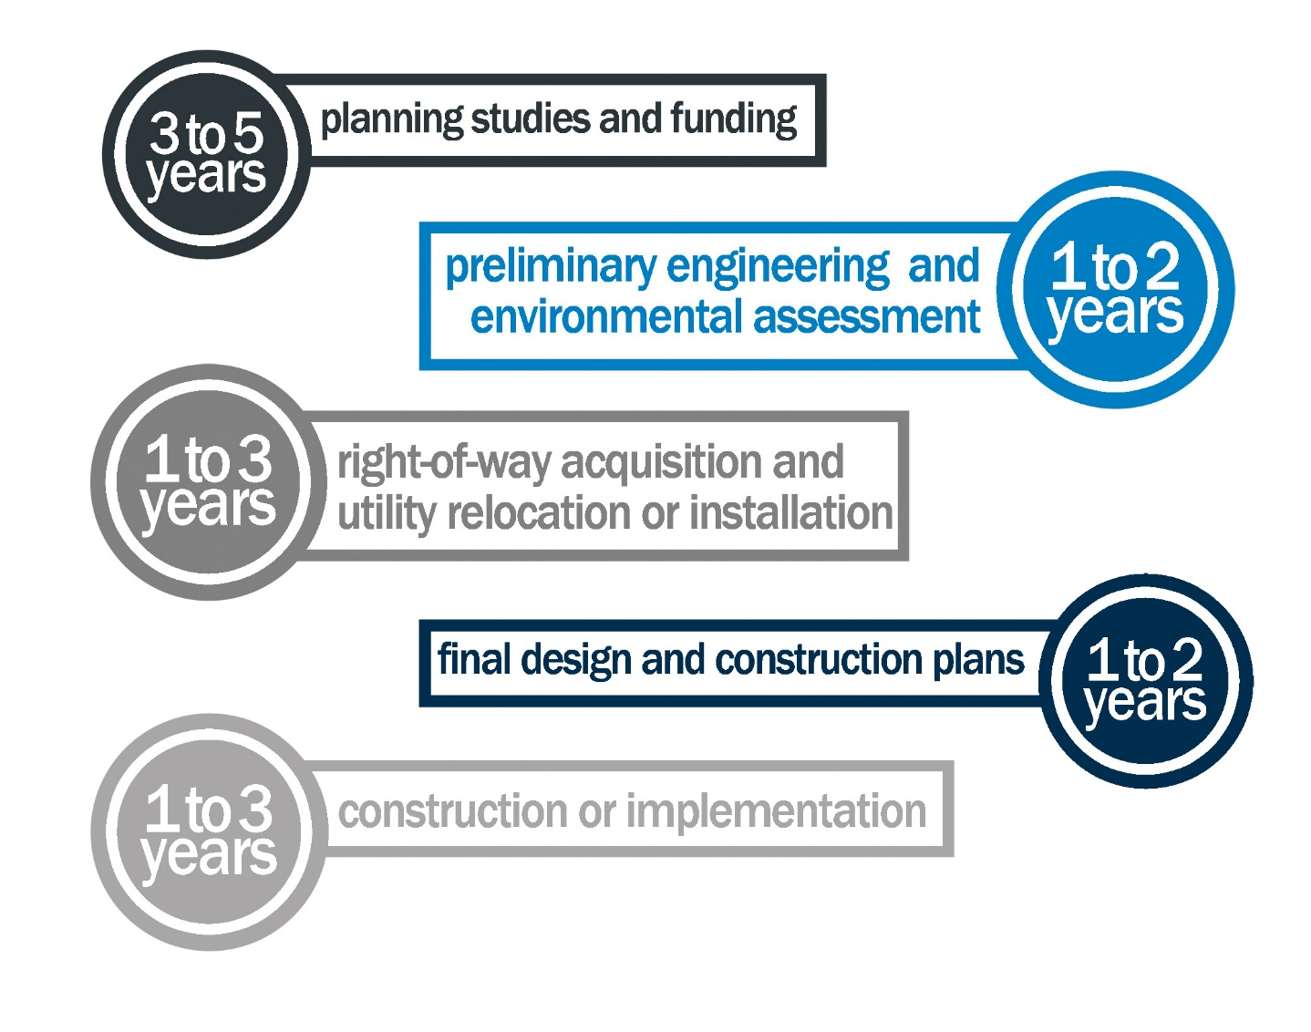
PROJECT DEVELOPMENT
Notes:
As we talk about the recommendations in the plan, it’s important to have a realistic understanding of the length of time for project development. Here is a graphic we use to show the time and steps to develop a typical transportation project. While some of these steps can happen simultaneously, even once fully funded, there many step to complete a project.
As you can see, it can take 10-15 years to complete due to funding shortages or complications arising during environmental review or right-of-way acquisition. In many respects, the RTP is just the beginning for most transportation projects. Once they are included in the plan, projects must take several steps toward implementation, including more public involvement, environmental study, preliminary engineering, final project design, right of way acquisition, and then construction.

Slide 20
MAJOR MILESTONES
State Enabling Legislation for RTA July 2009
Political Leadership Organization (Mayors Caucus) July 2009
Private-Sector Advocacy Group (Transit Alliance) April 2010
Regional Vision, Policy, Plan (RTP) Feb 2016
RTA Re-Constitution under New Statute January 2012
MPO Planning Area Expansion July 2014
Education, Outreach, Advocacy Ongoing
Conduct Detailed Studies to Evaluate Alternatives & Costs Ongoing
Identify Political & Biz Support for Dedicated Funding Ongoing
Develop Transit Agency Master Plan for Implementation Fall 2016
Seek Formal Approval of Local Dedicated Funding
Secure Matching Federal and State Funding FAST Act / 2017 TN Legislative Session
Adoption and Implementation of nMotion 2016 and onward
- Project Development and Construction
- Operate and Maintain New Investments
Notes:
We often hear comments like “why is nothing getting done to improve transit or transportation” As with the project development process, there are also many steps to achieve that goal. This slide offers a recap of where we are, and where we are headed.
I mentioned the need to increase funding for transportation in the region and you see on this slide that identifying support for a dedicated funding source is currently being explored. How we fill the gap between declining revenue and increasing costs will require citizen engagement focused on all levels of government. Initiatives like the Nashville Area Chamber’s Moving Forward and the programs offered by the Transit Alliance are supporting those efforts.
Our region is one of the largest in the nation without a dedicated source of funding for public transit – instead, opting for year after year contributions from local government general funds. Dedicated funding would create a reliable source of local revenue to 1) leverage additional federal funds for large capital projects, 2) secure the annual operations of existing and future services, and 3) provide the region the financial capacity to implement its long-range vision for mass transit.

Slide 21
ON THE HORIZON
Address funding shortfalls
State level – increase in gas tax
Local level – identify and secure dedicated funding for transit.
nMotion implementation
Corridor level studies
Community education, buy-in
Notes:
TDOT recently kicked off its I-65 Corridor Study which aims to identify multimodal solutions for identified deficiencies along Interstate 65. The I-65 Multimodal Corridor Study is an 18-month study covering a distance of 120.16 miles, from the Alabama state line to the Kentucky state line.
The South Corridor Transit Feasibility Study will complement the I-65 Corridor Study and serves as the transit component of the effort for Davidson, Williamson, and Maury counties.
the MPO is pursuing an update the Regional ITS Architecture Inventory with an emphasis on broader Smart Cities components. The inventory will include a regional survey of the technology standards (including hardware and software), human resources working on technology and mobility, and how ITS is integrated into other city, county, or regional efforts to improve quality of life. This analysis of how technology can be used by the public sector, the private sector, and the individual user to improve efficiency system-wide and inform mobility choices will play a significant role in guiding the region’s future. The project scope will feature recommendations for technical and performance standards, as well as mapping performance on energy consumption, air quality impacts, vehicle miles traveled, and other sustainability goals.

Slide 22
QUESTIONS?
Michelle Lacewell
lacewell@nashvillempo.org
615-880-2452
@MFLacewell

