Slide 1


Mass Transit for
Greater Nashville
Nov. 9, 2016

Slide 2
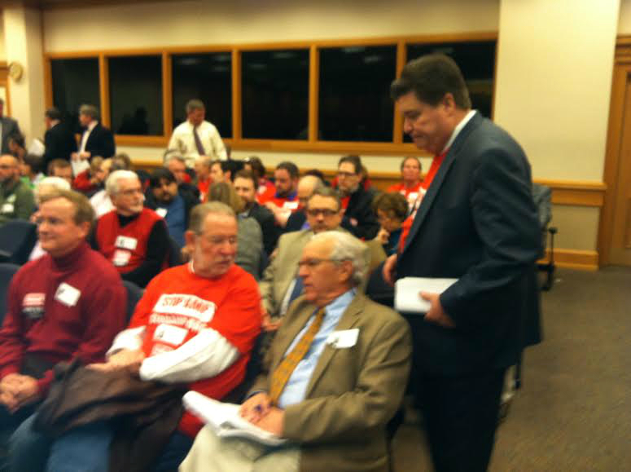

NIMBYs are Organized and Ready to Fight Your Project

Slide 3
Mass Transit In Trouble
Atlanta
Nashville
2015 Results 10 States 34 Measure Win: 23 Loss: 11 Success Rate: 68%
2014 Results 18 States 61 Measures Win: 42 Loss: 19 Success Rate: 69%
2013 Results 8 States 15 Measures Win: 11 Loss: 4 Success Rate: 73%
2012 Results 17 States 62 Measures Win: 49 Loss: 13 Success Rate: 79%

Slide 4
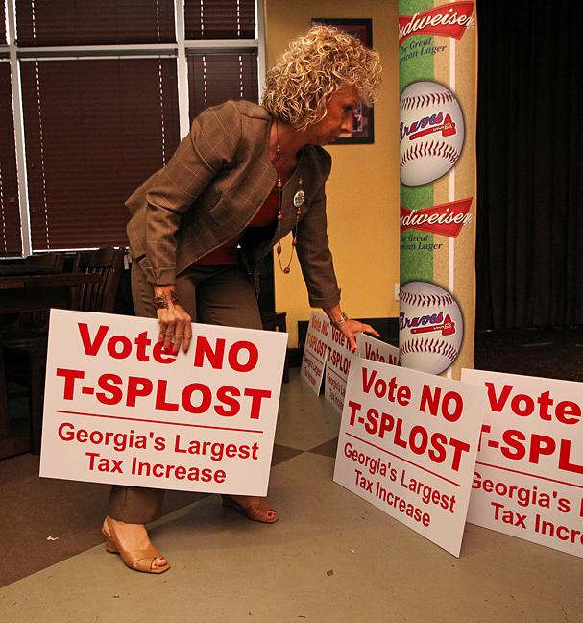
Atlanta Opposition

Slide 5
Four Types of Opposition
Financial
  NIMBY’s
  Competitors
  Unions
Ideological
  Environmentalists, Tea Party/Tax groups

Slide 6
Mass Transit, Status Quo Ante:
A contentious issue - strong opinions on both sides.
Natural allies are disparate, usually not well-funded, don’t always agree with each other.
Natural opponents are unified, well-funded.
A myriad of hurdles “built-in” to the process.
Keys to success:
  well-planned, carefully executed campaign: message and action
  Unification of stakeholders
  Getting out the vote

Slide 7
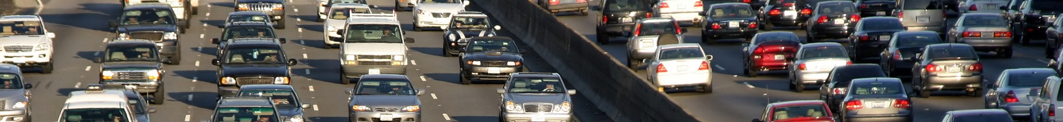

72%
Believe their communities are over-developed
or fine just the way they are.
Notes:
Was 79% in 2011
75 and older significantly differ from the general population with 32% saying communities are overdeveloped
20% overall think land is overdeveloped compared to 25% who said land was underdeveloped.
Latinos and African Americans significantly differed regarding overdeveloped from the overall population in favor of under-development
Latinos +28 for Underdevelopment
AA +21 for Underdevelopment
incomes under $25,000 were significantly more inclined to believe there is over-development
Independents are significantly more likely to believe there is more under-development.
Males are significantly more likely to find their community under-developed

Slide 8
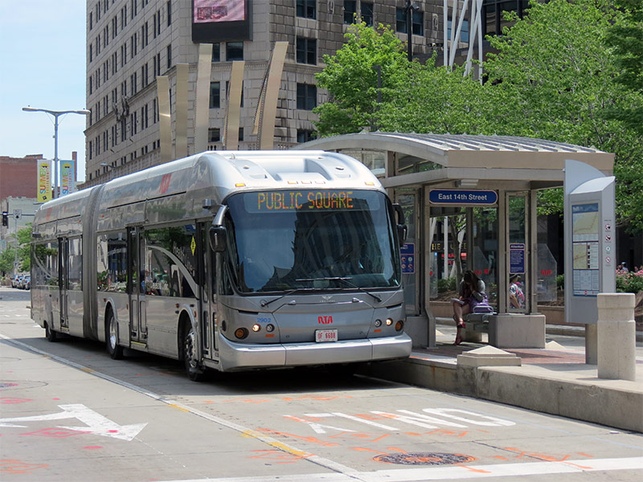
Cleveland BRT

Slide 9

18%
Have actively opposed a real estate
development project in their community.
Notes:
16% have actively supported a project.

Slide 10
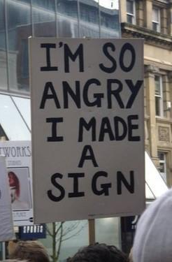
Most Likely Opponents to New Development
Aged 55-74 (26%)
White (22%)
Some college or more
Registered Independents
Homeowner
Rural

Slide 11
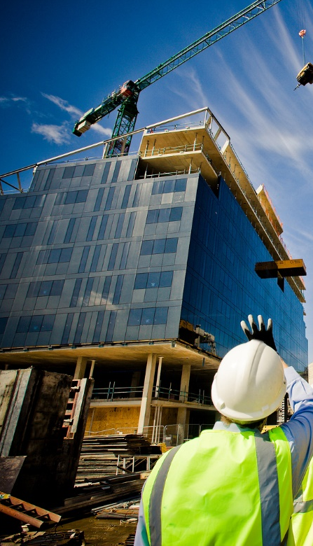
Most Likely Supporters of New Development
Aged 18-34 (20%)
Asian American (27%)
Post Graduate degree
Registered Independents
Suburban
Notes:
HH income over $75,000 were significantly more likely to support new development

Slide 12
What about Rail, specifically?
We Asked:
Would you support a rail line that would run through your community, IF…

Slide 13
What about Rail, specifically?
Then We Asked:
Would you support a rail line that would run through your community, IF…
Notes:
So it’s pretty clear – if the train is going to have a stop IN a given community, it’s a lot more likely there will be some natural support in that community. In a community that the train won’t stop, there’s likely to be a lot more opposition. There will still have to be land use approvals in that community though – and now you can see a little bit of the difficulties inherent in permitting a linear land use like a rail line.
Another issue inherent to the situation is that there are going to be pockets of vocal opposition all along the route, even in towns where the train will stop. After all, if someone told you they wanted to put a train line right behind your house, would your immediate reaction be, “yes please!”? Even a committed, ideological supporter of mass transit will have some second thoughts.
Finally, and this is a very important point – these two sets of numbers are national numbers. It’s almost guaranteed that the natural areas of support and opposition, by demographic and psychographic, are going to be quite different than these national aggregates. This was driven home to us when we actually did a rail project, in Honolulu, Hawaii.

Slide 14
Case Study: Honolulu, Hawaii
Coalition led by Honolulu Mayor proposed a ballot initiative to authorize rail transit system.
Anti-Rail forces unified and began a well-organized opposition campaign.
Coalition had poll data and paid/earned media, but no clear message or grassroots action plan.
Support for measure eroded quickly under opposition campaign.
Saint Consulting brought it for grassroots & GOTV component.

Slide 15
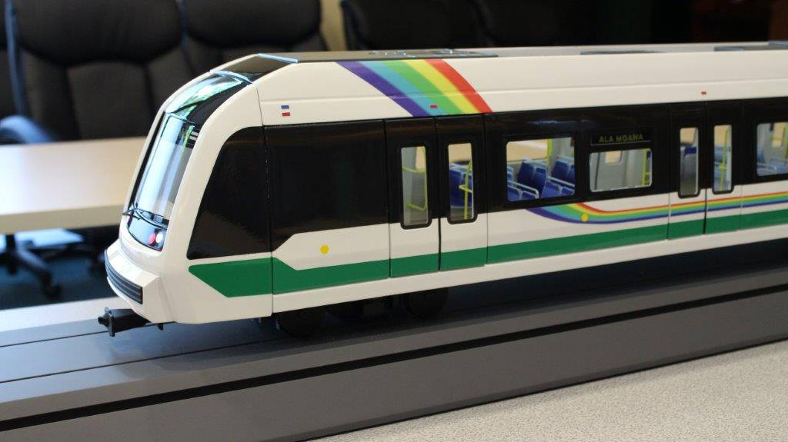
Honolulu Rail

Slide 16
Case Study: Honolulu, Hawaii
Polling data found some key information:
  Many people supported the concept but didn’t understand the ballot language.
  Ideal supporter profile (30-45, male, Filipino).
  Large support base among those with longest commute, and in certain geographical areas.
  Message testing found the most resonant support messages and opposition messages.

Slide 17
Case Study: Honolulu, Hawaii
Said our project manager in charge of the case:
“The most important takeaway is this: if you don’t do your polling, and do it right, you’re not going to know who to talk to, or what to say when you knock on their door.”
(also…)
“Another important thing to mention, even though you’d think it’s common sense, is to make sure people can actually understand your ballot language…one of the biggest problems we had initially is that people didn’t know what a “yes” vote meant. Test your language before you file the initiative!”

Slide 18
Case Study: Honolulu, Hawaii
What We Did:
Developed pro messages, and counter-anti messages for use in grassroots GOTV campaign
Knocked 12,000 doors
6500 volunteer phone calls
Over 12,000 paid phone calls
(all based on the targeted demographics from the polling data)
What Happened:
Measure passed 53% - 47%, a difference of 15,257 votes out of 296,503 cast.
Notes:
These numbers here at the bottom are quite important, actually. Studies – such as those done by Professor Donald Green at Yale – have shown that a well-run GOTV campaign can mean as much as a 3% to 5% difference in the final results. And, as it happens here, 15,257 of 296,503 is actually 5.1%. Without that GOTV campaign, it’s very unlikely that the measure would have passed.

Slide 19
Case Study: Honolulu, Hawaii
Against Us - the likely Natural Opponents:
Taxi & Limo companies, their industry associations
Right Wing Think Tanks, funded by Big Oil
Anti-Tax Activists & Groups
With Us – the likely Natural Allies:
Greens & Environmental Groups
Building Trades & Union Groups
Infrastructure Companies
Commuters with Long Rides
Notes:
The thing to note here is the natural unity among the opponents and the natural disparity of the supporters. The opponents are all in opposition for the same reason – they see this as being bad for their wallets. The Taxi and Limo companies will see an immediate drop in revenues; Big Oil sees reduced income as demand for petroleum products decreases, and the Anti-Tax folks know that a mass-transit solution will require massive public subsidies, which means more money out of their pockets through increased taxes. Though they’ll use different messages, and perhaps have slightly different ideologies, they’re all brought together by their wallets.
The supporters, as I think you can tell, are united in what they want – a transit solution – but the reasons they want that solution vary greatly, and each is quite likely to have a different vision of what that solution should entail. A coalition that is brought together by very different viewpoints is a lot harder to align and push into unified action than one that is already unified by a single, overarching common cause. Also, the opponents in this case were pretty well heeled – they had a quite a bit of money to spend, whereas on the support side, each set of stakeholder has differing – but usually much smaller – amounts of ready cash to fund a major campaign.

Slide 20
Case Study: Honolulu, Hawaii
Messages Against:
Tax-money giveaway to large developers
Not profitable/self-sufficient, will always require public money
Will affect “character of community”
Will have negative affect on existing business
Messages For:
Eases congestion, makes commutes easier & faster
Promotes smart growth, transit-oriented growth
Jobs, jobs, jobs
Much “greener” than 1 person/1 car status quo
Reduces reliance on auto usage overall

Slide 21
Building Support: A “Road Map”
Key Components:
Identify and align stakeholders early
Conduct polling program; test language and messages, build supporter profile
Develop materials to educate public
Execute PR/PA campaign (paid/earned media)
Execute grassroots/GOTV campaign
Turn undecideds and supporters into Advocates!

Slide 24
Need Public Private Partnership
Opposition will be funded and organized.
Supporters need to be identified and organized and directed to vote.
Funding of campaigns. Major employers need to contribute.
Campaigns cost money and government is not equipped to raise or spend it on campaigns.

Slide 25
Using Digital Techniques I
RESEARCH
  Websites, Social Media presence, Mentions in Local websites (patch.com)
  Polling, online and telephone, IVR
  Blog and article monitoring, Google alerts
  Door to door and city hall
  Town halls, telephone and in person

Slide 26
Using Digital Techniques II
COMMUNITY EDUCATION
  Websites
  Email newsletters
  Text messaging
  Social Media
  Social events

Slide 27
Using Digital Techniques III
• BUILDING SUPPORT
- Enhanced databases
- Digital petitions and text messages
- Facebook likes and ads
- LinkedIn, Twitter, Instagram, Telephone TH

Slide 28
Using Digital techniques IV
DEMONSTRATING SUPPORT
  Online Petitions
  Email patch-throughs
  Robo calls
  Video petitions
  Text and email invites to meetings and other actions
  Facebook posts

Slide 29
Some Parting Thoughts
These ballot issues are about winning votes, not hearts and minds.
Do not let parochialism sour your project.
Its about process not the product; don’t get bogged down in the details.
Be prepared to run separate and different campaigns across your community.
Attempt to schedule ballot issues during the same time frame.

Slide 30
P. Michael Saint
  Chairman
  Saint Consulting Group
  www.tscg.biz
  615-207-8065
  Msaint@tscg.biz

