Slide 1
Transit Leadership Citizen Academy 2016
Transit Alliance of Middle Tennessee
October 19, 2016
Shaping the Future of Transit In Nashville

Slide 2
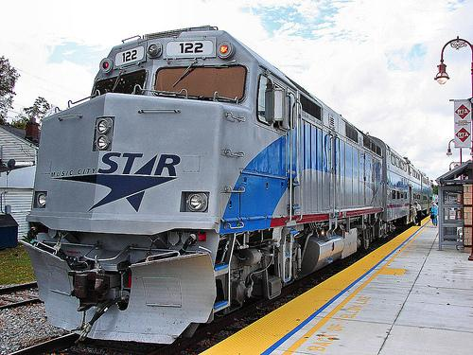
Presentation Outline
01
Existing Transit Environment
02
Transit Master Planning
03
Transit Technologies
04
Examples from Other Communities
05
Funding The Plan
06
In Conclusion

Slide 3
Existing transit environment
01

Slide 4
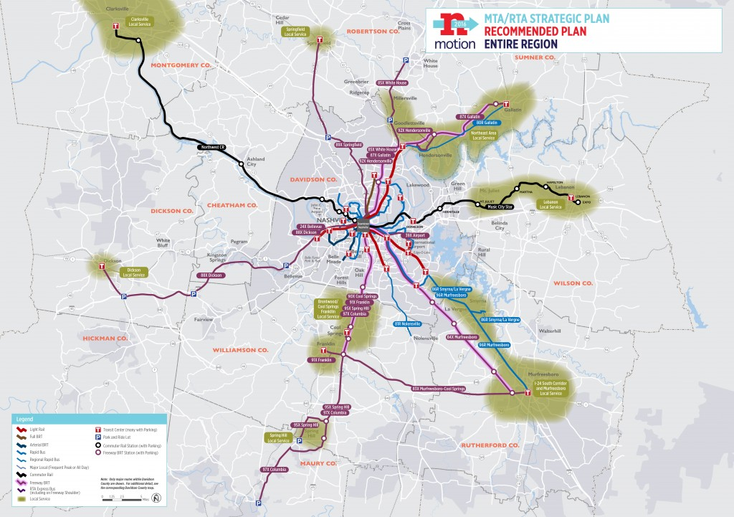
Transit In The News…
MTA Board approves nMotion 2016 transit plan. Staff Reports • Updated Sep 27, 2016 at 3:00 PM ​
Recommendations:
Make Service Easier To Use
Improve Existing Services
Improve Access to Transit
Make Service More Comfortable
Develop a Network of Regional Transit Centers
Expand Services to New Areas
Build High-Capacity/Rapid Transit Network
Notes:
Transit is a business issue, a political issue, a media issue, a personal issue, a financial issue, a community issue.

Slide 5
transit MASTER PLANNING Success” Is A Comprehensive Word!
02

Slide 6
Simplify service

Slide 7
Develop a single seamless system provide better customer information simpler fare payment smart technology

Slide 8
What about autonomous vehicles?

Slide 9
What about autonomous vehicles?
Improved pedestrian and bicycle connections

Slide 10
Transit technologies The Big Ticket Items…
03

Slide 11
Transit Functions Better When It Offers Choices…
Bus Rapid Transit
Modern Streetcar
Electric Multiple Units
Bus Rapid Transit (Lite)
Light Rail Transit
Commuter Rail
Trolley
Regular Bus

Slide 12
Transit Functions Better When It Offers Choices…
Elon Musk Hyperloop
Autonomous
Personal Rapid Transit
POD cars
Maglev
Smart Cars
Monorail
Bus on Shoulders

Slide 13
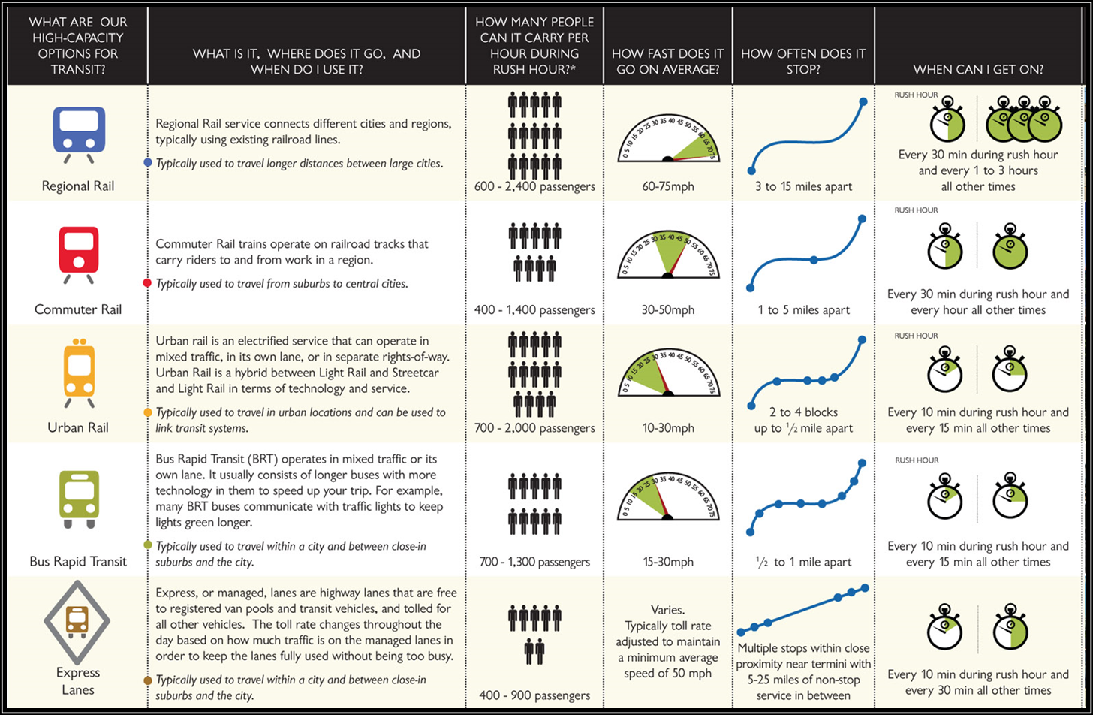
How Transit Technologies Compare

Slide 14
Stories from other places What Have Others Done?
04

Slide 15
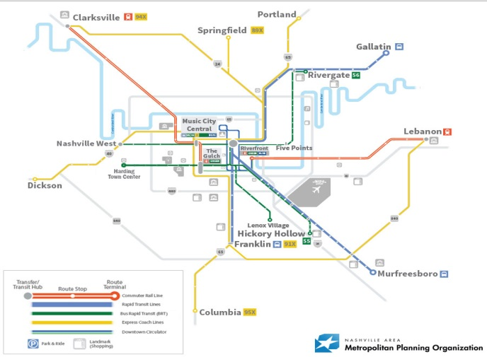
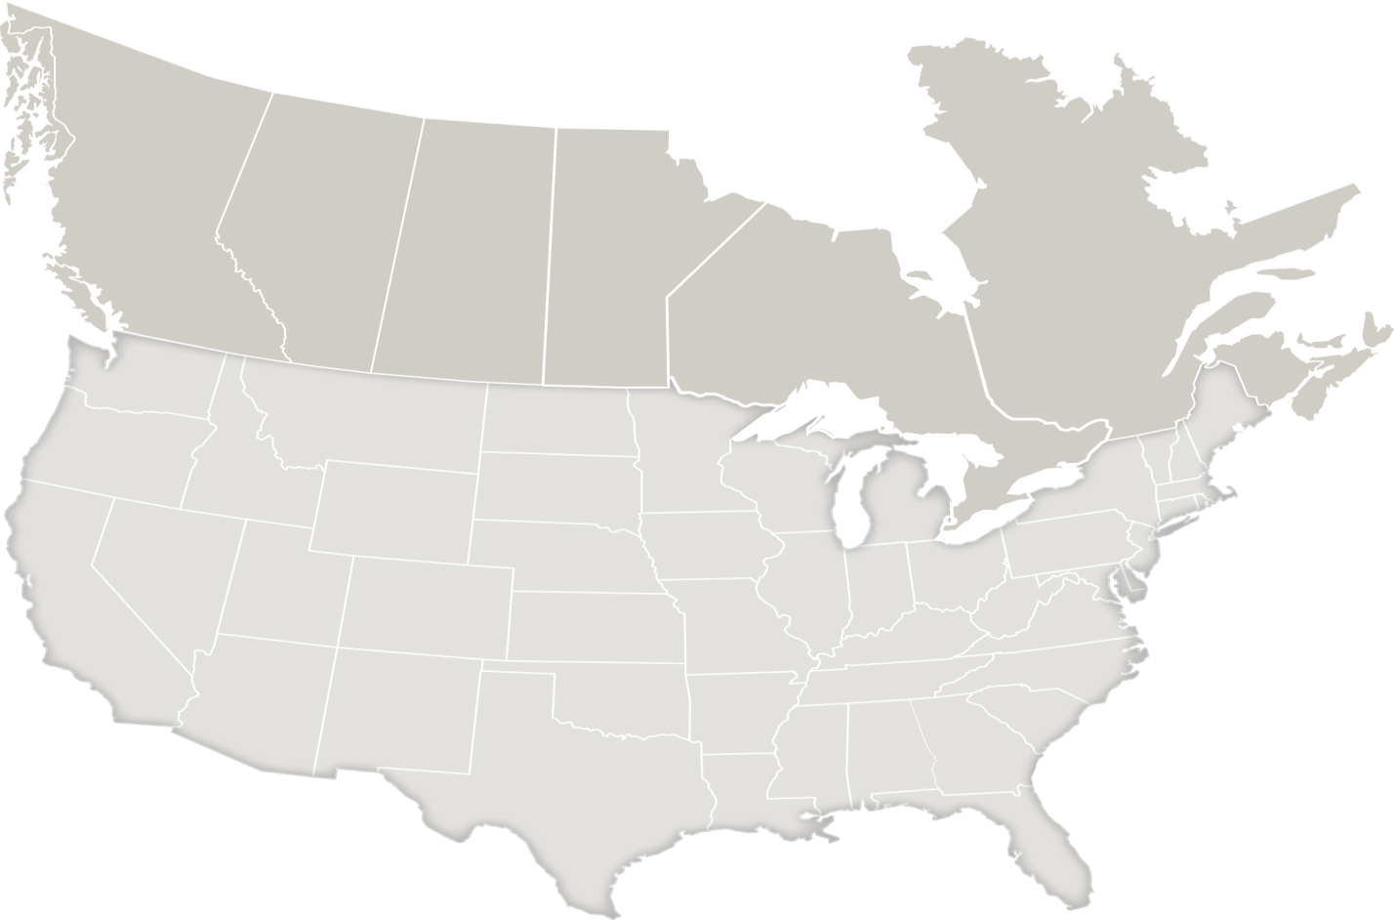
TRANSIT MASTER PLANS
Asheville, NC
Boulder, CO
Fort Worth, TX
Grand Rapids, MI
Sacramento, CA
Saginaw, MI
Seattle, WA
Nashville

Slide 16
Linking Transit and Land Use Focus on Centers and Corridors

Slide 17
Station Priorities

Slide 18
Transit Friendly Development Types

Slide 19
Transit Development Strategy Linking Transit and Land Use

Slide 20
Funding & revenue strategies “To Build A Great Transit System, Additional Funding Will Be Needed For Both Capital Projects And Ongoing Operations” State of MTA System Report
05

Slide 21
Potential Funding Opportunities
Private Contributions/Donations
Tax Increment Financing
Improvement Districts
Dedicated taxes (local or Statewide – but primarily local)
Sales Tax
Property Tax
Payroll Tax
Gas Tax
State capital matching programs for capital projects e.g. Florida, Michigan and North Carolina (with legislation that requires States to provide match for capital projects)
Rental Car surcharge
Hotel/Motel Tax
Parking Fee

Slide 22
IN CONCLUSION
06

Slide 23
““We've got to figure out some way to address mass transit and be able to not just build more roads and bigger and wider roads because that won't solve our problem but…to start to talk about public transportation”
governor Bill Haslam (January 2016)

