Slide 1
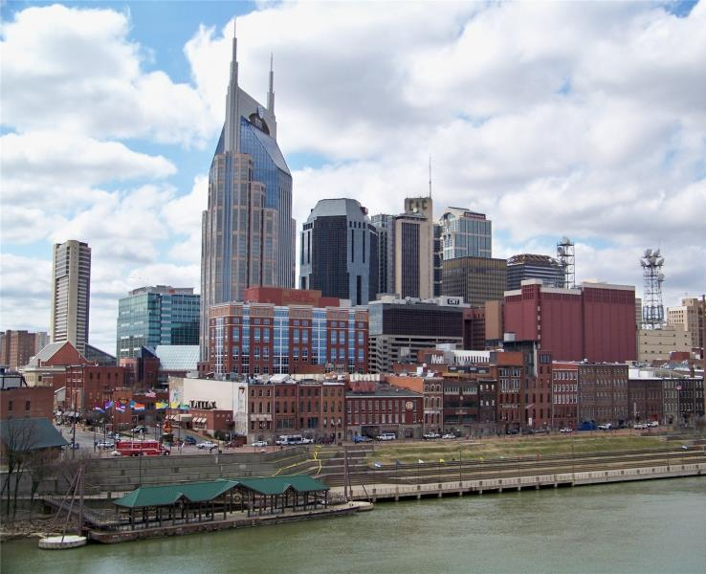
Nashville: Growth with Intention
Erin Hafkenschiel, Director of Transportation & Sustainability
Office of Mayor Megan Barry, Nashville, TN
Notes:
Welcome
Provide a brief background on Nashville and future growth projections
Quickly review how we are connecting our land use and transportation decisions so we grow with intention
Give overview on how we are using private redevelopment to transform some of our major corridors
Highlight a few of the city’s projects that are changing how we link people to transportation choices

Slide 2
Nashville’s Transportation Strategy
Infrastructure
Smart City Technology
Mass Transit
Transportation
Complete Streets
Bicycles
Pedestrians
Goals:
Maximize the benefits of urban agglomeration economies while also improving mobility and access to jobs and opportunities
Improved health outcomes by encouraging more active transportation
Cleaner air and lower carbon emissions by promoting alternatives to private vehicle transportation

Slide 3
Nashville is Booming
2015 Population 1,830,345
2.03% annual growth
36,435 new residents
26,062 moved to Nashville
71 people moving per day on average
Major Economic Drivers
Health Care
250,000 jobs / $38.8B Economic Impact
Music & Entertainment
60,000 jobs / $9.8B Economic Impact
Manufacturing
70,700 jobs / $9.5B Economic Impact
Tourism & Hospitality
55,000 jobs / $5.7B Economic Impact
Austin
Orlando
Raleigh
Houston
Las Vegas
San Antonio
Denver
Dallas
Nashville
Jacksonville
2.95%
2.60%
2.46%
2.45%
2.21%
2.20%
2.12%
2.08%
2.03%
2.00%

Slide 4
Job Growth
Top ten metro in the U.S. for job growth over last 25 years
#10
Last 25
Years
#8
Last 10
Years
#3
Last 5
Years
Austin
San Jose
Nashville
Riverside
Orlando
San Francisco
Denver
Raleigh
Dallas
Salt Lake City
23.2%
20.8%
20.1%
19.4%
18.9%
18.6%
18.5%
17.1%
17.1%
16.3%
Region has achieved >3% job growth in 59 out of the past 60 months
Notes:
Source: Nashville Chamber Presentation

Slide 5
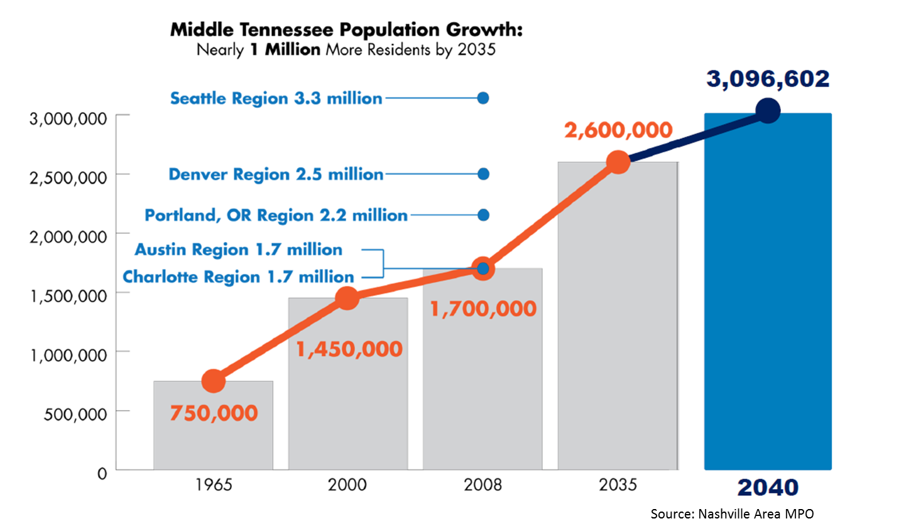
Population Growth, 1970-2040
Notes:
Source: nMotion Plan

Slide 6
Expected Traffic Congestion
2010
2040
Notes:
Source: Nashville Area MPO

Slide 7
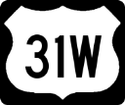
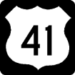
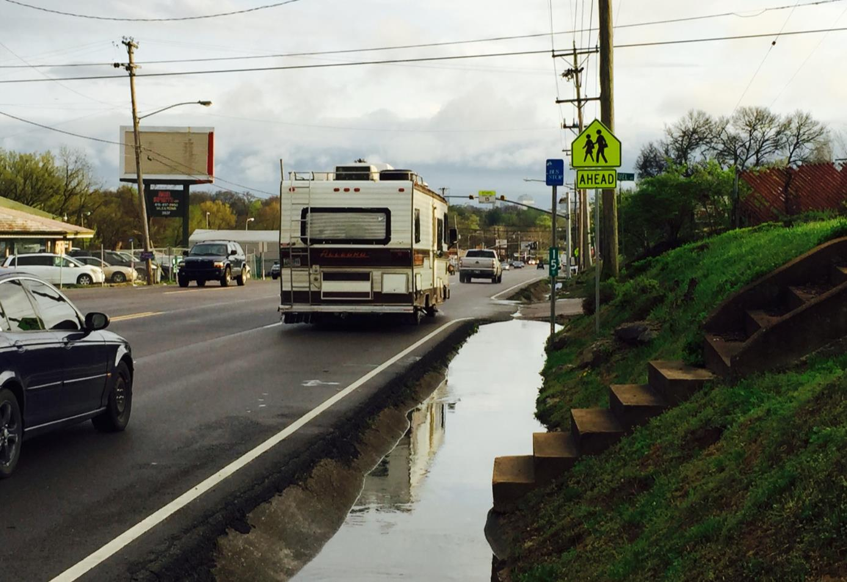
Existing Conditions
Dickerson
Pike

Slide 8
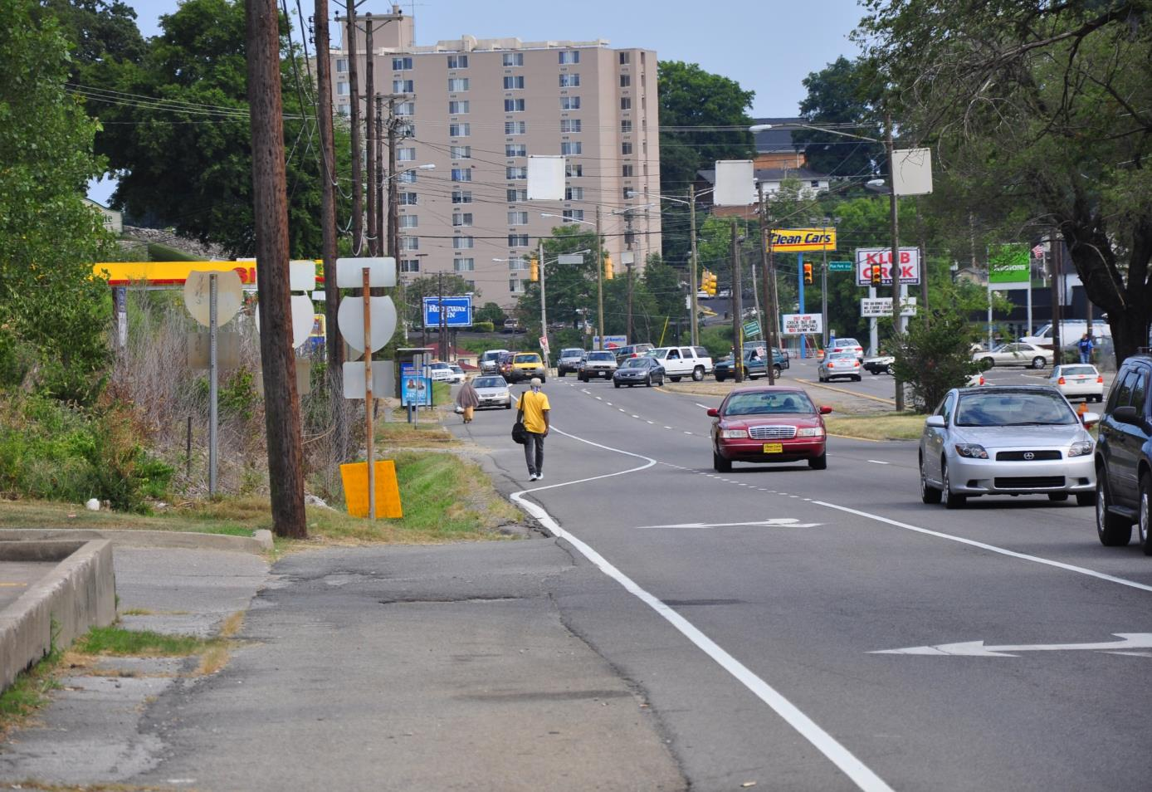
Existing Conditions
Murfreesboro
Pike
Notes:
This is Murfreesboro Pike where people are walking in the streets to access their bus stops.

Slide 9
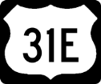
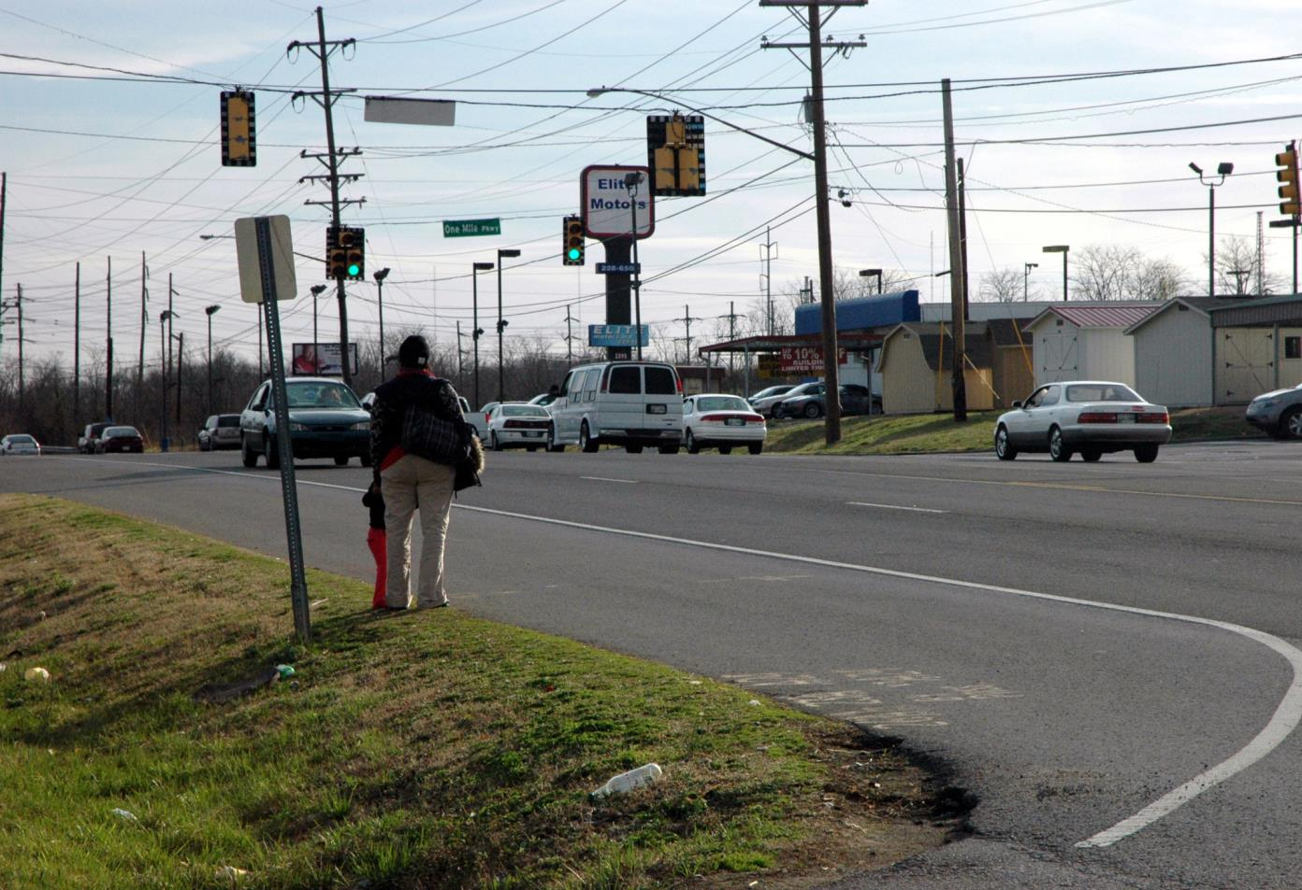
Existing Conditions
Gallatin Pike

Slide 10
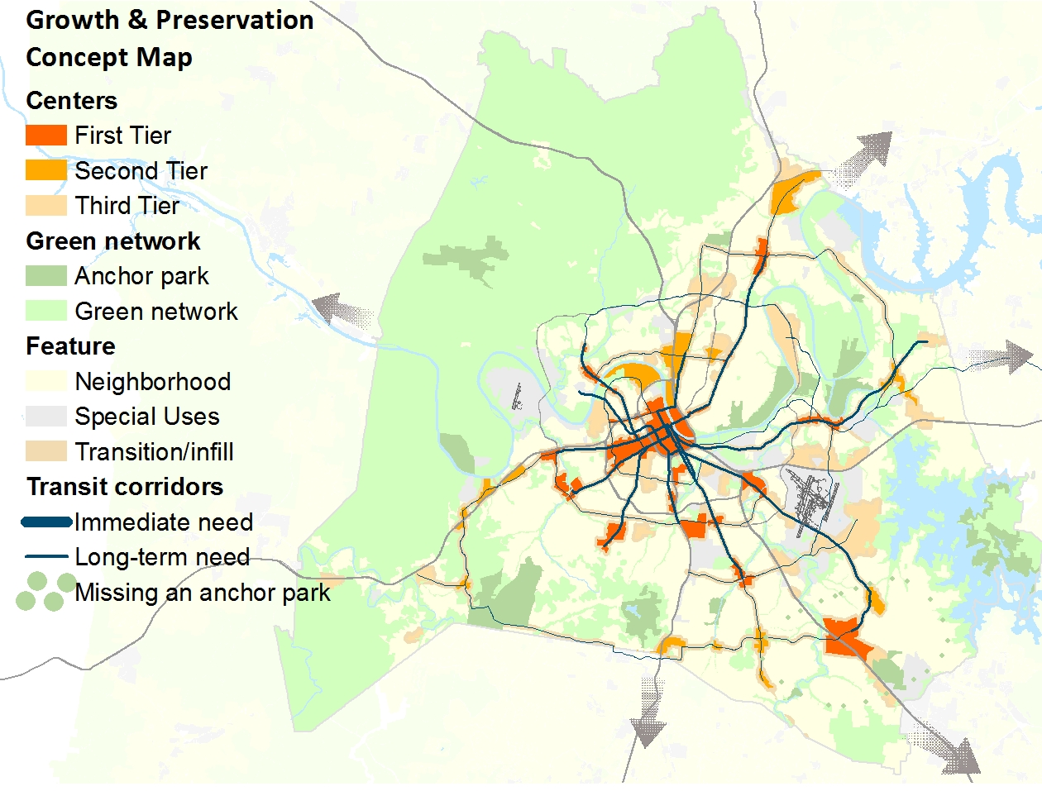
NashvilleNext General Plan
Notes:
It lays out a Growth & Preservation Concept Map that identifies centers and corridors where we should increase housing options and jobs.
The centers are identified in orange and the corridors are the blue lines on the map.
We envision these centers being connected with some form of High Capacity Transit in the future.

Slide 11
nMotion Transit Master Plan
Notes:
The Nashville Metropolitan Transit Authority or MTA built upon the work of NashvilleNext to determine which routes are more viable in the future, regional connections, and the type of mode.
The nMotion plan was just adopted on Sept 21/22nd by the RTA/MTA boards.
Includes: 4 light rail lines, 3 BRT lines, etc…

Slide 12
Metro Infrastructure Initiatives
Key
Public Works
ITS
Parks
Mayor’s Office
NashvilleNext
MTA/RTA
Planning
Draft Released
nMotion MTA/RTA Strategic Plan
Draft Report
GEAR UP 2020
Draft Report
Nashville Strategic Plan for Sidewalks and Bikeways
Draft Report
Metro Parks and Greenways Master Plan
Draft Report
Livable Nashville: We Make Nashville Green
Connected Nashville Working Group
Jan
Jan
Feb
Mar
Apr
May
Jun
Jul
Jan
Feb
Mar
Apr
May
Jun
Feb
Mar
Apr
May
Aug
Sep
Oct
Nov
Dec
Jun
Jul
Aug
Sep
Oct
Nov
Dec
2015
2016
2017

Slide 13
What needs to happen to help us implement Nashville’s plans for transit, sidewalks, and bikes?
We need to change the way we think about:
Space for cars to space for people
Funding for other modes besides vehicles

Slide 14
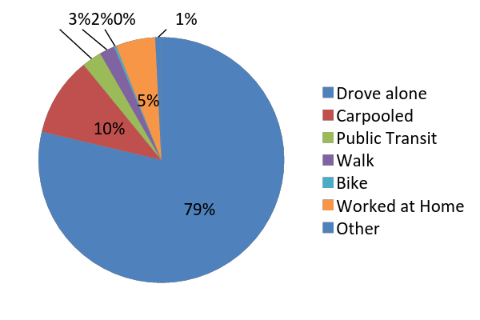
Mode Share
Public Transit Supply
Transit Ridership
Share of Homes/Jobs within .25 mi of Transit
Transit Agency Operating Costs
Miles of Sidewalk and Bikeways
VMT
Seattle | 49.1%
Denver | 29.1%
Austin | 24.4%
Nashville | 20.5%
Raleigh | 19.5%
Louisville | 18.2%
Indianapolis | 17.4%
Goal: 41% non-SOV commute mode share by 2040; 0.85% increase per year
14
Source: US Census Bureau, American Community Survey 2014

Slide 15
Transit Ridership
Mode Share
Public Transit Supply
Share of Homes/Jobs within .25 mi of Transit
Transit Agency Operating Costs
Miles of Sidewalk and Bikeways
VMT
Seattle | 416,936
Denver | 341,480
Austin | 121,241
Louisville | 50,269
Indianapolis | 36,052
Nashville | 33,426
Raleigh | 20,729
9,619,309 annual ridership (MTA)
33,426 avg. weekday ridership (MTA)
35,869 avg. weekday ridership (MTA/RTA)
Goal: 180,000 avg. weekday ridership (MTA/RTA) in 2040; 6,000 new riders per year
15
Source: National Transit Database

Slide 16
Miles of Sidewalk and Bikeways
Mode Share
Public Transit Supply
Transit Ridership
Share of Homes/Jobs within .25 mi of Transit
Transit Agency Operating Costs
VMT
1,110 total miles of sidewalk
2016 (to-date): 8.6 miles
2015: 8.1 miles
2014: 11.8 miles
268 miles of bikeways; 105.2 miles of bike lanes; 18.6 miles of buffered bike lanes
2016 (to-date): 1.8 miles
2015: 56.6 miles
2014: 11.8 miles
Goal: TBD – WalknBike Plan
Bikeways
Austin | 520
Seattle | 248
Nashville | 226
Denver | 220
Raleigh | 187
Louisville | 182
Indianapolis | 173
Sidewalks
Denver | 3,143
Austin | 2,360
Seattle | 2,100
Indianapolis | 2,000
Louisville | 2,000
Nashville | 1,103
Raleigh | 847
16
Source: Nashville WalknBike Plan, Peer & Aspirational City Review, Alta Planning

Slide 17
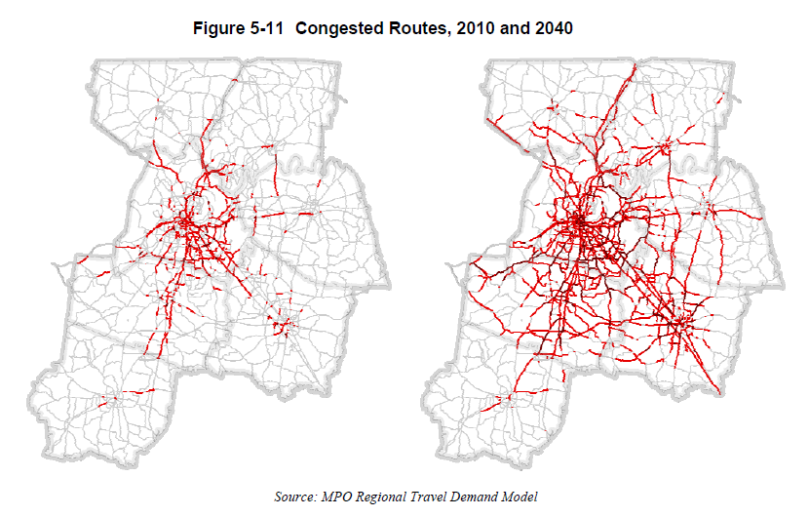
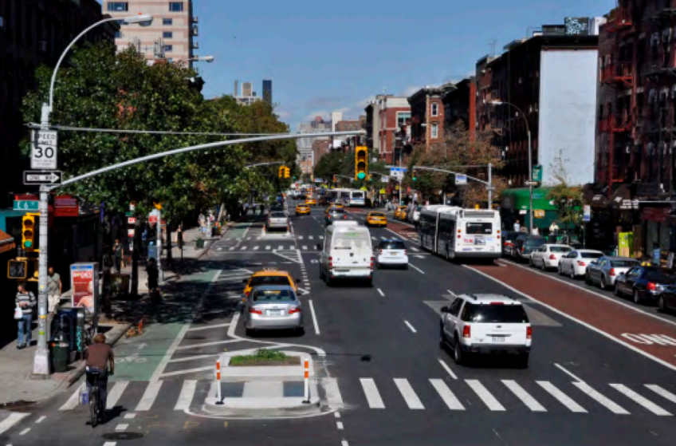
Infrastructure and Transportation Strategy: Key Concepts
Urban Agglomeration Economies
Road congestion will only get worse
Build more complete streets
Must increase share of other modes

Slide 18
Space for people

Slide 19
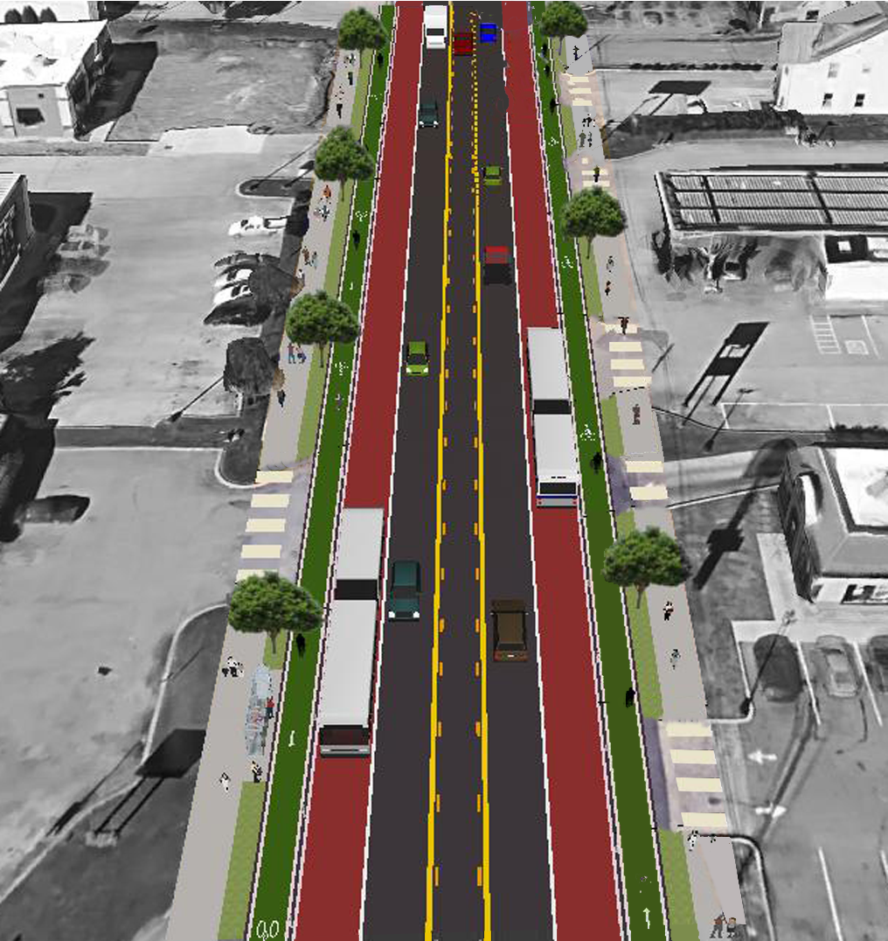
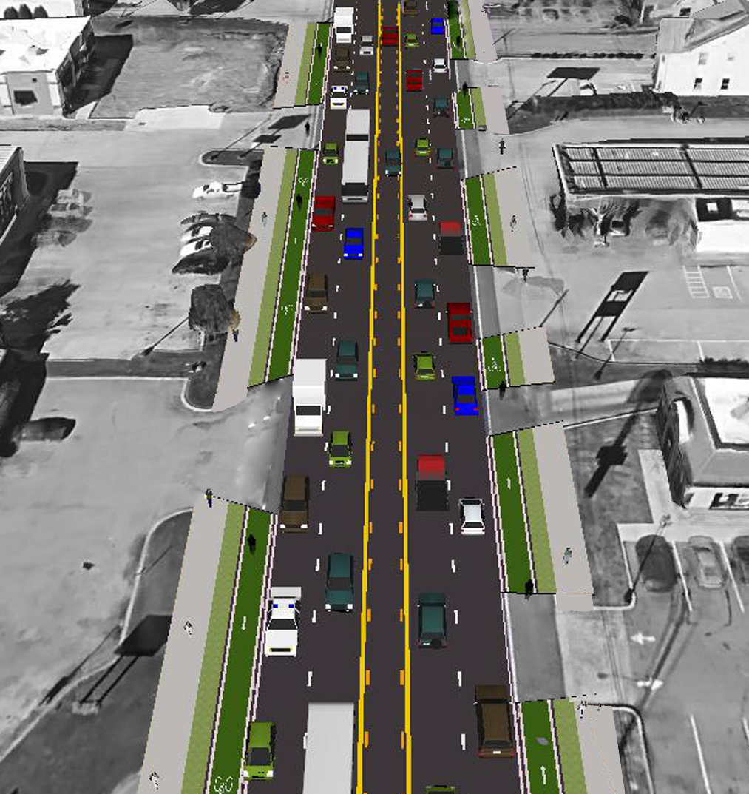
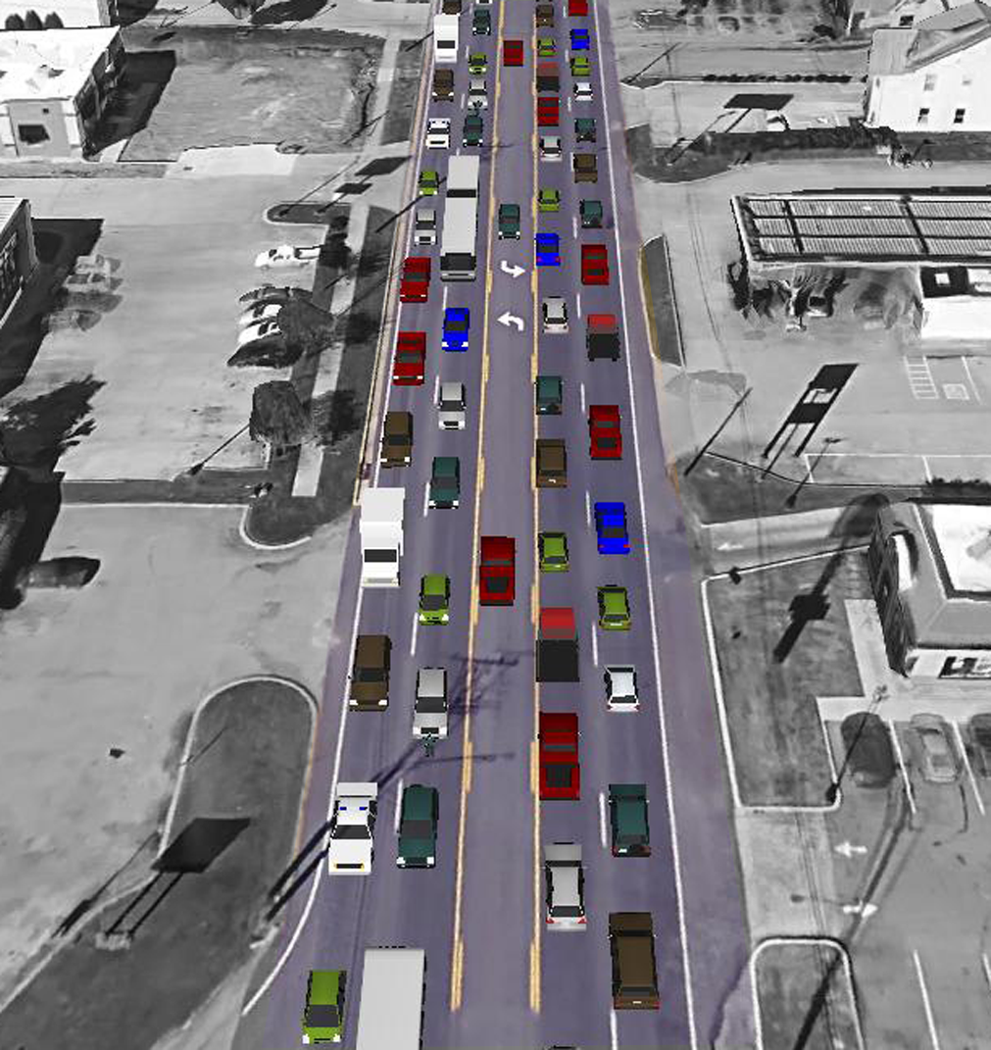
Space required to transport 80 people

Slide 20
Space required to transport 80 people, even with buses at only 50% capacity

Slide 21
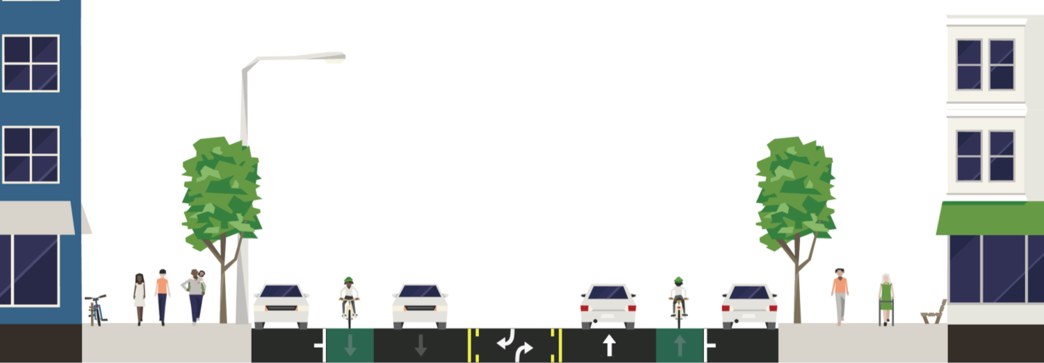
Retrofitting Corridors
How does the street blend with the building?
Development Zone | Pedestrian Zone | Green Zone | Parking Zone | Bicycle Zone | Vehicle Zone | Bicycle Zone | Parking Zone | Green Zone | Pedestrian Zone | Development Zone
Notes:
A major task ahead of us is retrofitting our corridors and doing this while we have a booming city to leverage the private sector in contributing to infrastructure.
This shows all of the elements that make up the right of way or space where people get around from one place to another between the red dashed lines.
I've shaded in where we must be very diligent in prioritizing pedestrians and achieving greater access for all modes.
If the building is built too close, then we make for a more uncomfortable walking environment next to cars.
The Planning Department’s Major and Collector Street Plan helps outline the needs in this shaded area.

Slide 22
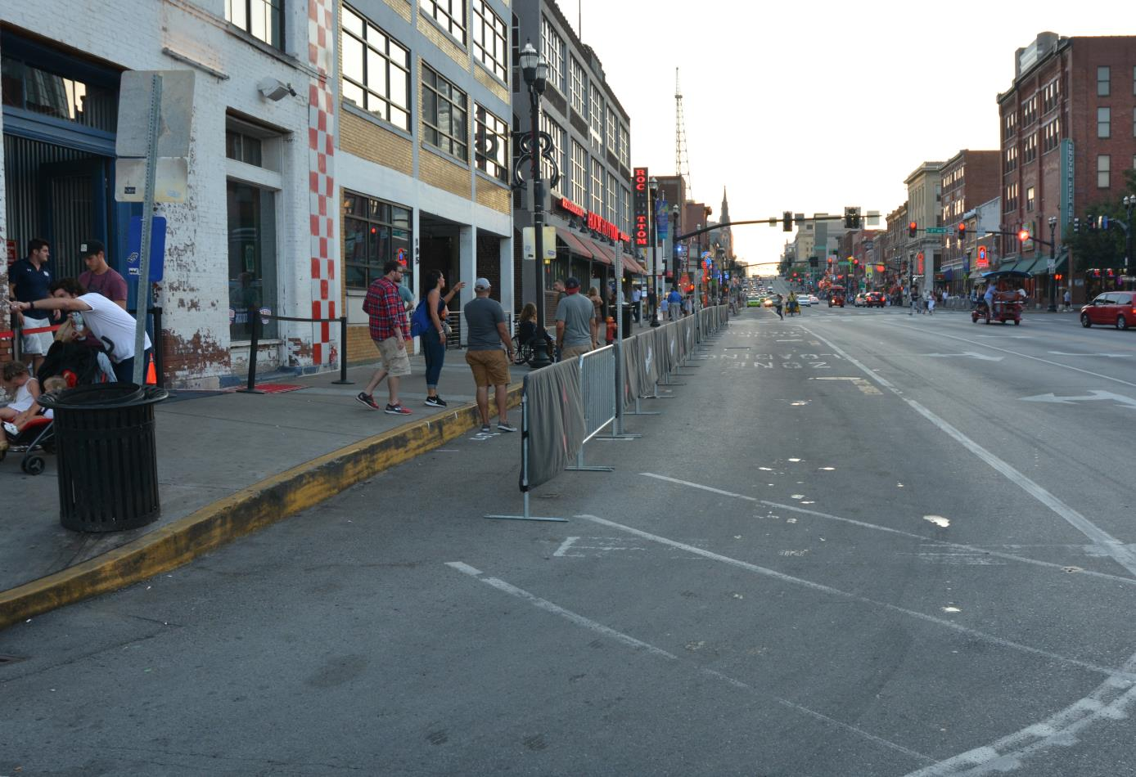
Interim Wider Sidewalks
Broadway
Notes:
This is an interim solution to provide more walking space with barricades.

Slide 23
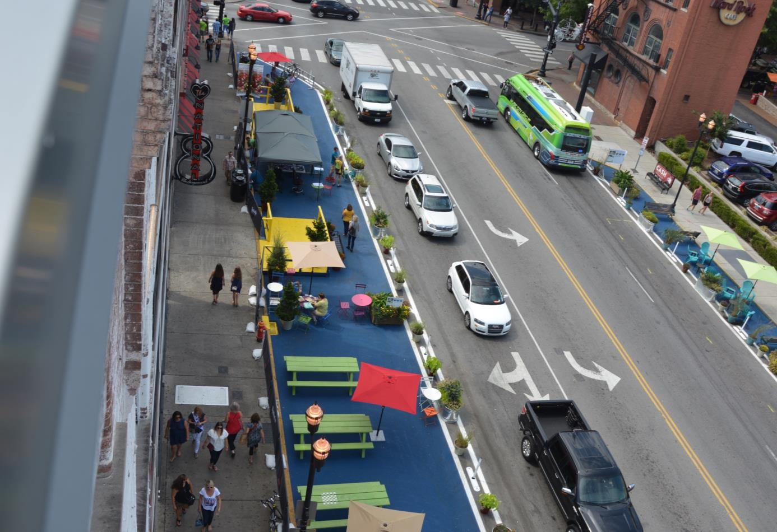
Interim Plaza, Seating, & Bike Parking
Broadway
Notes:
We also are testing one block that started on Park(ing) Day this year with a plaza containing seating, bike parking, and landscaping.

Slide 24
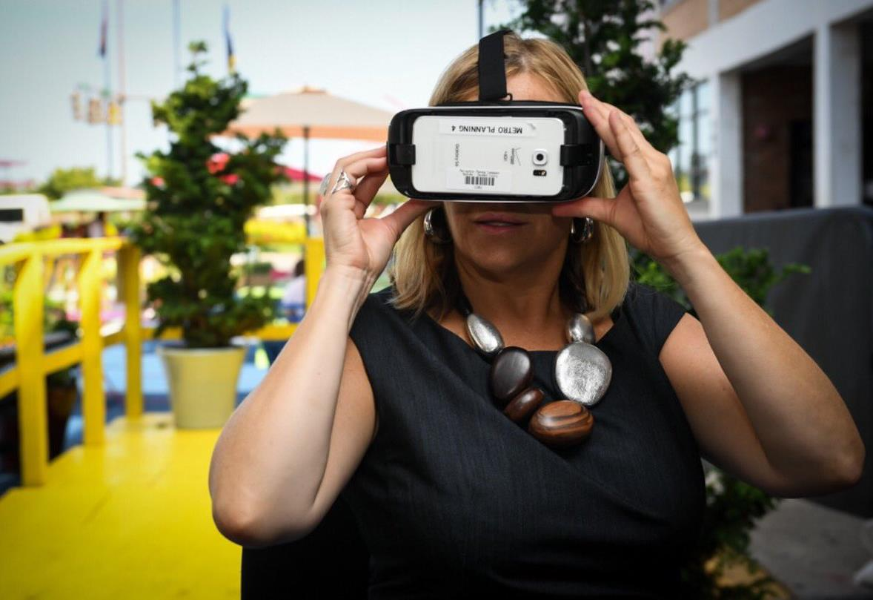
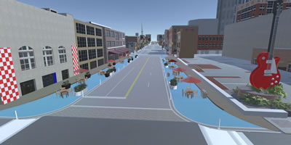
Envision Broadway
Broadway
Notes:
This is Mayor Barry on Park(ing) testing out the virtual reality headset that we are using to get additional input on the future design elements of Broadway.

Slide 25
Transit Agency Operating Costs
Mode Share
Public Transit Supply
Transit Ridership
Share of Homes/Jobs within .25 mi of Transit
Miles of Sidewalk and Bikeways
VMT
$66,688,699 MTA total operating expenses in 2014
$106.42 per capita
Goal: $338.4 million in annual operating costs (MTA/RTA) by 2040; $244/capita; $6.2 million increase per year
Seattle | $291.61
Austin | $171.74
Denver | $165.96
Nashville | $106.42
Louisville | $96.28
Raleigh | $83.14
Indianapolis | $67.96
25
Source: Nashville MTA; nMotion Plan; National Transit Database

Slide 26
Public Transit Supply
Mode Share
Transit Ridership
Share of Homes/Jobs within .25 mi of Transit
Transit Agency Operating Costs
Miles of Sidewalk and Bikeways
VMT
MTA operates bus service on 398 miles of roadway
MTA provides 40 miles of rapid bus service (BRT lite)
62.8 miles of fixed guideway (RTA Music City Star)
Goal: 177.4 miles of fixed guideway routes by 2040 (42.5 LRT; 22.1 BRT; 50 CR)
Seattle | 226.6
Denver | 99.8
Austin | 64.2
Nashville | 62.8
Louisville | 0
Indianapolis | 0
Raleigh | 0
26
Source: Nashville MTA; nMotion Plan Recommendations; National Transit Database

Slide 27
Share of Homes/Jobs within .25 mi of Transit
Mode Share
Public Transit Supply
Transit Ridership
Transit Agency Operating Costs
Miles of Sidewalk and Bikeways
VMT
49% of population (homes) within .25 miles of a transit stop
74% of jobs within .25 miles of a transit stop
Goal: 391,000 residents and 744,000 jobs in Davidson County within .5 mi of a transit stop by 2040
27
Source: Nashville MTA; nMotion Plan Recommendations

Slide 28
VMT
Mode Share
Public Transit Supply
Transit Ridership
Share of Homes/Jobs within .25 mi of Transit
Transit Agency Operating Costs
Miles of Sidewalk and Bikeways
Seattle | 25.2
Denver | 28.1
Memphis | 29.3
Austin | 37.7
Indianapolis | 39.4
Nashville | 48.9
Raleigh | 55.1
43.48 daily vehicle miles traveled per capita
Goal: 40% reduction by 2040
28
Source: Nashville Area MPO; Federal Highway Administration, Office of Highway Policy Information

Slide 29
Funding for Transit

Slide 30
Funding for Transit

Slide 31
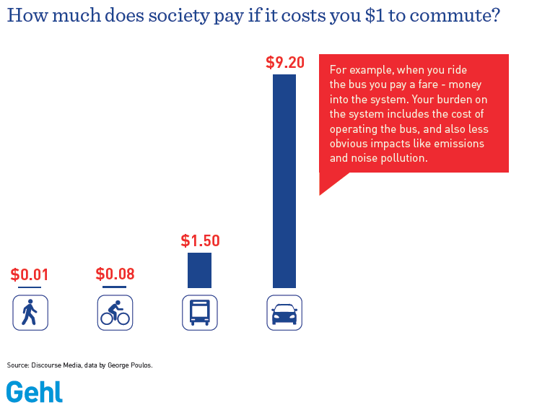
Funding for Transit

Slide 36
THANK YOU!
Erin.Hafkenschiel@nashville.gov

