Slide 1
Transit Citizen Leadership Academy
October 5, 2016

Slide 2
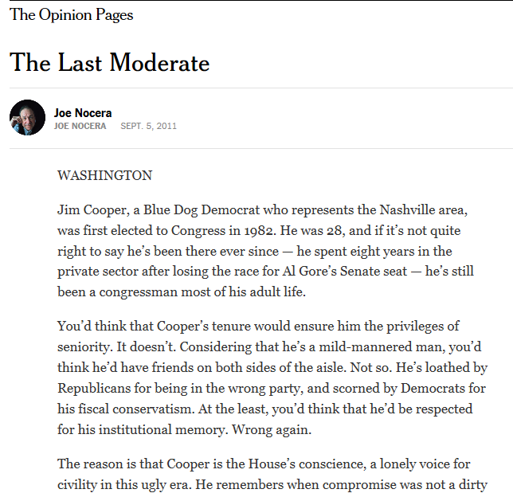
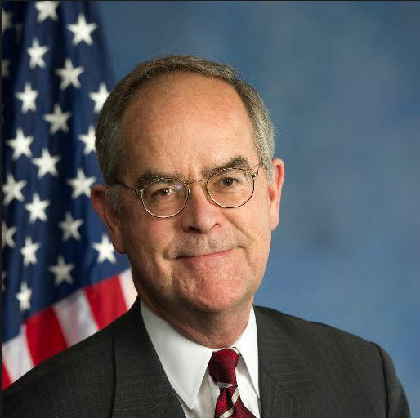
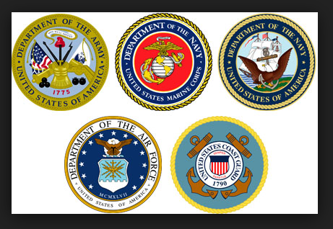
Davidson, Cheatham and Dickson counties

Slide 3
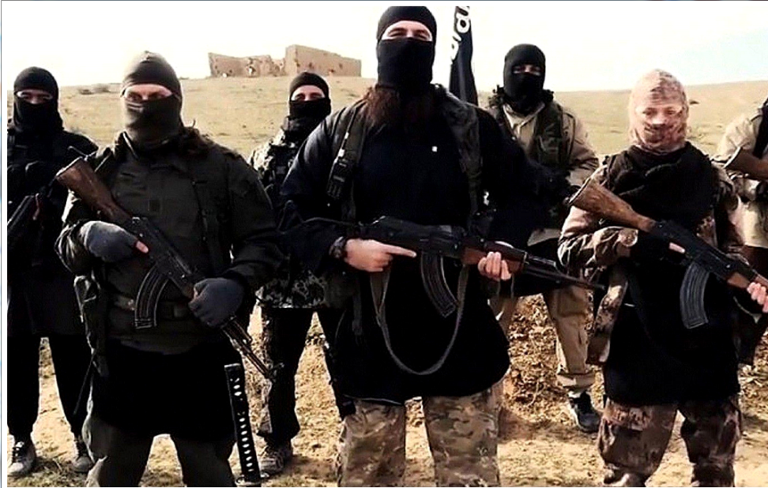
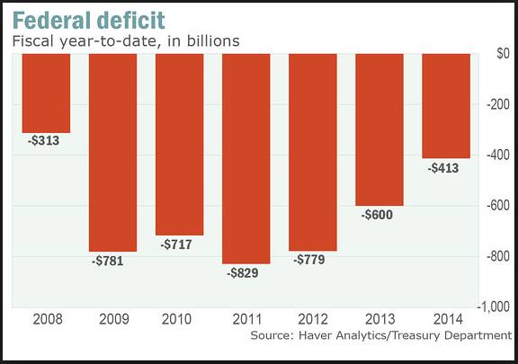
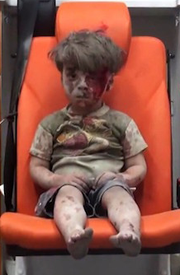
Solving problems

Slide 4
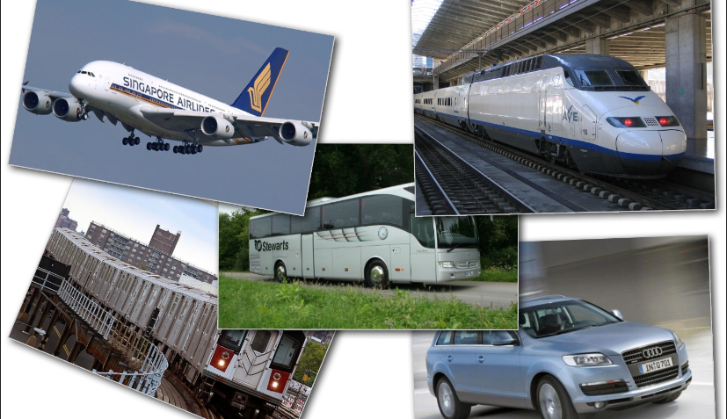
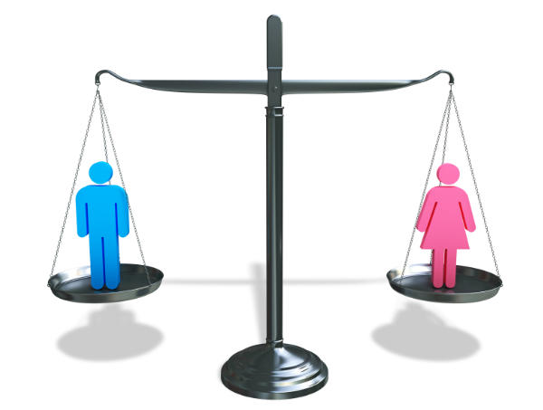
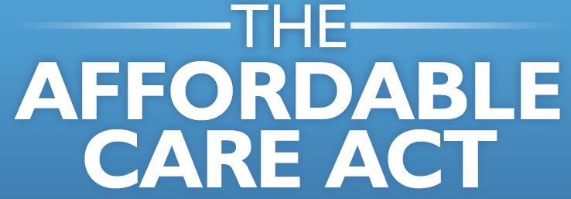
Growing, building our economy

Slide 5
31 transit systems in the US
Nashville is 25th largest city in the US & behind our peer cities
Most Middle TNs don’t have experience with transit.
New, young people love transit options

Slide 6
Transit = federal + state + local dollars
Current backlog of $86 billion in critical maintenance nationwide.
-- Metro in DC
-- L train in NYC
-- Boston’s Red Line

Slide 7
7. Urbanaphobia
-- Atlanta
-- Indianapolis
-- Nashville
Infrastructure NOT top of presidential campaign agendas, in part because both agree that we need more!
Federal funding flat; budget/deficit problems
Unity is required

Slide 8
Where we live in Tennessee

Slide 9
6,600,330
Nashville = 678,900
Memphis = 938,070
Knoxville = 451,330
Chattanooga = 354,100
TOTAL = 2,422,400
37% of the state is urban

Slide 11
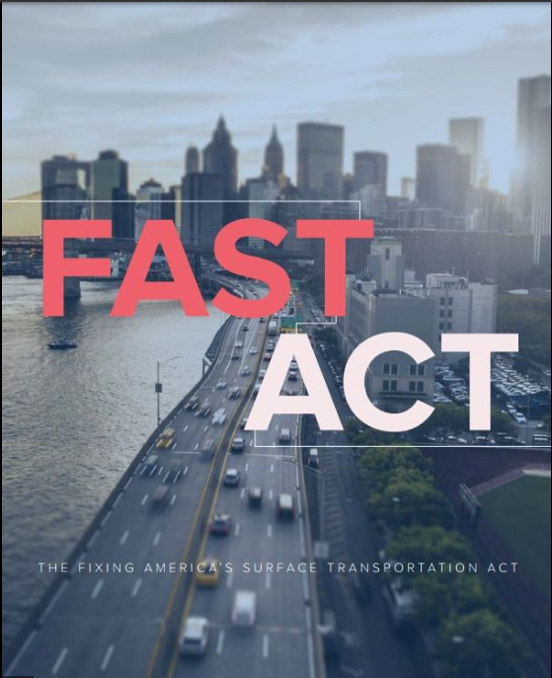

Slide 13
FAST Act Funding
$305 billion/5 years
Transit

Slide 14
“What is federal government? A giant insurance company that is $56 trillion in the hole, with a side business in defense.”
Peter Fisher, Department of Treasury official, President George W. Bush

Slide 16
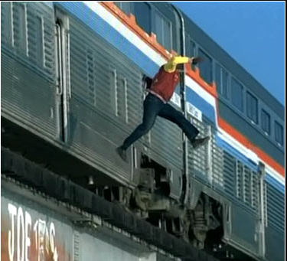

Slide 17
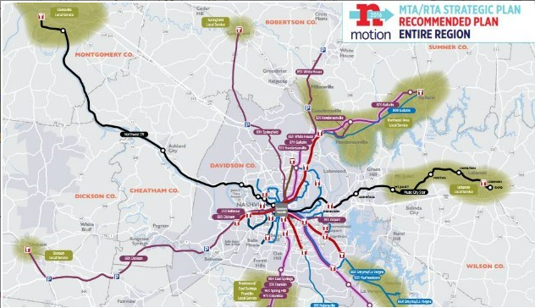

Slide 18
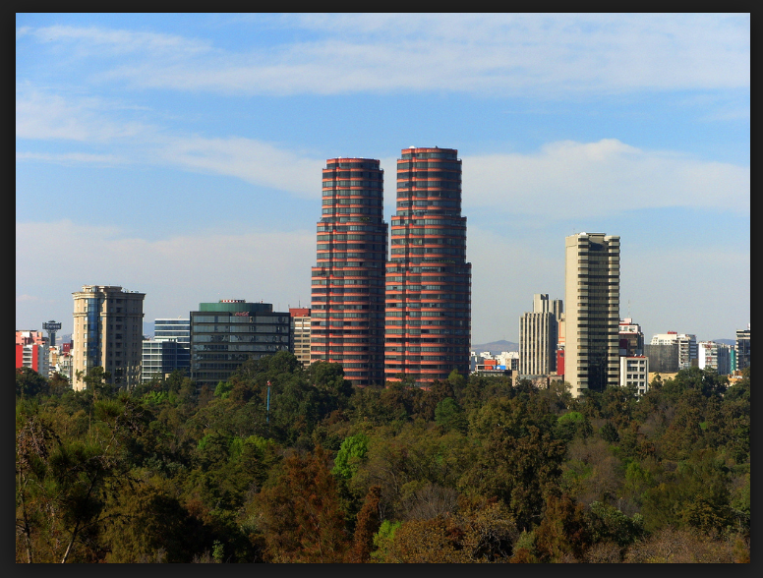

Slide 19
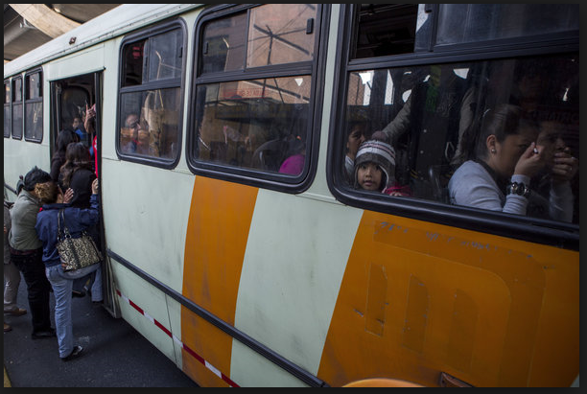

Slide 20
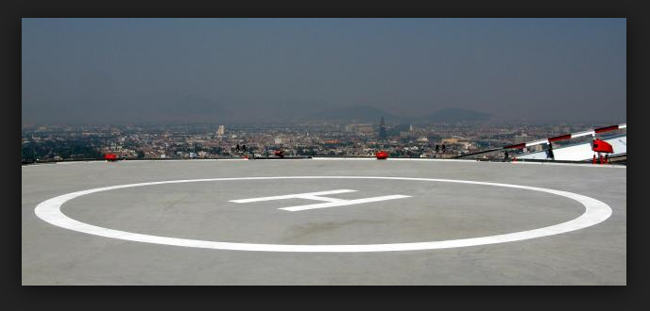

Slide 21
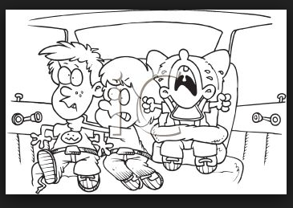

Slide 24
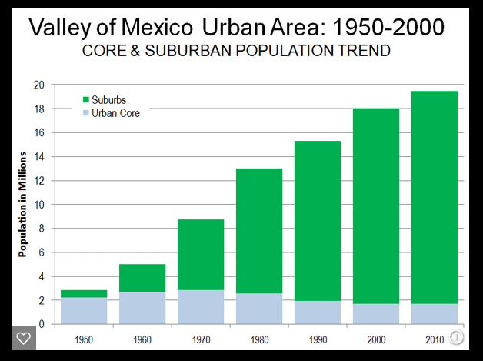

Slide 25
