Slide 2
What is the state of transportation in the Middle Tennessee area?
It needs attention
It needs to educate the public
It needs leaders who are willing to step out
It needs YOU as a voice

Slide 3
We have to understand the problem and look long term.
The Nashville Area MPO (Metropolitan Planning Organization) is designed to do that
Covers seven counties in Middle Tennessee
Davidson
Maury
Robertson
Rutherford
Sumner
Williamson
Wilson

Slide 4
The MPO
Plan
Fund
Study
Coordinate
The results are then given to TDOT to build, operate, and maintain.

Slide 5
The MPO
An MPO exists in every metro area with population over 50,000 people
The plans developed by the MPO provide the pathway for federal funding

Slide 6
What challenges are we facing personally?
Growing cross-county community patterns
Increasing cost of traffic congestion
Poor public transit access
Declining health in Tennessee related to physical inactivity

Slide 7
The Planning Process
The planning process puts out three plans you will hear more about if you stay in the transportation world
RTP- Regional Transportation Plan
Long range plan
TIP- Transportation Improvement Program
Short range plan
UPWP- Unified Planning Work Program

Slide 8
MPO Responsibilities
Monitoring the conditions of existing transportation network
Identify existing capacity or safety problems
Forecasting future population and employment growth
Evaluating the effects that future land use plans will have on transportation
Developing alternative growth scenarios to look into the future
Estimate the impact that an expanding transportation system will have on air quality
Developing a financial plan that identifies cost with the future expansion of the region’s transportation system

Slide 9
Individual Problems We Must Address
Pressures of population growth
Increasing density
Coordination with the land use, environmental and housing planning
Increasing freight traffic
Growing congestion and limited choices
Limited funding
Changing technology

Slide 10
We need to know who is growing and where…
2010 to 2040
2.5 Million Statewide
1.3 Million (52%) in the MIDDLE

Slide 11
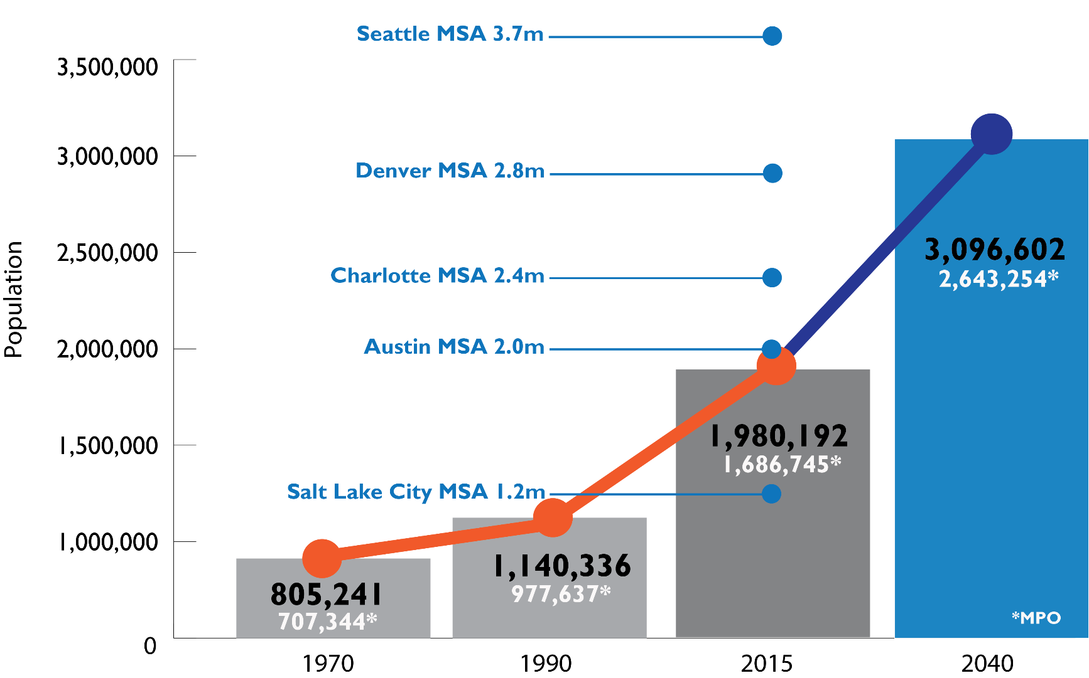
We understand that growth is real and we are surpassing other regions…

Slide 12
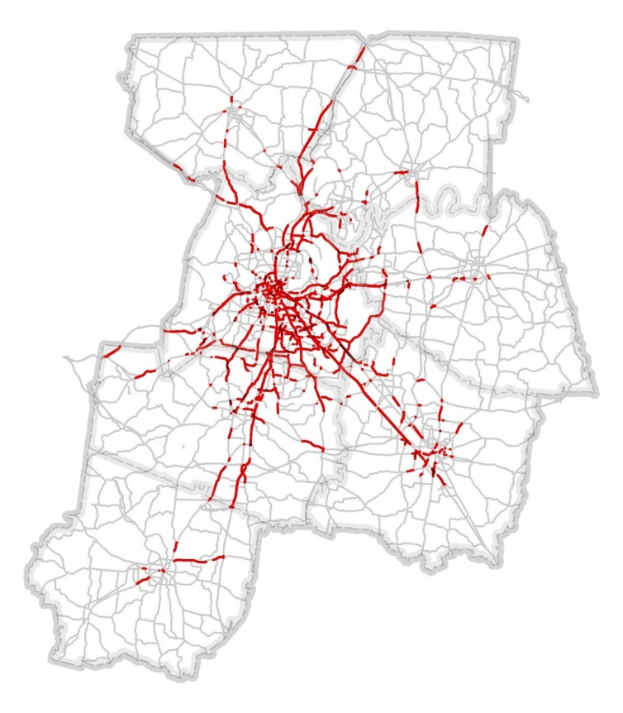
Congestion Projection
2015

Slide 13
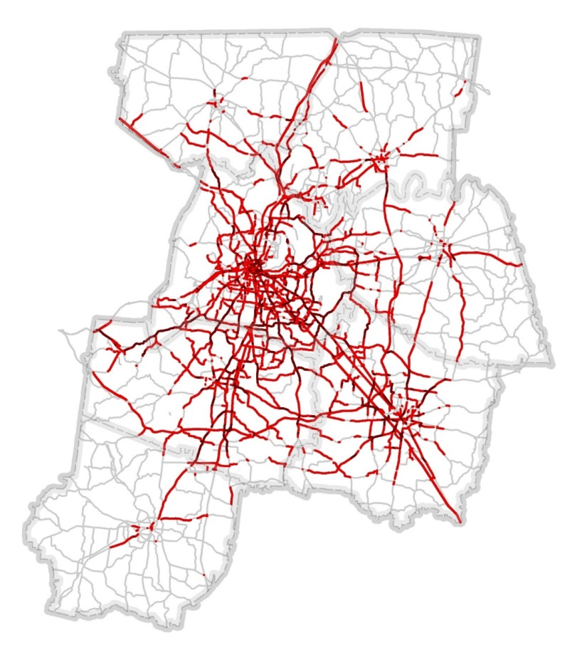
Congestion Projection
The amount of time we spend in our cars is expected to double by the year 2040.

Slide 14
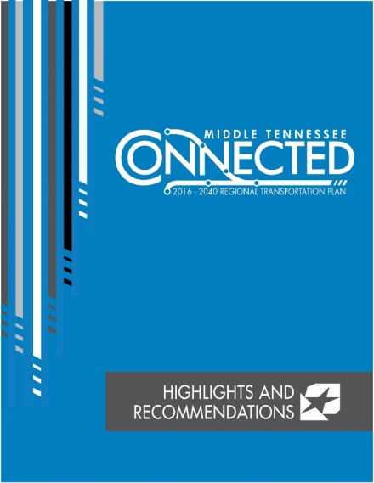
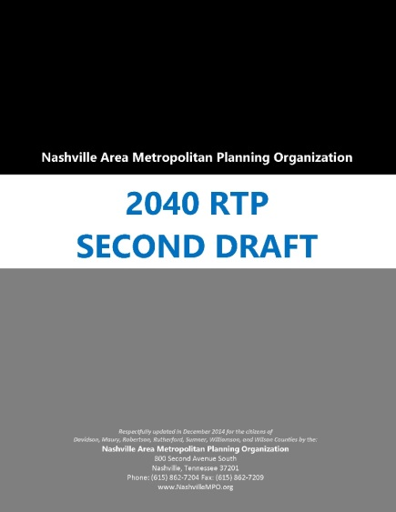
Problems and Solutions
Once we have identified the problem, we must have a solution in mind.
There are two documents out now that reflect a possible solution:

Slide 15
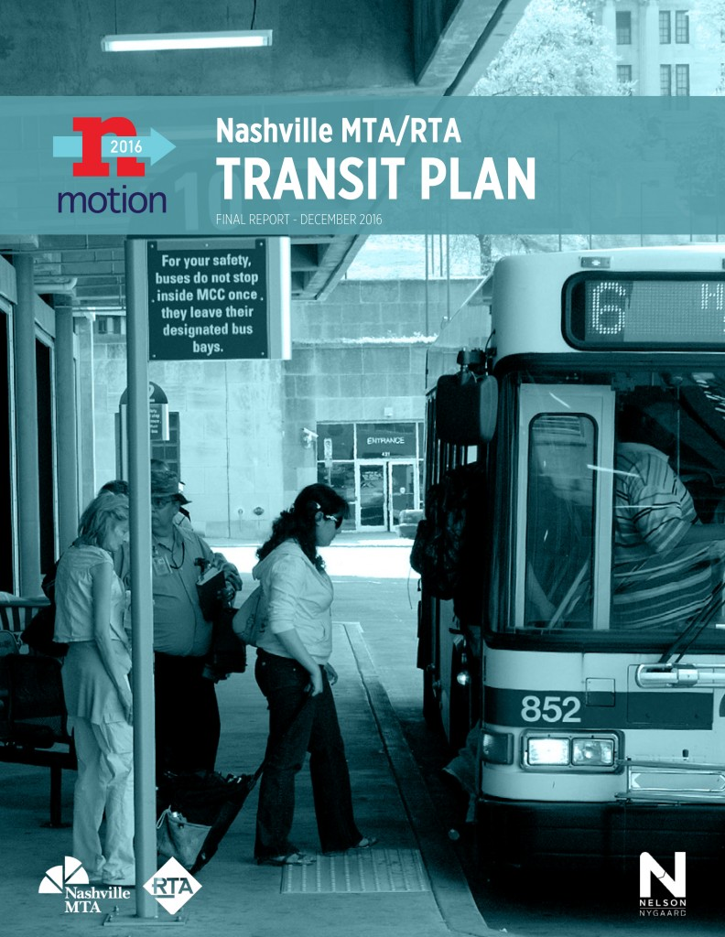
nMotion Plan

Slide 16
Estimated Cost
Based on 2016-2040 RTP
{
$8.5 Billion
80% Federal Funds
20% State and Local
$1.2 Billion Regional Fixed-Guideway Transit
$916 Million Local and Regional Transit Improvements
$206 Million Active Transportation Projects
$132 Million Technology Upgrades
$2.7 Billion U.S. Interstate Improvements
$396 Million Safety Improvements

Slide 17
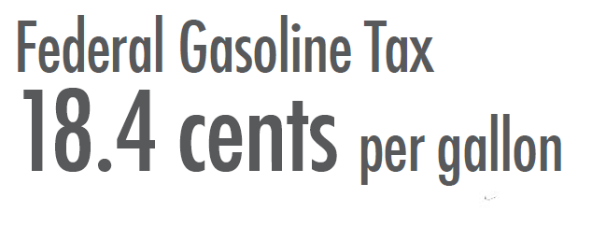
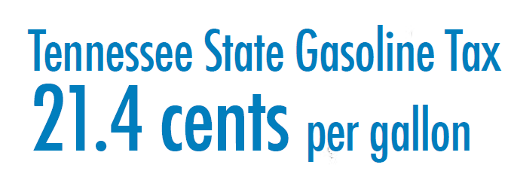
Transportation Funding
Middle Tennessee’s need for transportation dollars far outpaces available revenue by a margin of 4 to 1.
The IMPROVE Act will help, but the rest must kick in too. That’s where you and the local option opportunity to join in.

Slide 18
On the Horizon
Address funding shortfalls:
State level – Governor’s IMPROVE Act
Local level – Identify revenue source
Public referendum
nMotion implementation
Corridor level studies
Community education
Broad public support

Slide 19
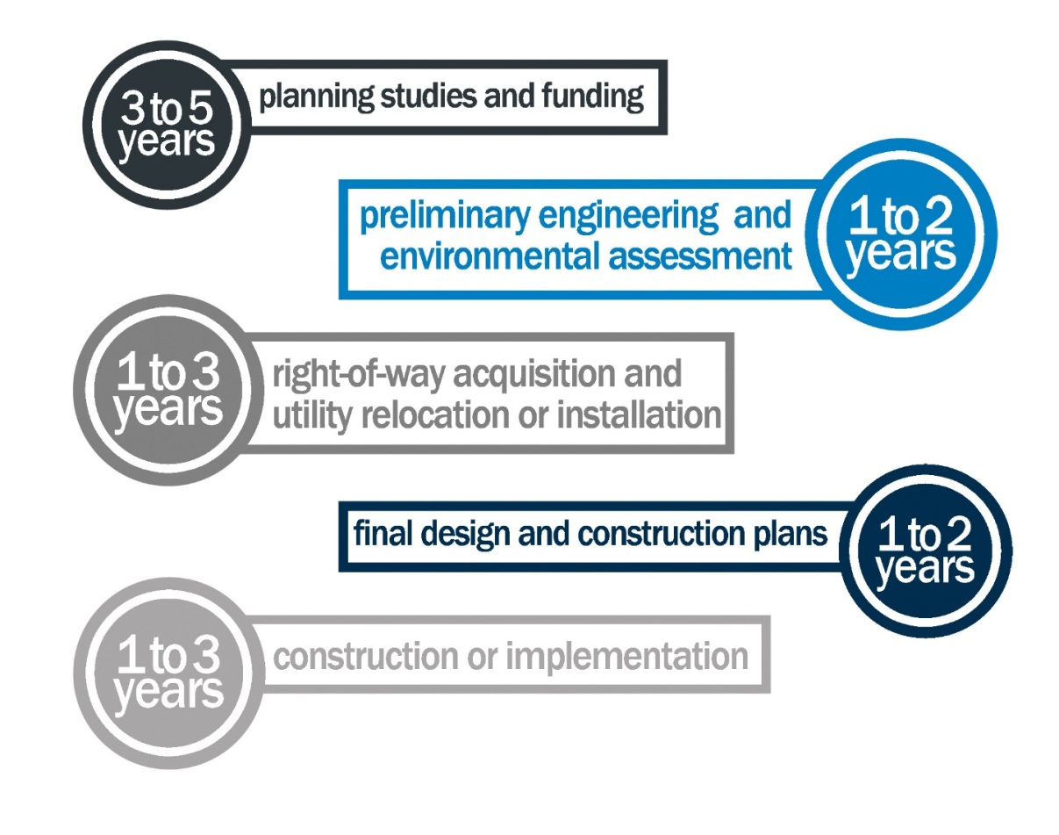
Project Development

Slide 20
What now?
The planning will take a while so we must start now

Slide 21
Mayor Barry’s transit referendum in Davidson County
May 2018
Transit Alliance
Help to get 30,000 signatures

Slide 22
Commute in and out of Wilson County
HOME |  | Work In
Wilson County |  | Davidson | 21,811
 |  | Rutherford | 3,209
 |  | Sumner | 1,041
 |  | Williamson | 1,573
HOME |  | Work In
Davidson | 4,227 | Wilson
Rutherford | 2,022
Sumner | 1,486
Williamson | 291

Slide 23
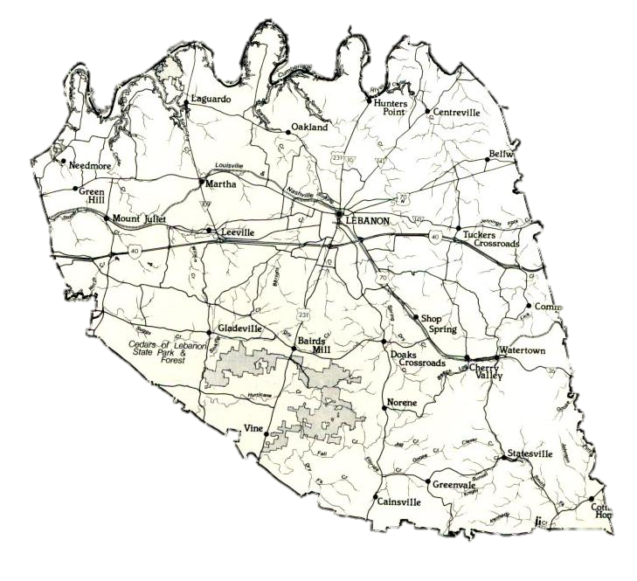
Overall Summary Wilson County

Slide 24
Q & A

Slide 25
Thank
You

