Slide 1

Transit Citizen
Leadership Academy:
Federal Perspective
Sabrina David, AICP
Federal Highway Administration – Tennessee Division
September 20, 2017

Slide 2

USDOT
Office of the Secretary
National Highway Traffic Safety Administration
Federal Aviation Administration
Office of Inspector General
Federal Highway Administration
Pipeline and Hazardous Materials Safety Administration
Federal Motor Carrier Safety Administration
Federal Railroad Administration
Saint Lawrence Seaway Development Corporation
Federal Transit Administration
Surface Transportation Board
Maritime Administration

Slide 3
USDOT
Office of the Secretary
National Highway Traffic Safety Administration
Federal Aviation Administration
Office of Inspector General
Federal Highway Administration
Pipeline and Hazardous Materials Safety Administration
Federal Motor Carrier Safety Administration
Federal Railroad Administration
Saint Lawrence Seaway Development Corporation
Federal Transit Administration
Surface Transportation Board
Maritime Administration

Slide 4
USDOT
Office of the Secretary
National Highway Traffic Safety Administration
Federal Aviation Administration
Office of Inspector General
Federal Highway Administration
Pipeline and Hazardous Materials Safety Administration
Federal Motor Carrier Safety Administration
Federal Railroad Administration
Saint Lawrence Seaway Development Corporation
Federal Transit Administration
Surface Transportation Board
Maritime Administration

Slide 5
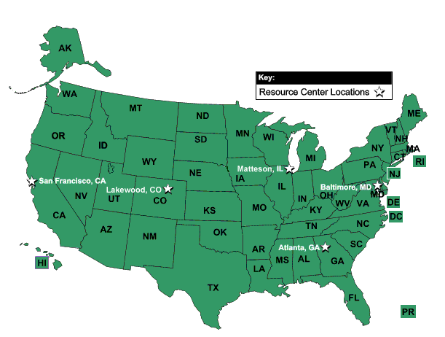
Federal Highway Administration Offices

Slide 6
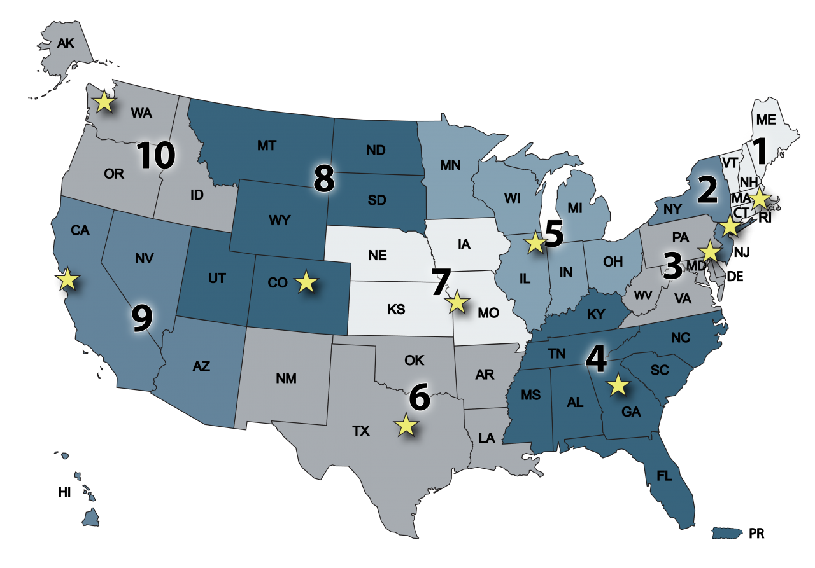
Federal Transit Administration Regions

Slide 7
Federal Transit Administration Regions

Slide 8
FHWA: Federally Assisted, State Administered
Federal Responsibilities
Review and approve State proposals
Develop regulations and guidance
Create and approve design standards
Provide technical assistance
Distribute funds
Reimburse States their eligible expenses
State and Local Responsibilities
Select projects for development
Plan, design, initiate and construct projects
Maintain and operate highways

Slide 9
FHWA: Federally Assisted, State Administered
Federal Responsibilities
Review and approve State proposals
Develop regulations and guidance
Create and approve design standards
Provide technical assistance
Distribute funds
Reimburse States their eligible expenses
State and Local Responsibilities
Select projects for development
Plan, design, initiate and construct projects
Maintain and operate highways

Slide 10

Federal/State Partnership
FHWA direct relationship with TDOT
All Federal funds flow through TDOT
If TDOT passes on Federal $$ to MPOs or Local Agencies, TDOT has statutory obligation to ensure Federal and State requirements are satisfied
TDOT is the recipient and Local Agency is subrecipient
Federal Aid Highway Program is a reimbursable program

Slide 11

Federal Gasoline Tax
0.1 cent
18.4 cents
L.U.S.T. Trust Fund
15.44 cents
2.86 cents
Highway Account
Mass Transit Account
Effective October 1, 1993
Notes:
The last change to the gas tax rate was effective October 1, 1993.

Slide 12
Federal Diesel Tax
0.1 cent
24.4 cents
L.U.S.T. Trust Fund
21.44 cents
2.86 cents
Highway Account
Mass Transit Account
Effective October 1, 1993
Notes:
Note that the diesel tax is 6 cents higher than the gasoline tax.
The entire 6-cent differential goes to the Highway Account of the HTF in recognition of the fact that large trucks—the primary users of diesel—require stronger pavement and structure design.

Slide 13
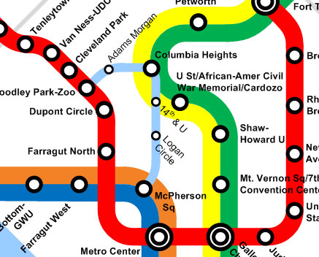
Flexible Funding: FHWA to FTA
TDOT requests FHWA to transfer highway funds to FTA
Eligible Projects, for instance:
  new transit service
  purchasing of new transit vehicles
  bicycle and pedestrian facilities
  bike storage/share programs
  park and ride
  bus stops
  multimodal transfer centers

Slide 14
Fund Transfers to FTA
FY 2017
Agency | Chattanooga | Knoxville | Memphis | Nashville
Federal Funds | $598,560.00 | $2,259,906.40 | $5,304,000.00 | $4,160,623.00
Total Statewide: $12,323,089.40

Slide 15
Thoughts for You Today and Moving Forward
Think Regionally
  You have some. I have some. Together we have a lot.
  We are attracting employers, employees and improving quality of life.
Be Ready
  You never know when funding will become available.
  Projects and plans with political support and matching funds will be in a much better position to move forward.
Projects waiting for money,
not money waiting for projects.

Slide 16
Questions and Contact Info
Sabrina David, AICP
Sabrina.David@dot.gov
615-781-5770

