Slide 1
National Association Railroad Passengers
Transit Alliance of Middle TN
Academy 9/27/17

Slide 2
National Association of Railroad Passengers (NARP)
Started in 1967
28,000 members and 135 member Council
Represent the American passenger
Full time staff in DC
Non-profit educational organization
Our goals: more capacity, routes, frequency, and consistent funding. Safety is very important.

Slide 3
History
1920: Railroads: 1.2 million riders, 9,000 inter-city trains every day
The steam engine
Pullman Co: 100,000 people/night
Nashville RR’s: L&N, NC&SL,TC
Atlanta, Chicago, Cincinnati, Knoxville Miami, New Orleans, New York, St; Louis,

Slide 4
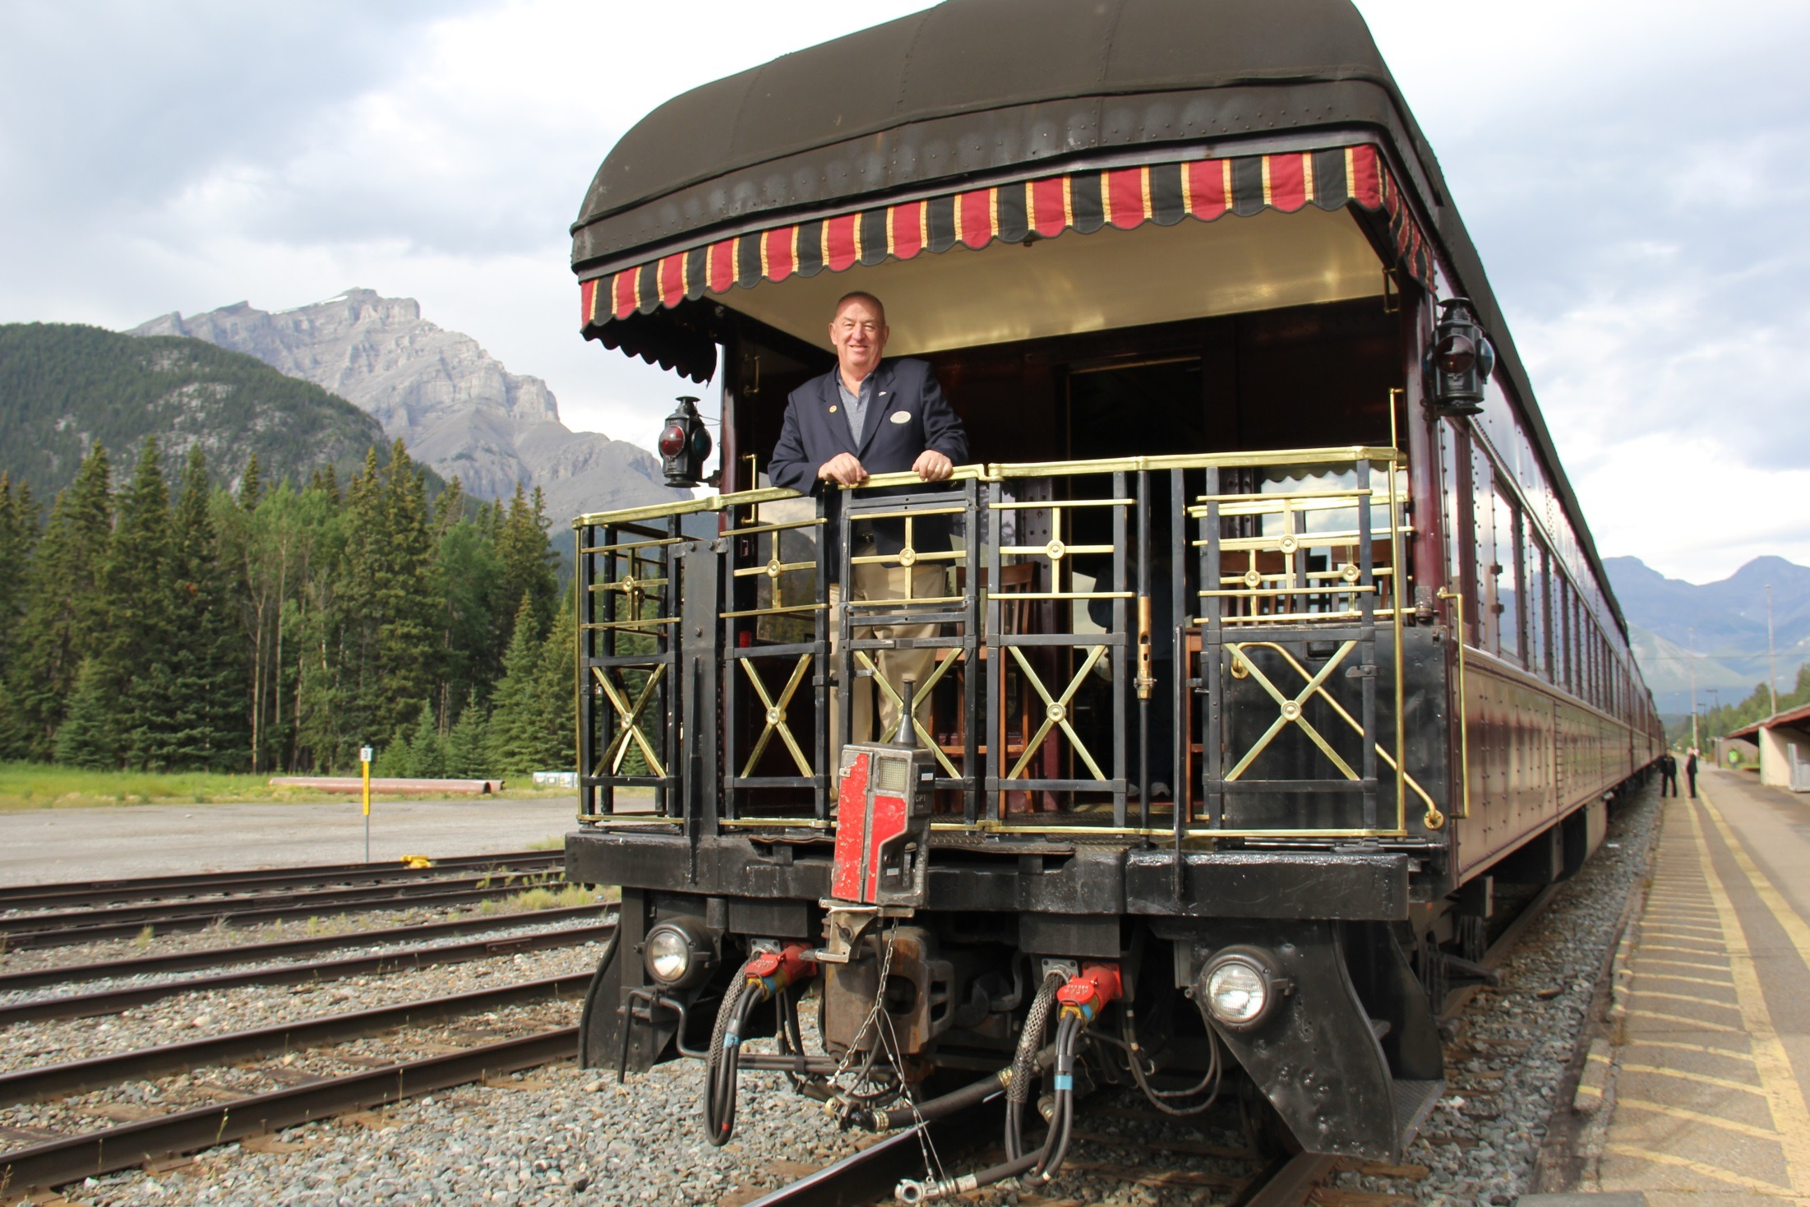

Slide 5
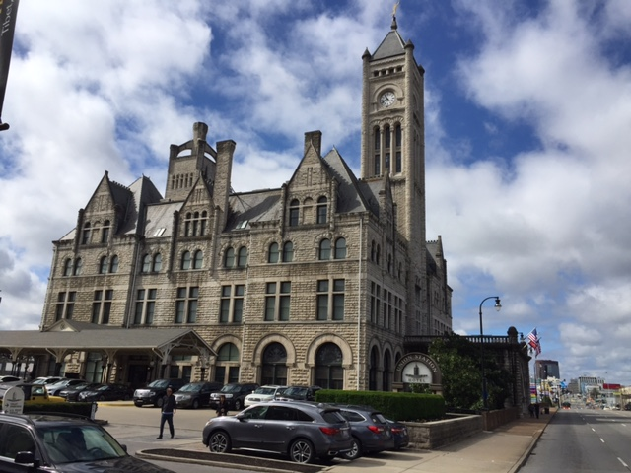

Slide 6
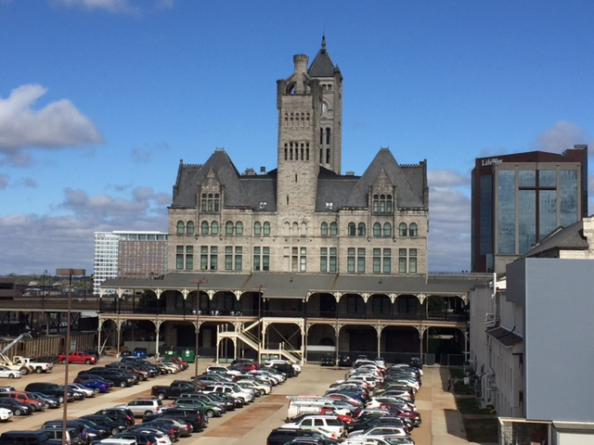

Slide 7
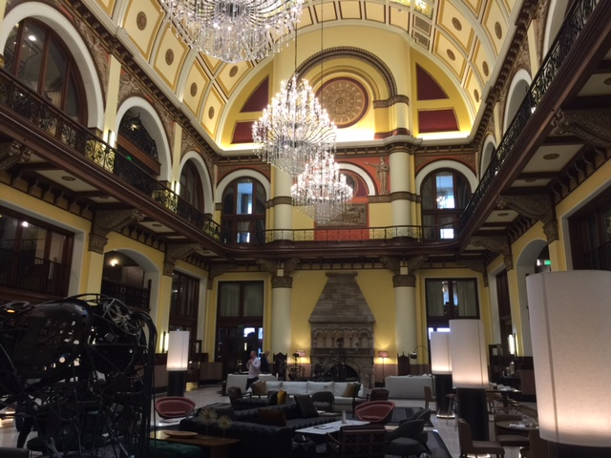

Slide 8
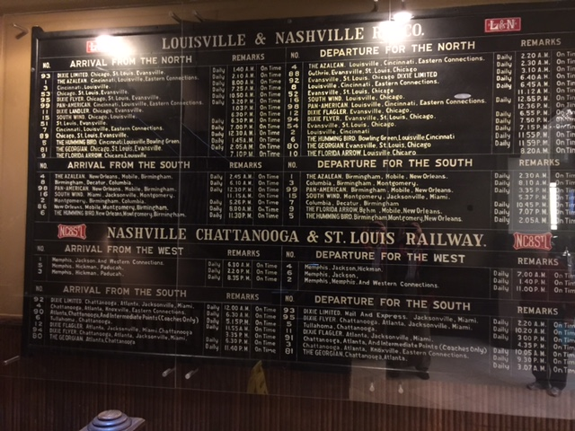

Slide 9
History
WWI and II: RR’s served the country well
Post WWII –streamliners & diesels
1950-1970—Ike and freight RR’s
1980 Staggers Act

Slide 10
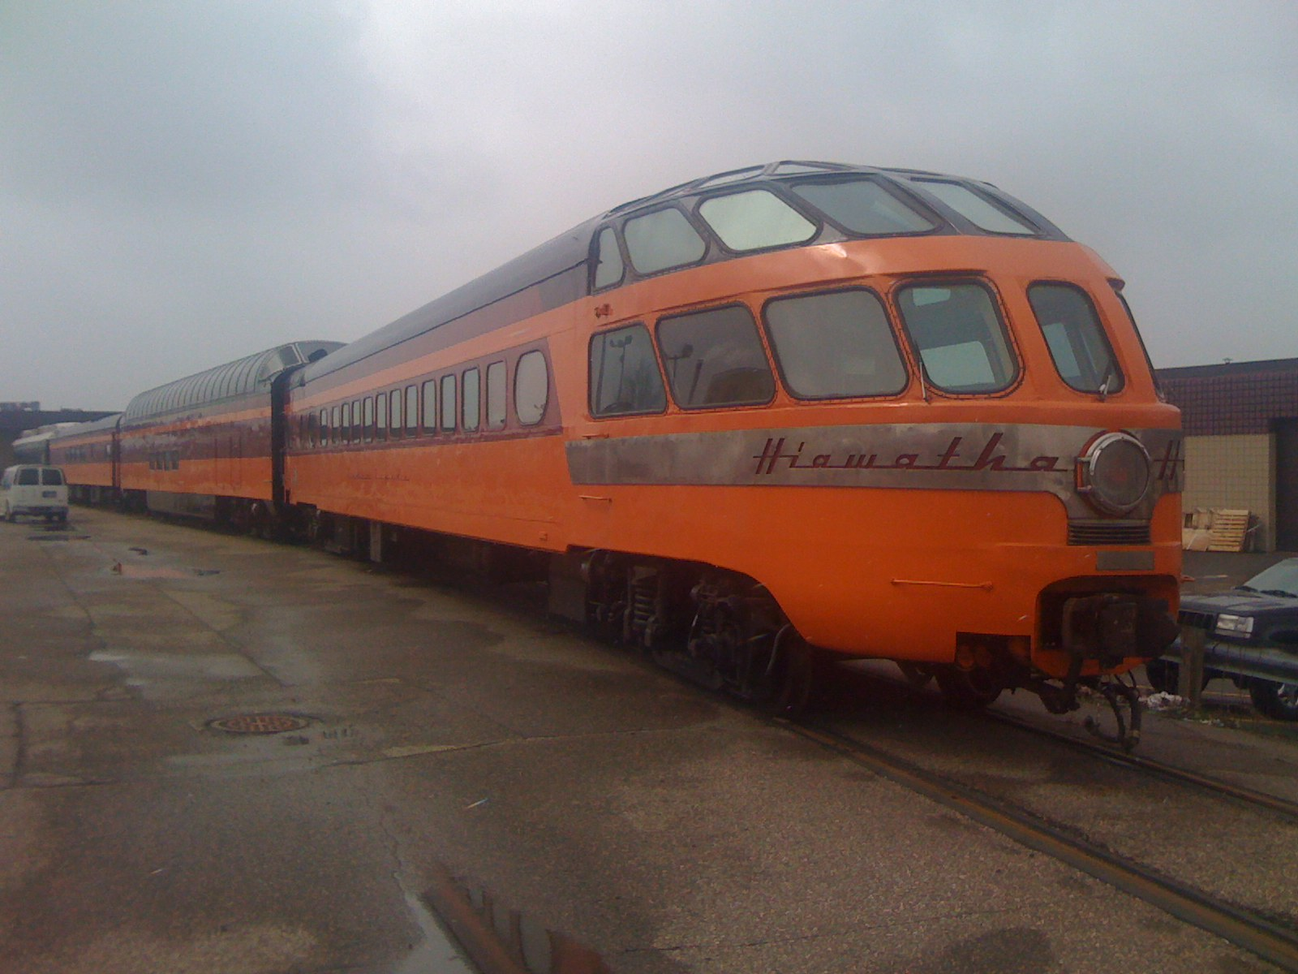

Slide 11
Airlines
AT&SF RR: Santa Fe Skyway airline
1978 Deregulation & Mergers: American, Delta, Southwest & ,United: control 80% of the market
Cinci., Cleve. & Memphis, St. Louis:-23-49%
Airline subsidy: $15 billion/year
Airlines pulling out of 400 mile or less markets
Shortage of pilots--$22,000/year, license:$125,000

Slide 12
HIGHWAYS
65 Million vehicles-1957 , 400 million by 2055
By 2020, 90% of urban interstates will be at or exceeding capacity
100 million more people in the US by 2050
$365 Billion—cost of accidents & congestion
40,000 killed in 2016—Boeing 737-every 28 hr
Cost to Society $382 Billion a year

Slide 13
CITY BUSES
Fares cover 33% of cost
Cities have cut back routes & schedules
due to budget cuts
Ridership is down due to less routes, schedules, fares, Uber, work at home, Millennials living near work offices in cities.
BRT-Not very successful

Slide 14
Europe
Major airports connected by rail
Rail lines connected to light rail lines
Light rail lines connected to streetcars
All connected by buses
Density of France = Ohio
TGV started in 1980, 37 yrs old!!

Slide 15
Long Distance Trains- A foundation for National Mobility
Must compete with freight traffic ex. NE
LD trains use: 3X faster than pop. Growth,
Goal: capacity, frequencies, gaps, tracks
15 routes and 43% of passenger miles
173 million-within 25 mi.-Amtk LD station
Sleepers: 17% of riders, 44% of revenue

Slide 16
Amtrak

Slide 17
Amtrak
Formed in 1971 by Congress—for profit
Railroads—turned over passenger service Agreed to give Amtrak priority
Nixon goal: shut it down but would not die
Never enough money
People rode the trains
Covering 94% operating cost

Slide 18
Trains
Amtrak: 32 million riders in 2016
LD trains: 43% of passenger miles
SW Chief: 92% riders—528 city pairs
Successes: NE Corridor, NW, CA: San Diego-LA,SAC-San Jose, LA region, IL
Why; Less energy, pollution, deaths, accidents, health, cost, space, security
Quality of Life,Mobility

Slide 19
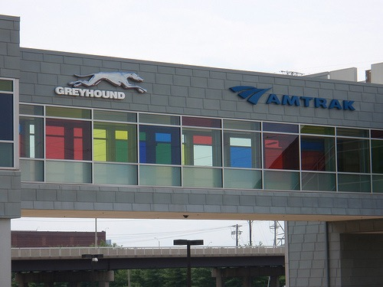
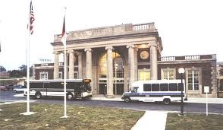
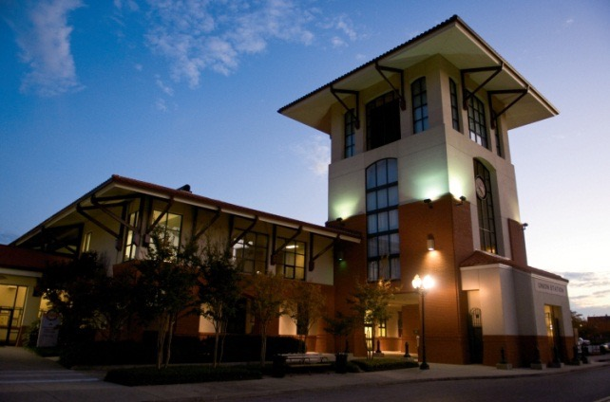
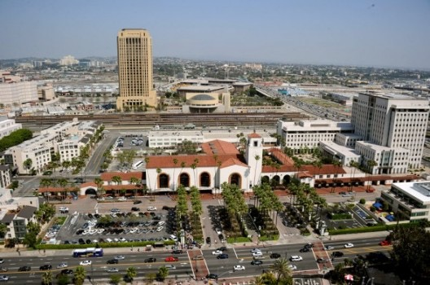
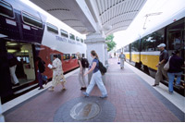
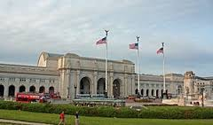
Train stations as travel hubs
Greensboro, NC Galyon Depot
(Amtrak, Greyhound, city & regional buses)
Meridian, MS Union Station
(Amtrak, Greyhound, city buses)
St. Louis Gateway Station
(Amtrak, Greyhound, MetroLink light rail)
Los Angeles Union Station
(Amtrak, Thruway buses, Metrolink commuter rail, Metro subway & light rail, many Metro bus routes, Megabus)
Dallas Union Station
(Amtrak, DART and TRE)
Washington Union Station
(Amtrak, commuter rail, intercity & local buses,
Metrorail, tour buses)

Slide 20
Serving our Populatiotn
Among the cities currently not served by intercity passenger rail: 1. Columbus, OH; 2. Nashville,3. Las Vegas, Madison, WI , Mobile, AL; Louisville, KY
NASHVILLE—lost service in 1979
Closest service: Memphis, Atlanta, & Birmingham

Slide 21
Serving our Population
Poll—Harris released January 2011 shows over 2/3 of Americans support federal and state funding for high/higher-speed rail. Conference of Mayors poll: 85%
Ridership: Washington-Lynchburg 126,000—2009,, 183,000 last year and still growing.
Keystones: Pgh-Phl 2013:1.5 million riders
Downeaster: 536,000 riders-2013 vs.338,000 in 2006

Slide 22
Subsidies
Airlines: $15 Billion/year
FAA, small airports, grants,
Highways: $65 Billion/year
Taxes & tolls: 52%
Amtrak: $1.3 Billion/year
Operating subsidy: $400 million

Slide 23
Mass Transit
Portland-light rail, streetcar, commuter
Denver-light rail, new airport, line
Dallas-light rail, new airport line
Los Angeles-light rail,commuter, subway
Charlotte-light rail
DC Metro subway: 800,000/day

Slide 24
Mass Transit
One rail=8 lane highway
Dallas:Value Added Tax
LA: renting buildings
NYC:additional wage & prop. taxes
Pay for with gas tax
Pay for with federal funds

Slide 25
Mass Transit—Pay for it??
Federal Government grants
Local gas tax
Local sales tax
Value added tax
Real estate income
State investment

Slide 26
Nashville & Region Population
City: 660,000
Region: 1,828,000 in 2017
Region growth: by100 more people every day
1 million more people by 2044
How do we move them around??

Slide 27
Solutions??
Amtrak-dedicated long term funding
Amtrak-funds for truly national system
National long term transportation plan
Congress-stop politics and micro-manage
Nashville-stop studying & start doing
Contact: Congress, Governor, Mayor, etc

Slide 28
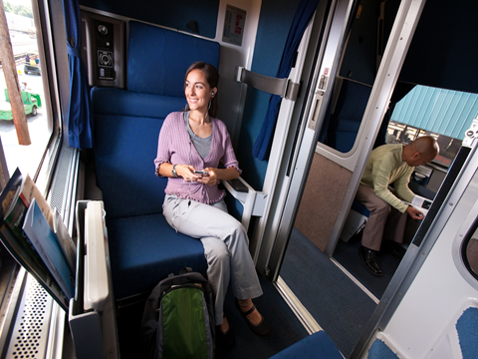

Slide 29
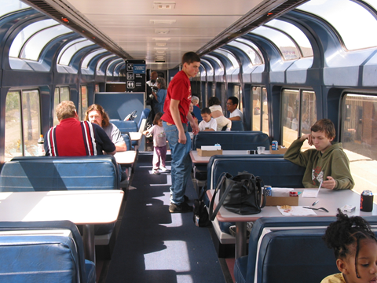

Slide 30
