Slide 1
Supportive Infrastructure: Transit and Active Transportation
Daniel McDonell
Policy and Education Manager

Slide 2
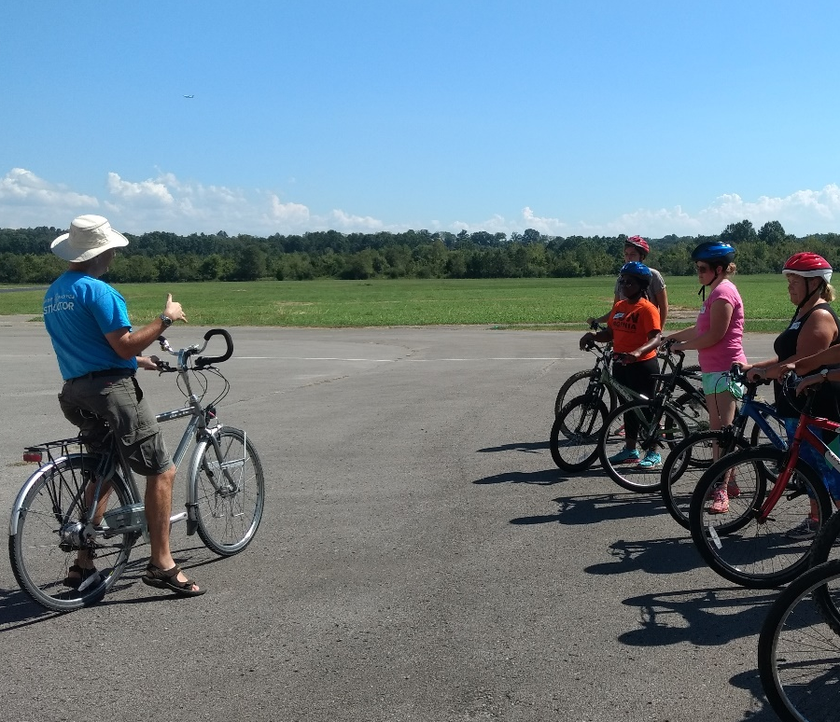
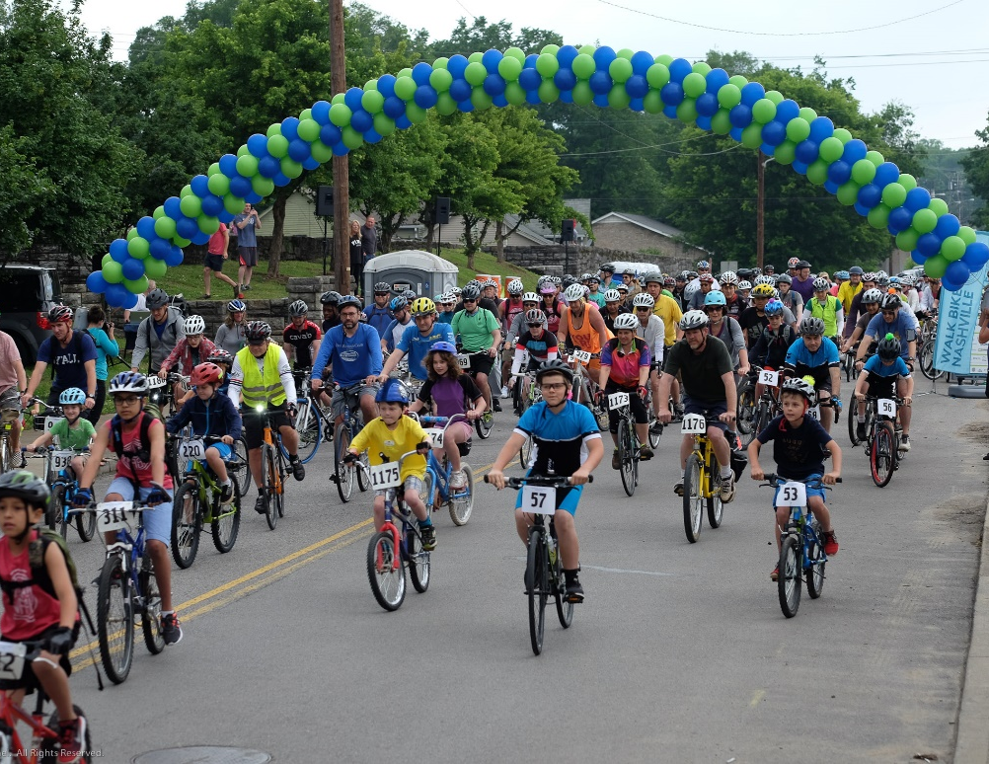
Working for a more walkable, bikeable and livable Nashville.
EDUCATE
ENGAGE
ADVOCATE

Slide 3
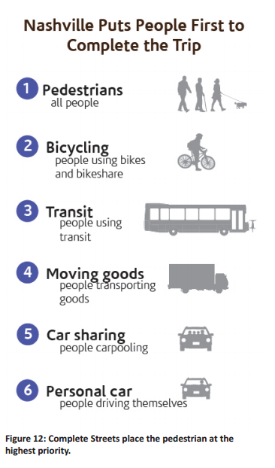
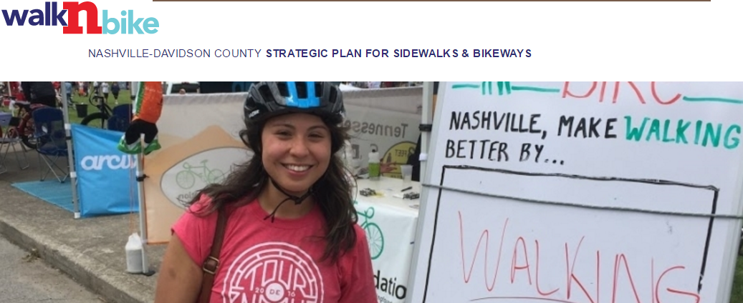
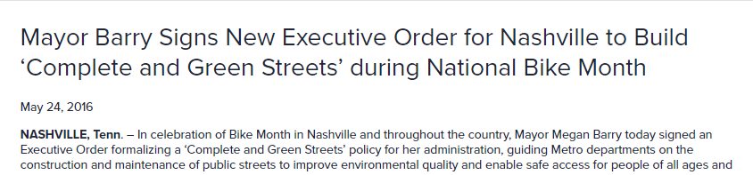
Street Priorities – The Aspiration

Slide 4
Street Priorities – The Reality
Nashville Metro/Davidson County 2012-2016

Slide 5
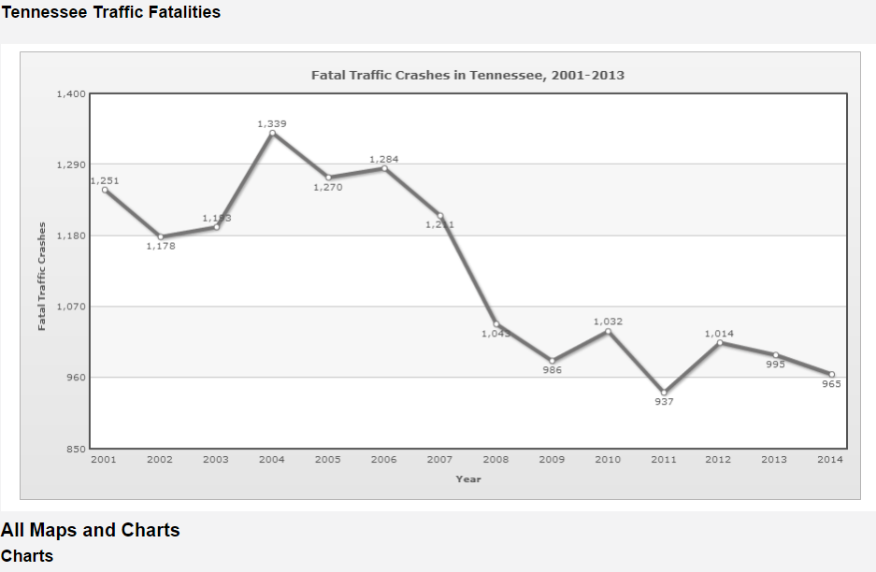
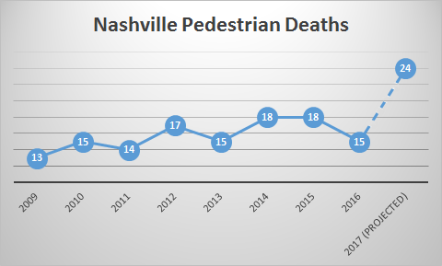
Crash Statistics

Slide 6
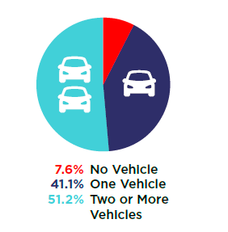
Transportation Equity
Almost 20,000 people in Nashville do not have access to a car
100,000 households only have one car available
Non-car owners are over represented in pedestrian crashes
Elderly and minority populations are over-represented in pedestrian crash victims
Only 19% of streets have sidewalks

Slide 7
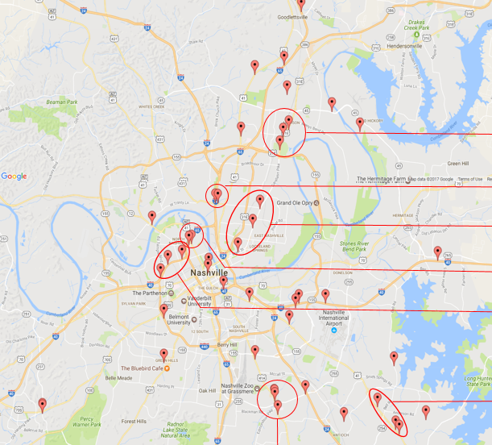
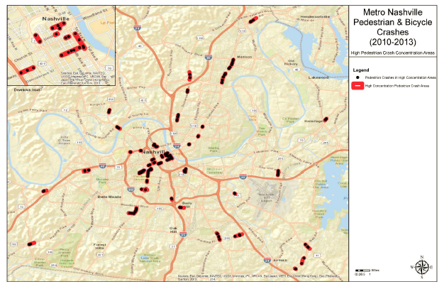
Where Crashes Occur
2014 Pedestrian and Bike Safety Study
Fatal Crashes 2012-2016, from TITAN by THSO
83% of Pedestrian Fatalities are on state-controlled (TDOT) roads

Slide 8
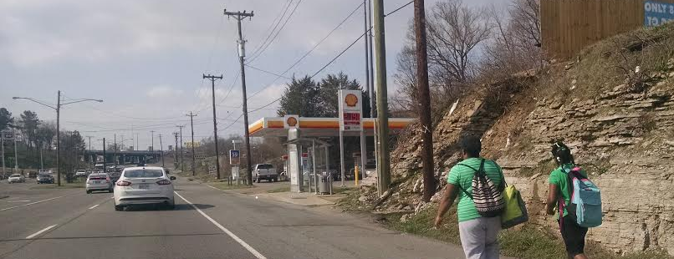
Street Priorities – Dangerous by Design
Notes:
Streets are public space.
Of the property that is owned by the Public. A MAJORITY is public streets.
How are we using our Public Space???

Slide 9
Street Priorities – The Reality

Slide 10
Safe Infrastructure

Slide 11
Transit Accessibility Frameworks

Slide 12
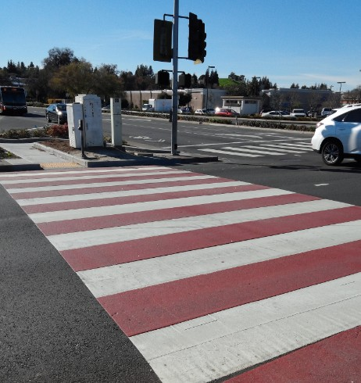
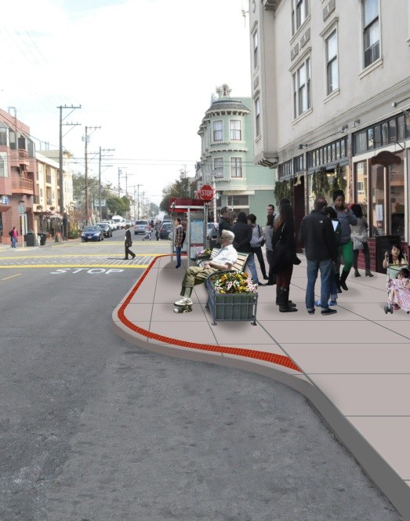
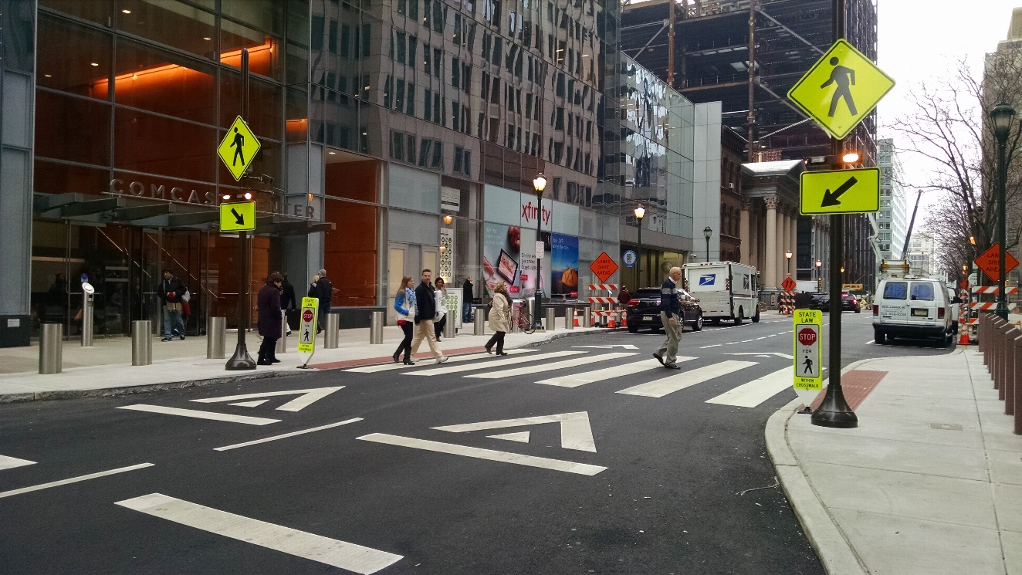
Crossings
Bulb Outs
Leading Ped Intervals
High Vis Crosswalks
Mid-Block crossings

Slide 13
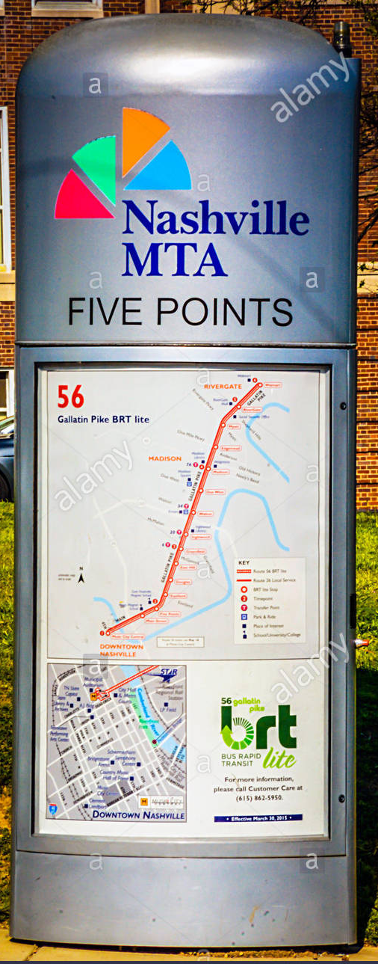
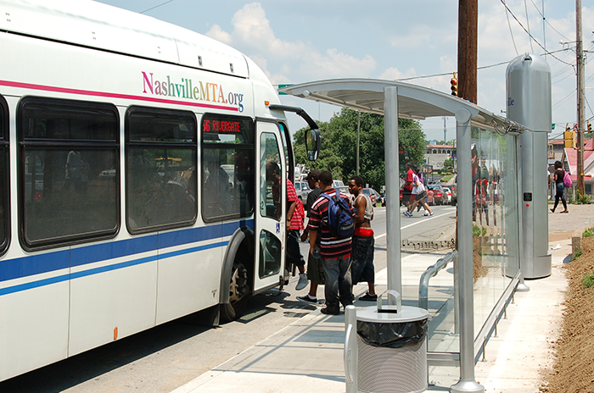
Bus Stops
Shade
Near crossings
Shelters
Trash cans
Bike racks
Wayfinding

Slide 14
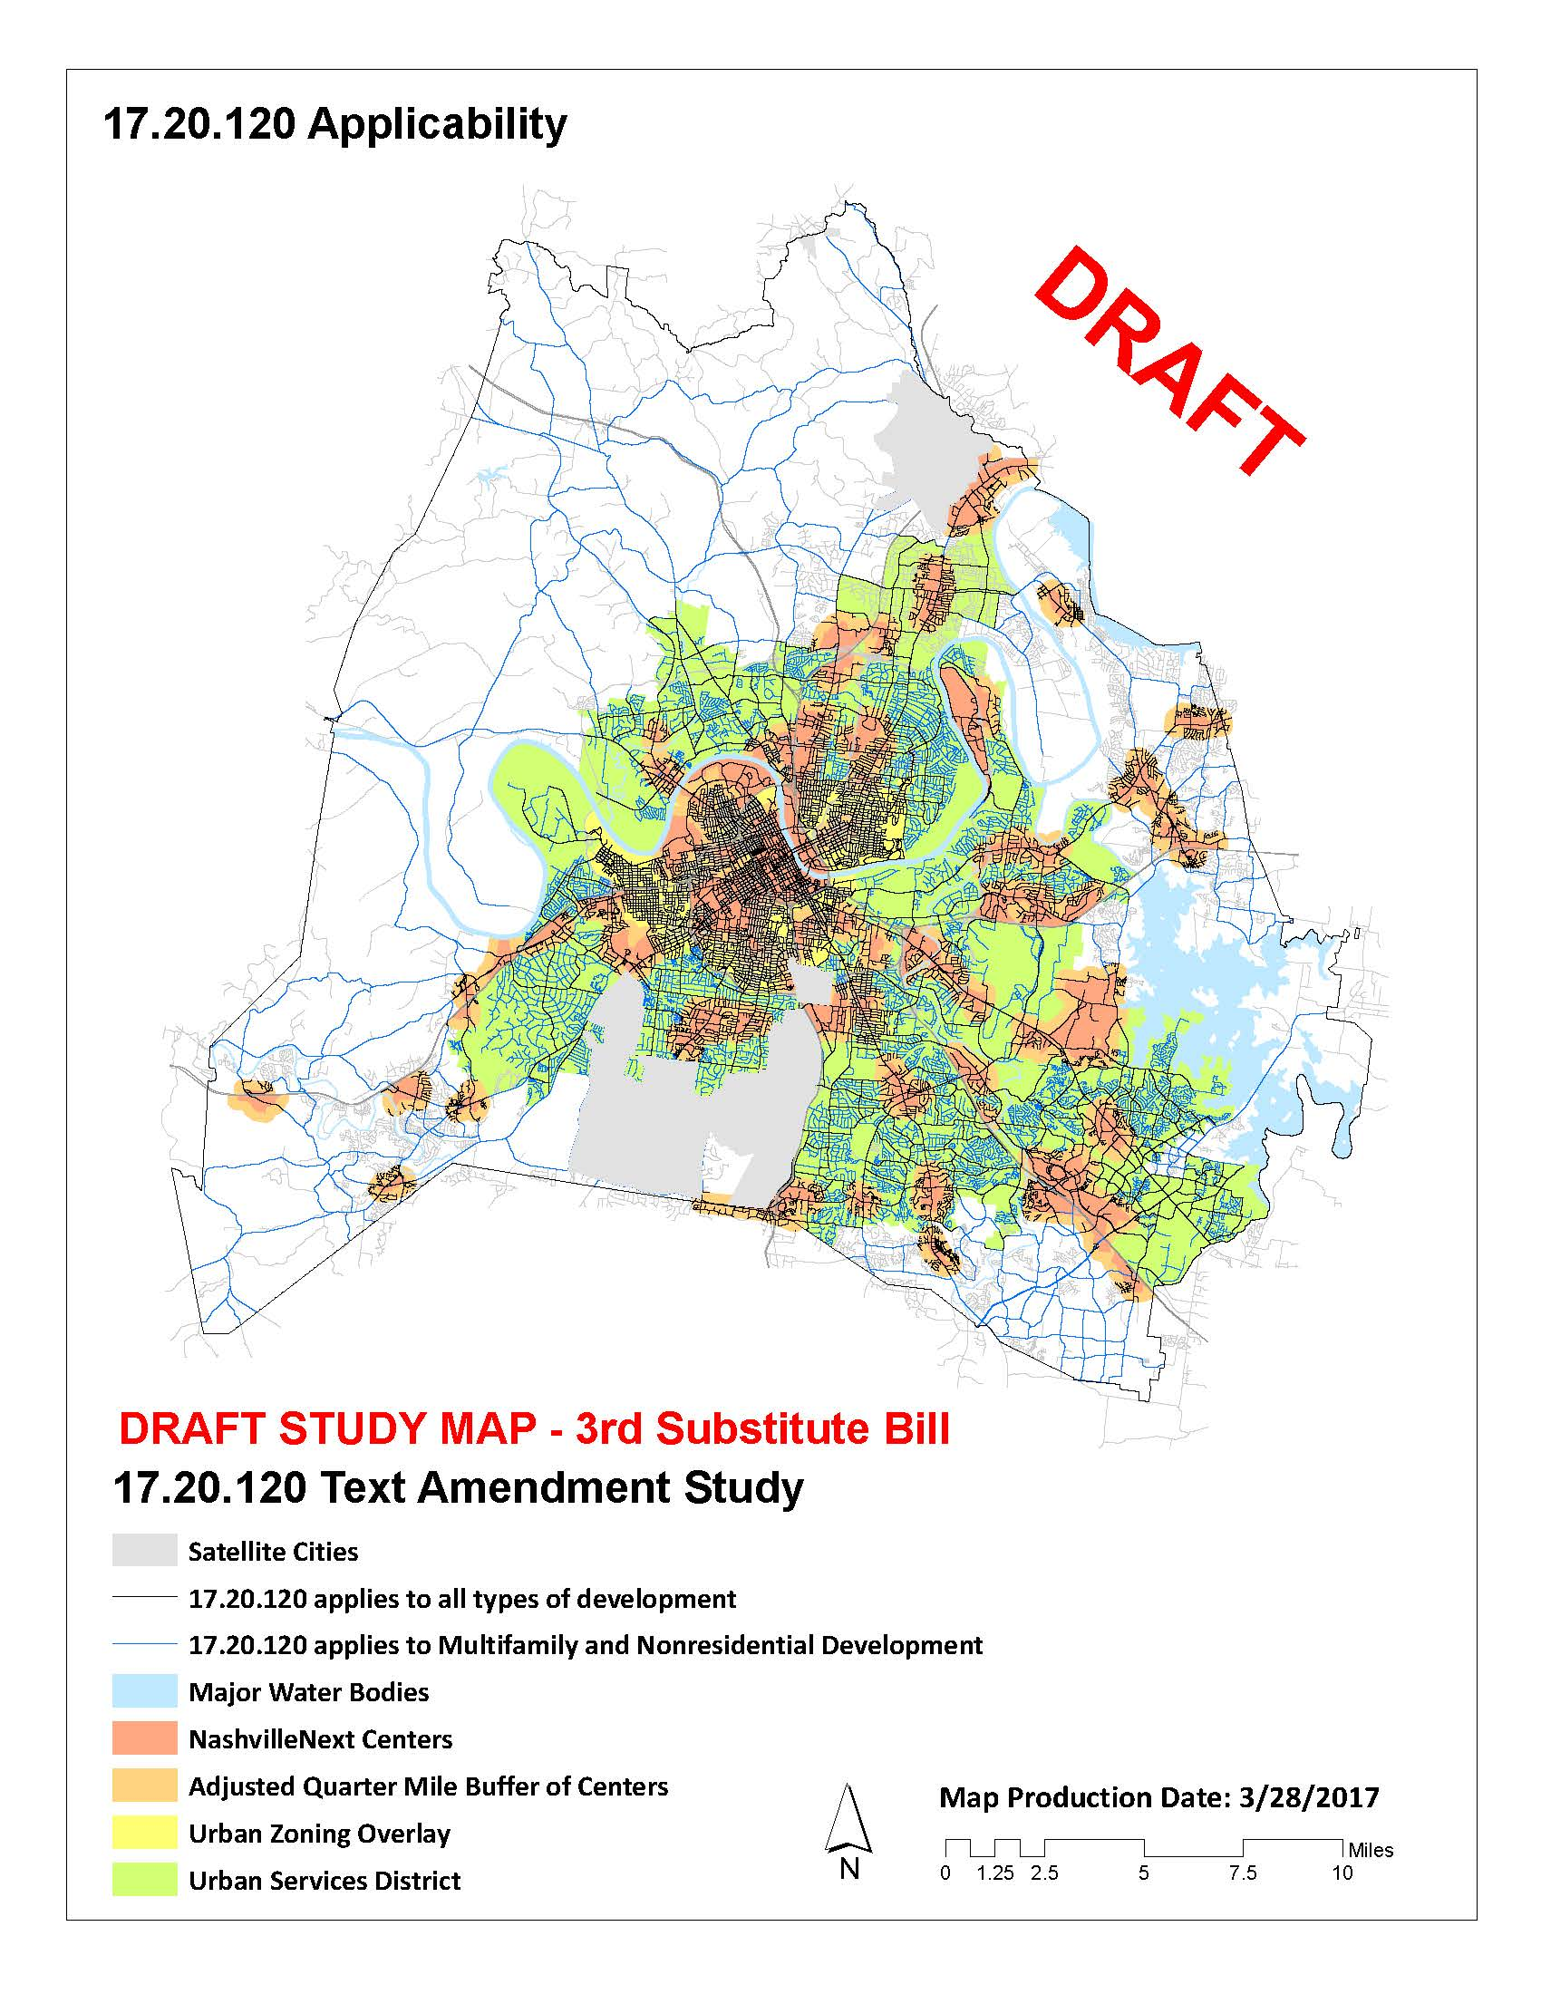
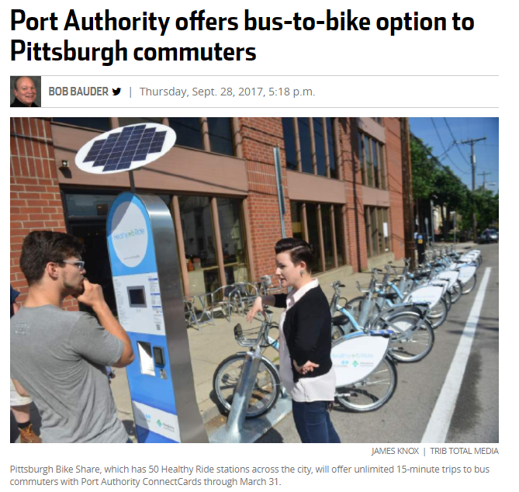
Network Connections
Sidewalks Bike Lanes
Greenways Bike Share

Slide 15
Initiatives

Slide 16
City Initiatives
Vision Zero
Complete Streets
nMotion
NashvilleNext
WalknBike Strategic Plan
Plan to Play
Transit Referendum
Traffic Calming / Neighborways

Slide 17
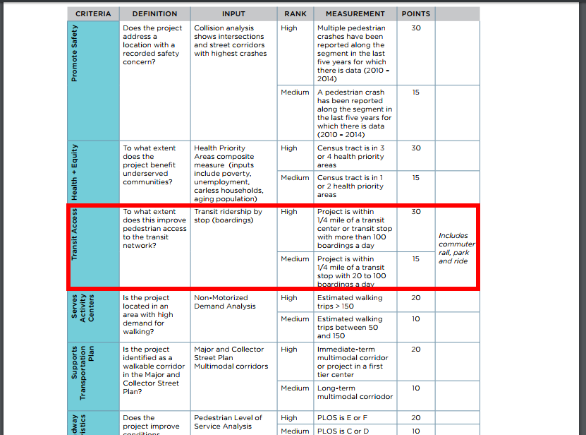
WalknBike Strategic Plan

Slide 18
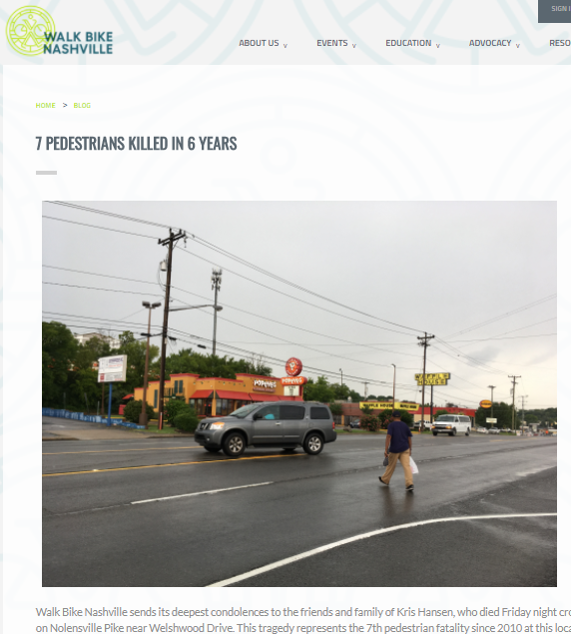
Livable Streets Project - Nolensville

Slide 19
Supportive Infrastructure: Transit and Active Transportation
Amy Crownover
Executive Director

Slide 20
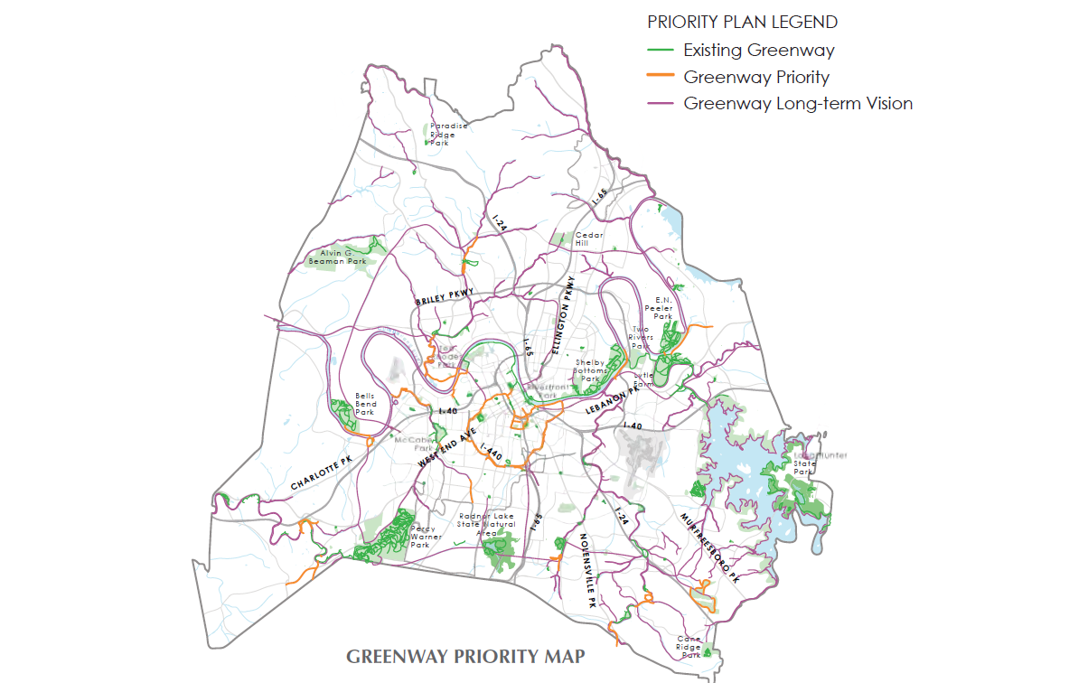
PLAN TO PLAY:
Metro Parks Master Plan

Slide 21
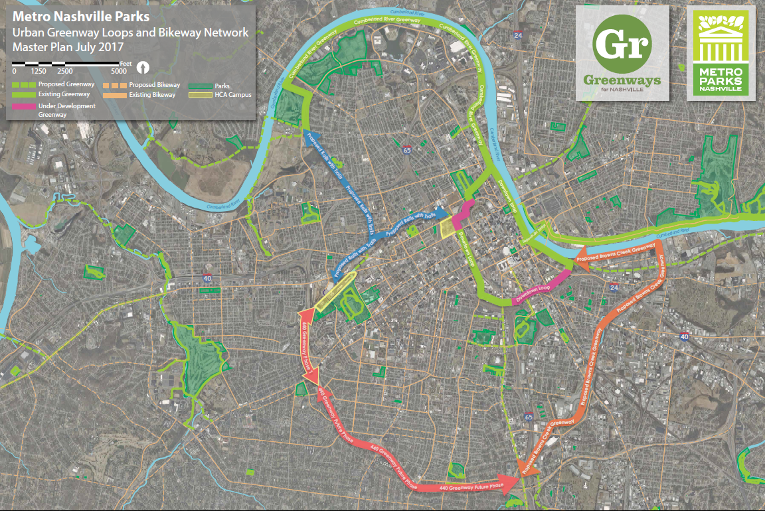

Slide 22
Example: Connections to Existing Transportation – 440 Greenway

Slide 26
Transit for Nashville

Slide 27
Questions?
Amy Crownover
Executive Director
Greenways for Nashville
amy@greenwaysfornashville.org
(615) 862-8400
Daniel McDonell
Policy and Education Manager
Walk Bike Nashville
daniel@walkbikenashville.org
(615) 933-9933

