Slide 1
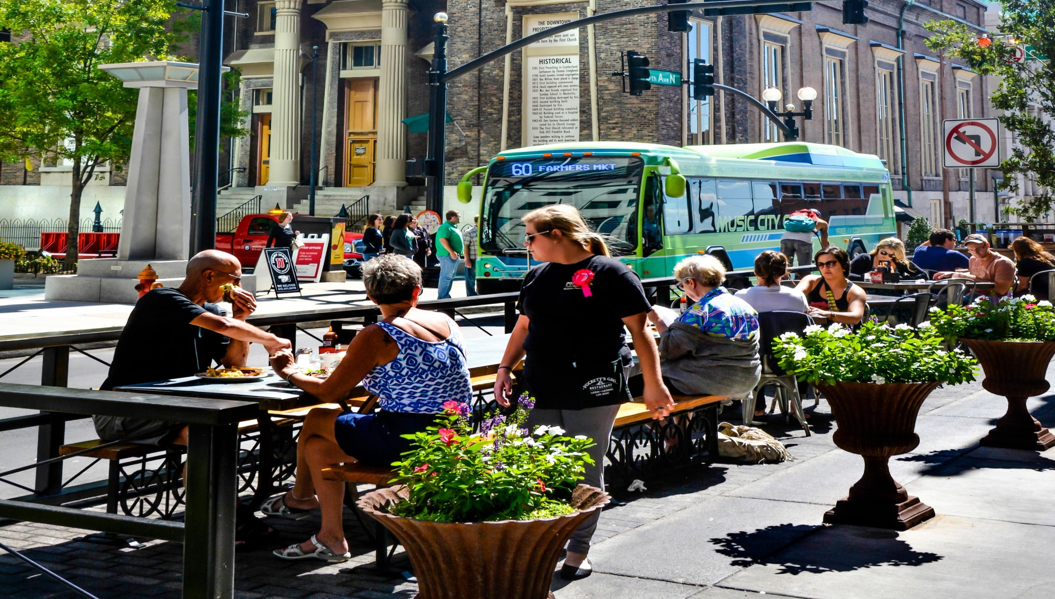
MOVING
THE
MUSIC
CITY
NASHVILLE & DAVIDSON COUNTY’S
2017-2020 TRANSPORTATION ACTION AGENDA
OFFICE OF THE MAYOR, MEGAN BARRY
Notes:
Good morning. Thank you for that kind introduction.
Acknowledge other elected officials
I’m excited to share Mayor Megan Barry’s Transportation Action Agenda for Nashville. (go to next slide)

Slide 2
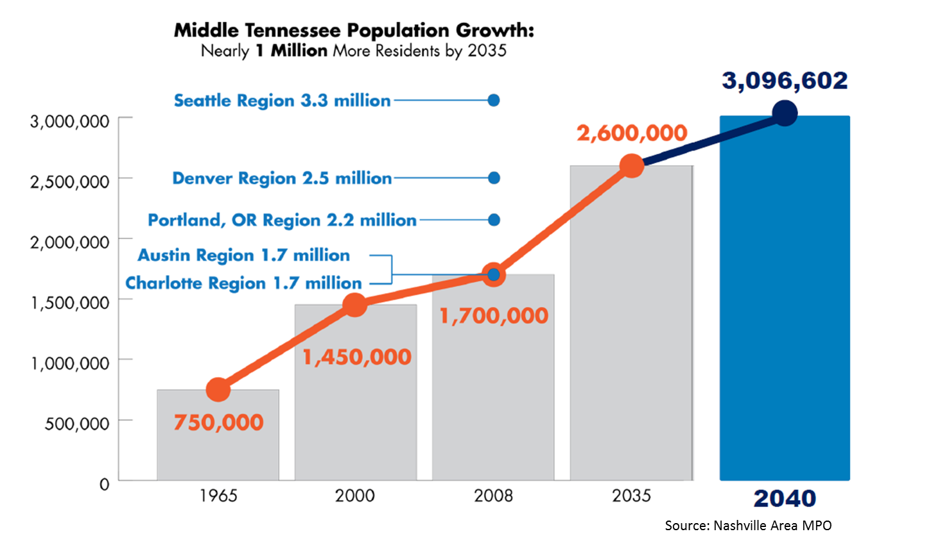
1. INTRODUCTION
Notes:
Nashville is growing, it’s going to keep growing, and we have to make sure growth does not equal gridlock.
We went over 2 billion dollars in building permits for the first time in 2014, and then we nearly hit 4 billion in 2016. That’s a lot of cranes, folks. It also means a lot more activity, a lot more people living and working in our city, and a lot more people moving around.
And that means we have to have high-capacity transit to help people move around.
We will be a 21st century transit-oriented city. We can’t wait any longer to embrace our future. We’re not going to look back one day and say we missed our opportunity and got stuck in the past.
(Go to next slide)

Slide 3
1. INTRODUCTION
2010
2040
Notes:
We have to make sure growth does not equal gridlock.
The MPO has predicted that if business as usual continues, our traffic will look like the photo on the right in 2040. More gridlock will impede our quality of life and hamper our continued economic progress.
(Go to next slide)

Slide 4
1. INTRODUCTION
Transportation Action Agenda
Public Transit
Vision Zero
Streets for People
Connected Transportation
Getting it Done
Notes:
So what are we doing about that? This is our Transportation Action Agenda.
Public Transit: We’re going to build light rail. We’re going to improve our bus system. We’re going to add to our commuter rail service. We’re going to clean our bus fleet and improve transit accessibility.
(Go to next slide)

Slide 5
1. INTRODUCTION
Transportation Action Agenda
Public Transit
Vision Zero
Streets for People
Connected Transportation
Getting it Done
Notes:
Vision Zero: Our streets can be safer, and they will be safer. No traffic fatality is acceptable.
(Go to next slide)

Slide 6
1. INTRODUCTION
Transportation Action Agenda
Public Transit
Vision Zero
Streets for People
Connected Transportation
Getting it Done
Notes:
Streets for People: We’re going to create walkable, bike-friendly streets that support healthy options for short trips.
(Go to next slide)

Slide 7
1. INTRODUCTION
Transportation Action Agenda
Public Transit
Vision Zero
Streets for People
Connected Transportation
Getting it Done
Notes:
Connected Transportation: We’re going to invest in innovations and technologies that will enhance all forms of transportation.
(Go to next slide)

Slide 8
1. INTRODUCTION
Transportation Action Agenda
Public Transit
Vision Zero
Streets for People
Connected Transportation
Getting it Done
Notes:
And Getting It Done: We can’t always wait for time-intensive capital projects to happen. We also have to make improvements today, and we have to reorient Metro departments to deliver better transportation both today and over the long term.
(Go to next slide)

Slide 9
2. PUBLIC TRANSIT
Action Highlights
Better Bus Service
Upgrade the Bus Fleet
Start Work on High Capacity Corridors
Notes:
So let’s talk about public transit:
Better Bus Service– We’re increasing frequency of service on 2 to 3 routes per year, starting with Bordeaux and Jefferson Street (extending the Music City Circuit)
(Go to next slide)

Slide 10
2. PUBLIC TRANSIT
Better Bus Service
Notes:
Better Bus Service– We already have frequent service (meaning it comes at least every 15 minutes during peak travel times) on 5 routes: Gallatin, Nolensville, Charlotte, Murfreesboro, and West End. This year, with the extension of the Music City Circuit to TSU, we will be able to increase frequency of service on both the Jefferson Street and Bordeaux routes.
We will continue to build out our frequent transit network over the next few years until MTA’s 14 busiest routes, serving 70% of our riders, have frequent service.
(Go to next slide)

Slide 11
2. PUBLIC TRANSIT
Action Highlights
Better Bus Service
Upgrade the Bus Fleet
Start Work on High Capacity Corridors
Notes:
Upgrade the Bus Fleet– With 31 new hybrid-electric buses in this year’s budget, more than 50% of our transit fleet will be alternative-fuel vehicles.
(Go to next slide)

Slide 12
2. PUBLIC TRANSIT
Upgrade the Bus Fleet
Notes:
MTA will purchase 31 40-foot hybrid-electric transit coaches this year. When these buses arrive in mid-2019, that will bring our total alternative-fuel coaches to 101 out of 176, increasing our percentage from 17% today to more than 57%.
(Go to next slide)

Slide 13
2. PUBLIC TRANSIT
Action Highlights
Better Bus Service
Upgrade the Bus Fleet
Start Work on High Capacity Corridors
Notes:
High-Capacity Corridors – We’re developing a financing plan and development timeline, starting with design and engineering for Gallatin Pike light rail. And for all of you who are Davidson County voters, I’m just letting you know now that we’ll be bringing a referendum on dedicated transit funding to the ballot in 2018. We have to have dedicated funding to do all of these things.
(Go to next slide)

Slide 14
2. PUBLIC TRANSIT
Start Work on High Capacity Corridors
Notes:
We will be a 21st century transit-oriented city, and we are starting today. We are focusing our high-capacity corridors on:
4 Light Rail Lines (Gallatin, Nolensville, Murfreesboro/Airport, and Charlotte pikes)
2 Commuter Lines (the Music City Star and the Northwest Commuter Rail through North Nashville to Clarksville)
and 1 center-median Bus Rapid Transit line (Dickerson Pike)
(Go to next slide)

Slide 15
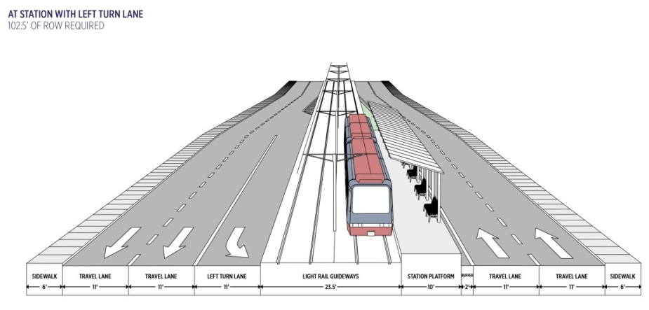
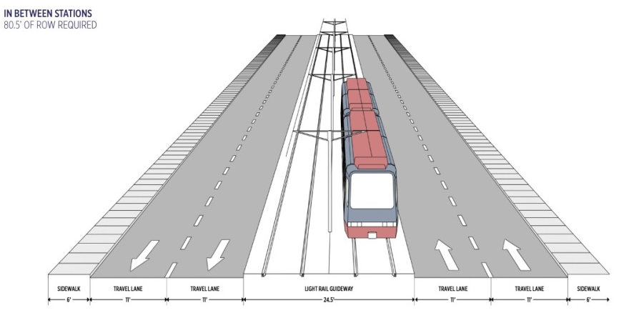
2. PUBLIC TRANSIT
Notes:
The light rail line on Gallatin that we’ve started working on will be center-running, and the first phase will be between 5 and 6-and-a-half miles. It will offer service along the corridor that is 5 to 15% faster than current options.
(Go to next slide)

Slide 16
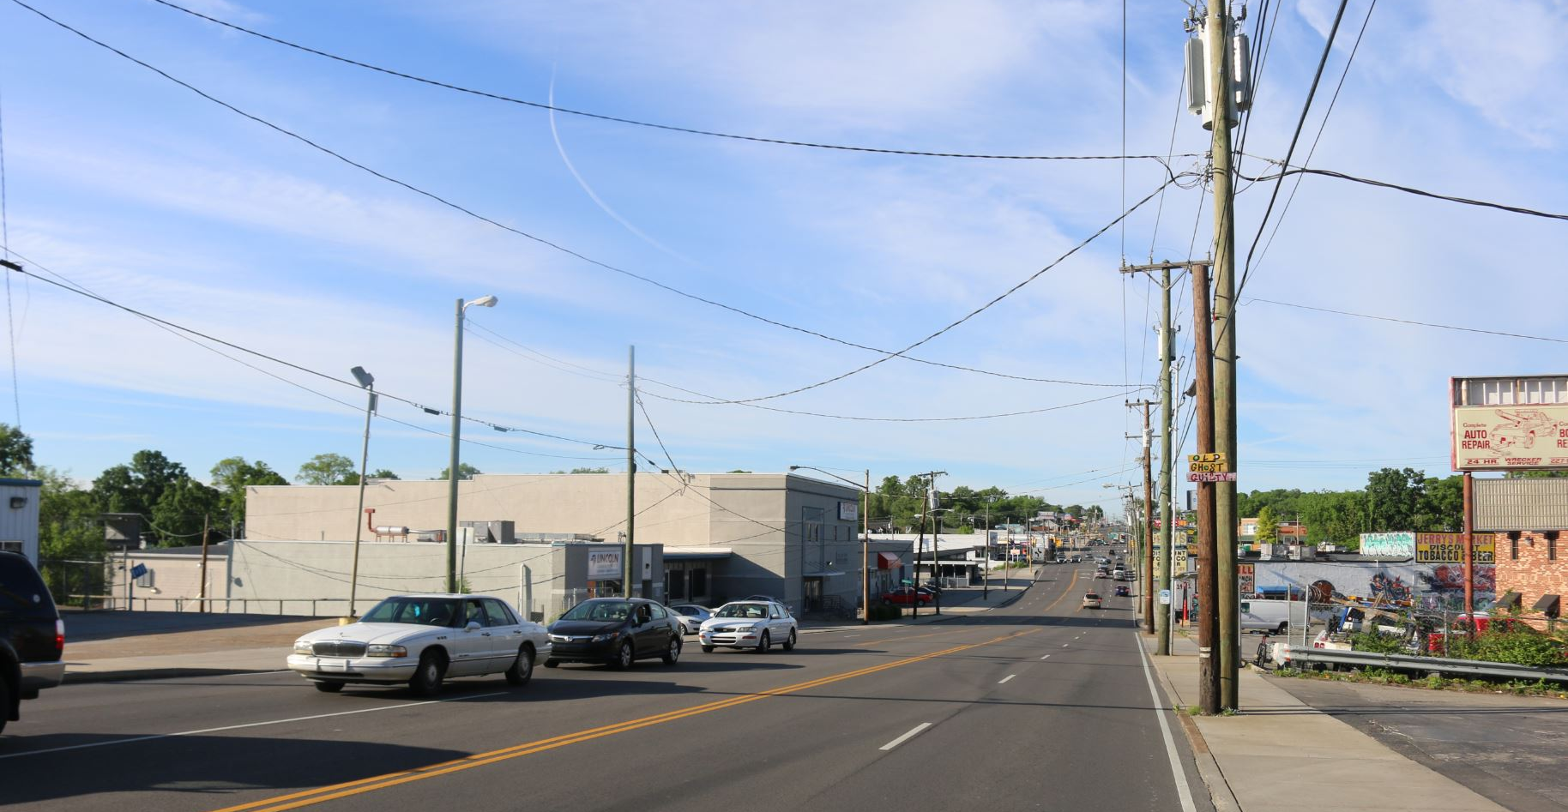
2. PUBLIC TRANSIT
Notes:
Current conditions on Gallatin Pike are not favorable to pedestrians and transit riders.
(Go to next slide)

Slide 17
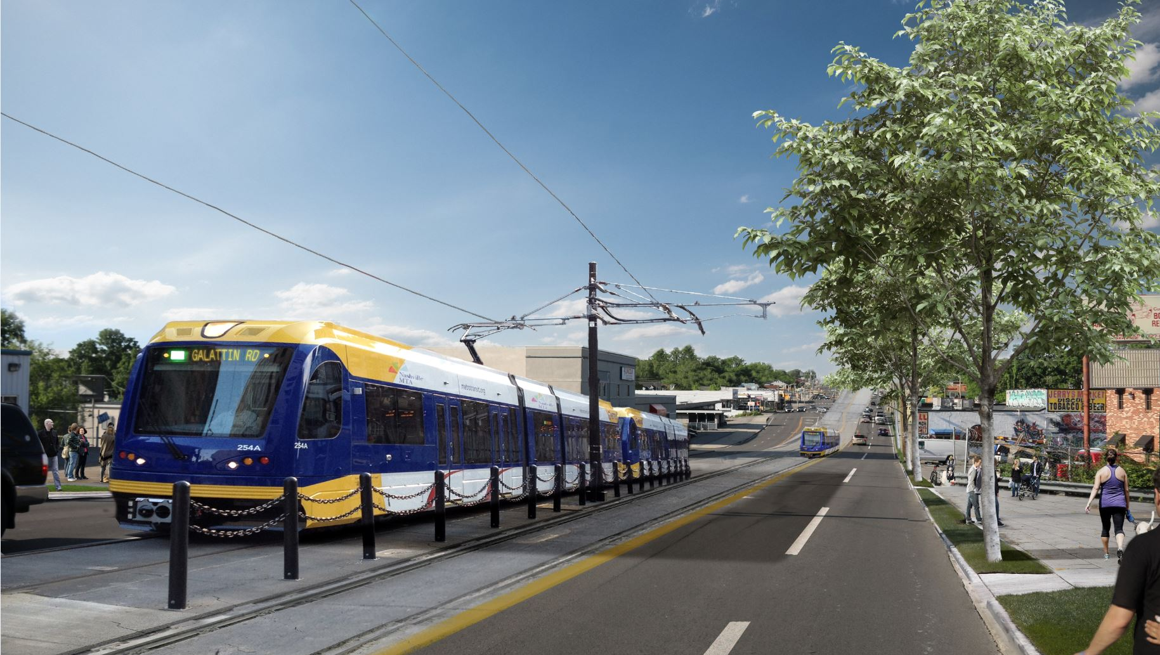
2. PUBLIC TRANSIT
Notes:
We have the opportunity to retrofit the corridor to provide more opportunities for walking and transit.
(Go to next slide)

Slide 18
2. PUBLIC TRANSIT
Notes:
Current conditions on Gallatin are not favorable to pedestrians and transit riders.

Slide 19
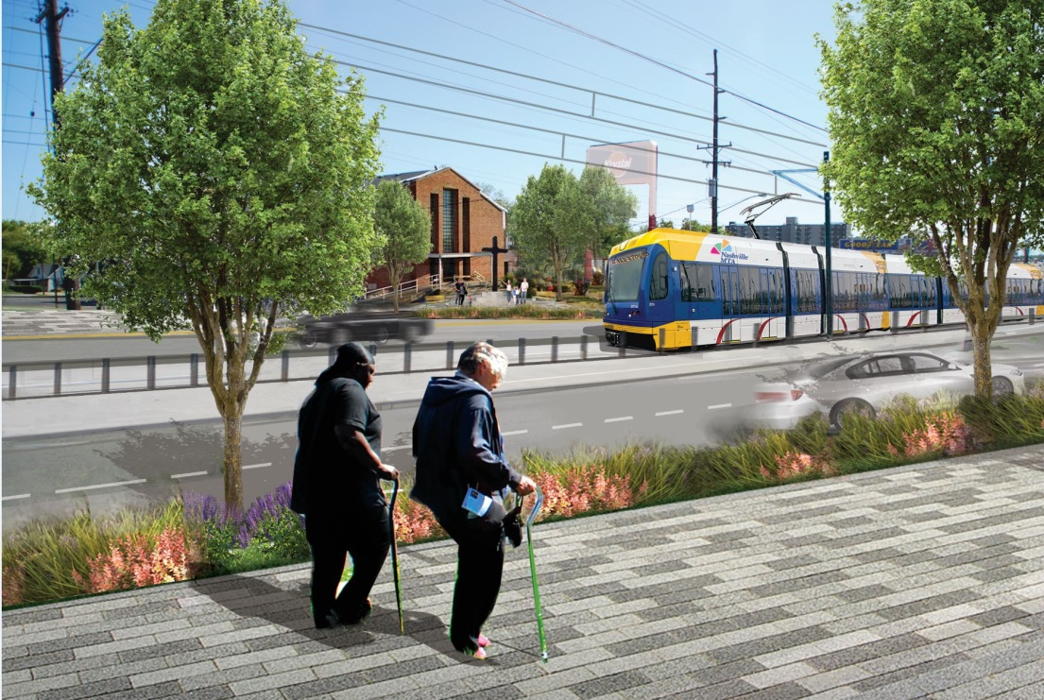
2. PUBLIC TRANSIT
Notes:
We have the opportunity to retrofit the corridor to provide more opportunities for walking and transit.

Slide 20
3. VISION ZERO
Action Highlights
Build with Urgency
Expand Safe Intersection Program
Construct More Sidewalks
Create Safer Neighborhoods
Notes:
Now let’s talk about Vision Zero for a couple of minutes. We are going to continually reduce fatal crashes, and improve public safety.
We must build with urgency, without taking shortcuts.
We will implement projects quickly, but without compromising quality at high-crash intersections, including walkways, sidewalk extensions, protected bicycle lanes, bus lanes and walkable, enhanced bus stops.
(Go to next slide)

Slide 21
3. VISION ZERO
Action Highlights
Build with Urgency
Expand Safe Intersection Program
Construct More Sidewalks
Create Safer Neighborhoods
Notes:
We’re going to keep addressing the most dangerous intersections. Intersection projects will include re-aligning intersections, sidewalk and curb extensions, crosswalk and traffic signal improvements. Our goal is to expand this program to address at least 10 intersections per year.
(Go to next slide)

Slide 22
3. VISION ZERO
Action Highlights
Build with Urgency
Expand Safe Intersection Program
Construct More Sidewalks
Create Safer Neighborhoods
Notes:
We’re going to invest 30 million dollars in building sidewalks again this year, with an additional 3 million dollars dedicated exclusively to sidewalks connecting students to schools.
In addition to maintaining consistent funding levels, we will build more sidewalks through streamlined processes and regulations, and more partnerships, again without compromising quality and our commitment to Complete Streets.
(Go to next slide)

Slide 23
3. VISION ZERO
Action Highlights
Build with Urgency
Expand Safe Intersection Program
Construct More Sidewalks
Create Safer Neighborhoods
Notes:
And we’re going to add more options to our traffic calming program, including piloting walking districts and developing safety education campaigns.
(Go to next slide)

Slide 24
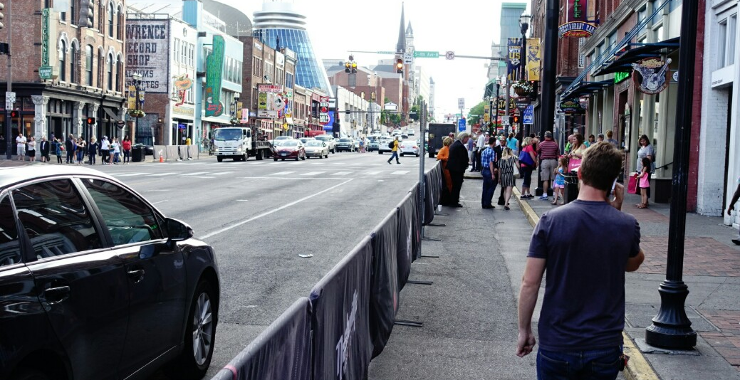
3. VISION ZERO
Case Study: Lower Broadway
Notes:
Two projects we are working on this year – Lower Broadway and Envision Nolensville - exemplify how all these actions come together in one project to make a tangible difference to improving pedestrian safety.
Lower Broadway - I know you all are familiar with this scene. Metal barriers as sidewalk extensions on Lower Broadway. Pedestrian counts on Broadway tell us that this street is among the busiest in the world, and we need to improve safety and provide more space for pedestrians.
(Go to next slide)

Slide 25
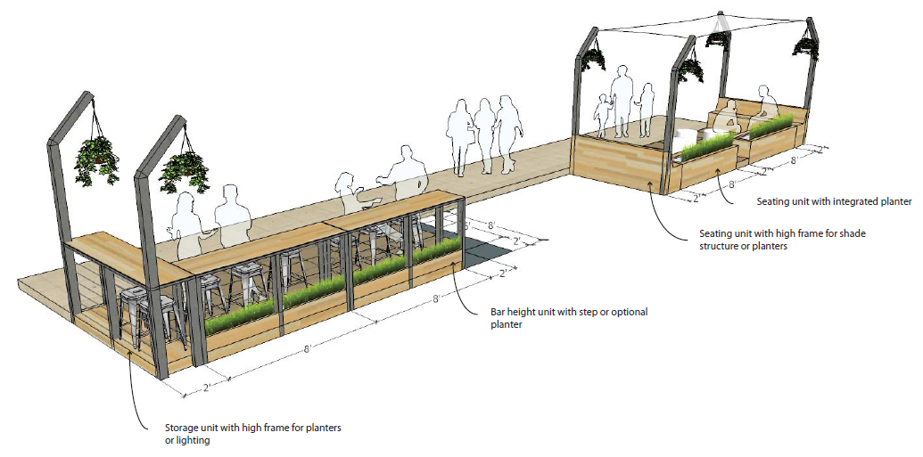
3. VISION ZERO
Case Study: Lower Broadway
Notes:
This summer we’ll pilot a sidewalk extension on the north side of Lower Broadway between 3rd Avenue and 4th Avenue, including protective barriers and pedestrian seating.
(Go to next slide)

Slide 26
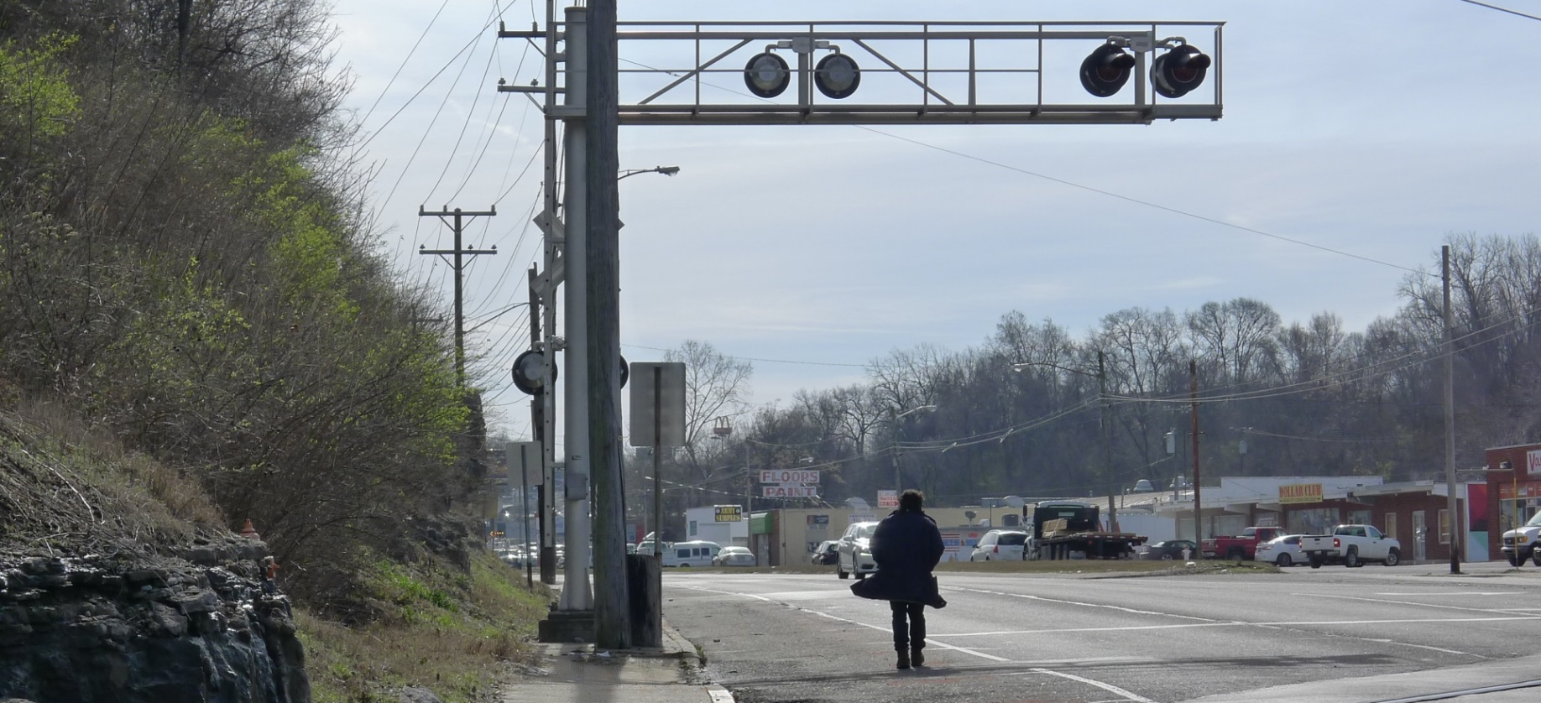
3. VISION ZERO
Case Study: Nolensville Pike
Notes:
Now, shifting a bit south of downtown, this is Nolensville Road, one of our key transit corridors.
Metro Nashville has recently started working to retrofit Nolensville Road to improve pedestrian safety and access to transit. Nolensville is our 2nd-busiest bus route, and it’s set to get a light rail line as part of our nMotion strategic plan.
Unfortunately, large sections of the corridor don’t have sidewalks – or in many cases have sidewalks blocked with utility poles - so our transit riders are often risking their lives by walking to bus stops along shoulders and stormwater ditches and then trying to cross a major roadway with high-speed traffic.
(Go to next slide)

Slide 27
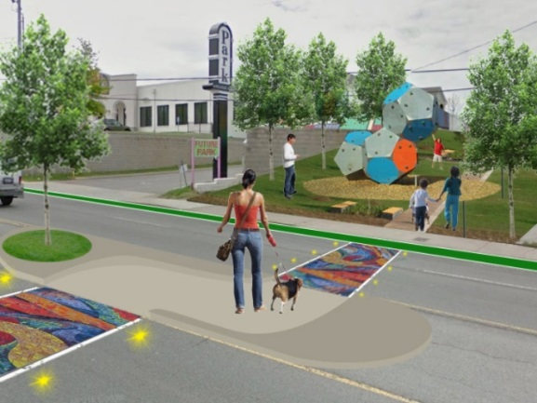
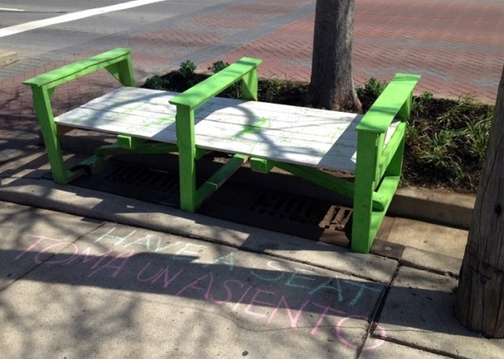
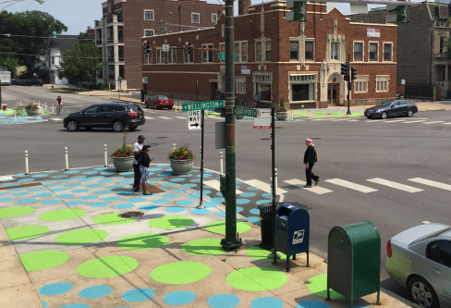
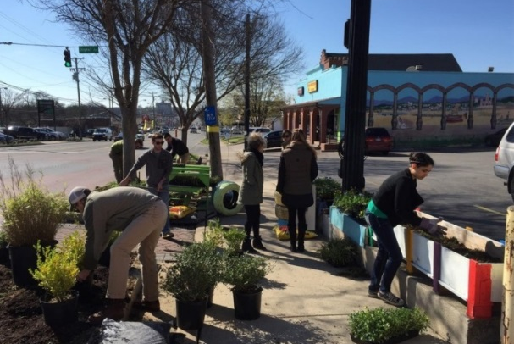
3. VISION ZERO
Case Study: Nolensville Pike
Notes:
A stretch of Nolensville Road is actually being re-paved as we speak in a joint project between Metro and TDOT. The repaving will add new crosswalks at key intersections and bike lanes along the entire corridor.
We are also targeting improvements at 5 key intersections that have important bus stops. Improvements include relocating bus stops closer to the intersections, providing new bus shelters and real-time digital signage, high-visibility crosswalks at all 4 legs of the intersection, and new signals for pedestrian crossings.
(Go to next slide)

Slide 28
4. STREETS FOR PEOPLE
Action Highlights
Create a Low-stress Bikeway Network
Ensure Safe Routes to Schools
Remove Barriers to Walking
Notes:
We also have to make sure we build streets that work for walkers and bike riders. That means more sidewalks and bikeways – and not just any bikeways, but protected ones.
(Go to next slide)

Slide 29
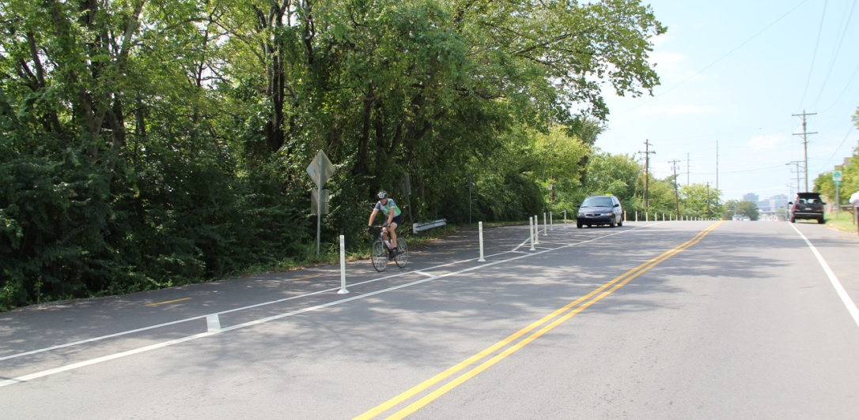
4. STREETS FOR PEOPLE
Davidson Street Protected Bike Lane
Notes:
This protected bike lane on Davidson Street has led to a fourfold increase in bike traffic.
(Go to next slide)

Slide 30
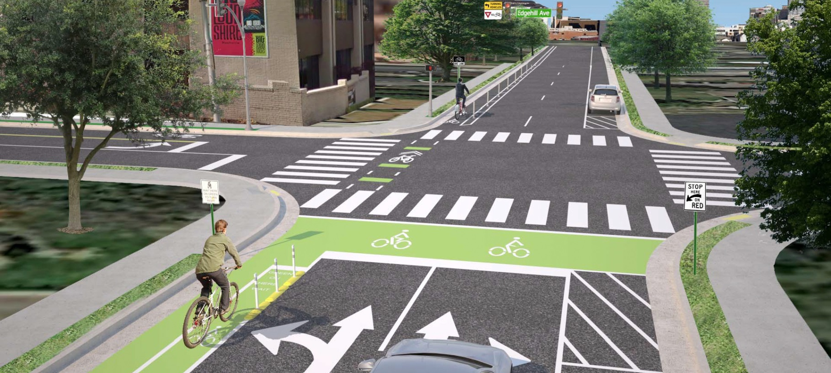
4. STREETS FOR PEOPLE
Magnolia Avenue Protected Bike Lane
Notes:
Magnolia Avenue also is going to get a left-side protected bike lane this year. This is going to let bike riders, especially newer ones, feel more comfortable, and it’s going to reduce potential conflicts with drivers.
(Go to next slide)

Slide 31
4. STREETS FOR PEOPLE
Action Highlights
Create a Low-stress Bikeway Network
Ensure Safe Routes to Schools
Remove Barriers to Walking
Notes:
We are also going to build more sidewalks to schools
(Go to next slide)

Slide 32
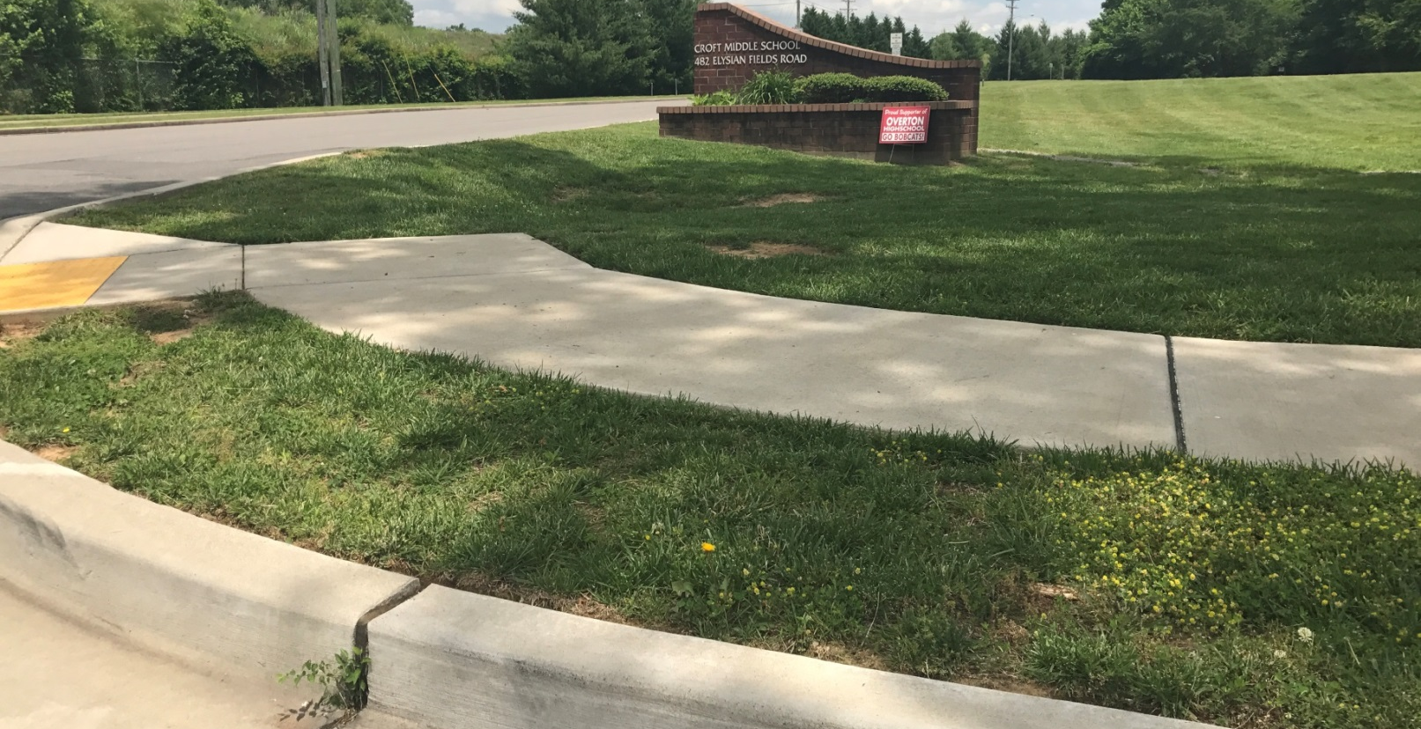
4. STREETS FOR PEOPLE
Croft Middle School Sidewalks
Notes:
Just like this sidewalk project to Croft Middle School.
Everyone knows that when school is out of session, traffic seems to be much less. More student and their parents walking to school is good for our health and helps lower congestion, and help with carpooling headaches. I know every parent appreciates that.
(Go to next slide)

Slide 33
4. STREETS FOR PEOPLE
Action Highlights
Create a Low-stress Bikeway Network
Ensure Safe Routes to Schools
Remove Barriers to Walking
Notes:
And my favorite topic, we are going to actively work to remove barriers to walking by better coordinating construction projects to prevent unnecessary sidewalk closures, working with utility companies to remove poles from sidewalks, and creating more tree-lined streets as they are more welcoming to foot traffic.
(Go to next slide)

Slide 34
5. CONNECTED TRANSPORTATION
Action Highlights
Ensure Optimal Use of Our Streets
Nashville Complete Trips
Expand Innovative Transportation Options
Notes:
Connected transportation means we invest in innovations and technologies that will enhance all forms of transportation.
Ensuring optimal use of our streets means continuing to update Nashville’s traffic signals to help smooth vehicle flow on our streets and improve safety and increase the number of traffic cameras installed at priority intersections.
We updated 550 of our 850 traffic signals last year. We will continue to update the remaining traffic signals, starting with the 41 intersections along Murfreesboro Pike, which also includes pedestrian improvements and transit signal priority.
(Go to next slide)

Slide 35
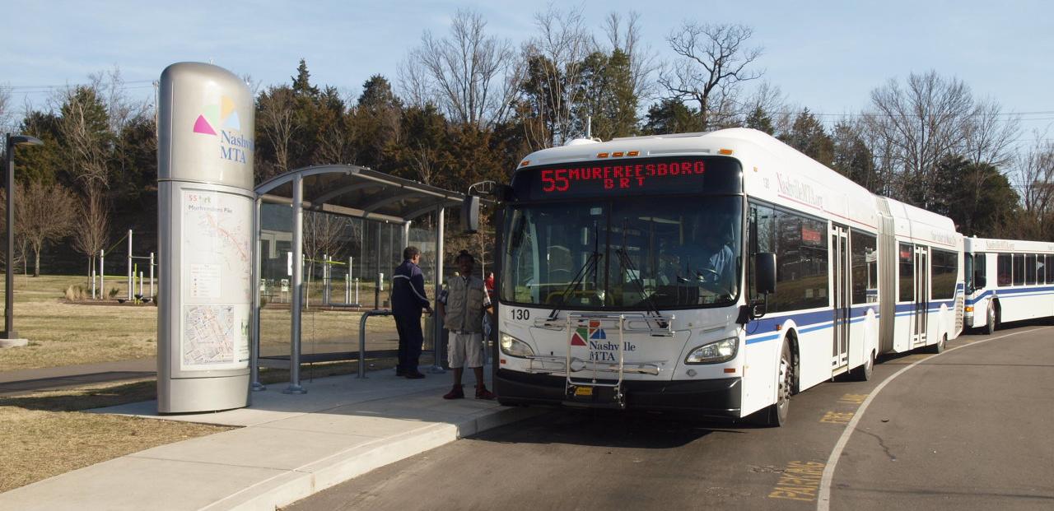
5. CONNECTED TRANSPORTATION
Murfreesboro Transit Signal Priority
Notes:
Ensure Optimal Use of Our Streets:
The Murfreesboro Transit Signal Priority project will make improvements at 41 intersections along Murfreesboro Pike, from Lafayette Street to Bell Road.
The best part is that once this is completed, MTA buses on this corridor will receive signal priority, meaning green lights will be extended to allow the buses to remain on time or to catch up and get back on schedule. This will dramatically improve travel times and on-time performance.
The project also includes new traffic signal controllers, signal equipment, new fiber along the entire corridor, pedestrian improvements at 39 intersections, real-time signage at bus shelters, and queue jumps at 4 intersections.
Construction will start in August 2017 and be completed in January 2019.
(Go to next slide)

Slide 36
5. CONNECTED TRANSPORTATION
Action Highlights
Ensure Optimal Use of Our Streets
Nashville Complete Trips
Expand Innovative Transportation Options
Notes:
We’ve got to give greater priority to those who are walking, bicycling, and taking transit on Nashville’s streets, and we have to ensure that residents can complete their trips with meaningful transportation options so they can arrive at their destination safely.
Over 91,000 people commute into Nashville each day, and another 258,000 people live and work within Davidson County. People get around Nashville multiple ways, and there are options our residents may be unaware of or unfamiliar with. So, by default, we often drive alone.
(Go to next slide)

Slide 37
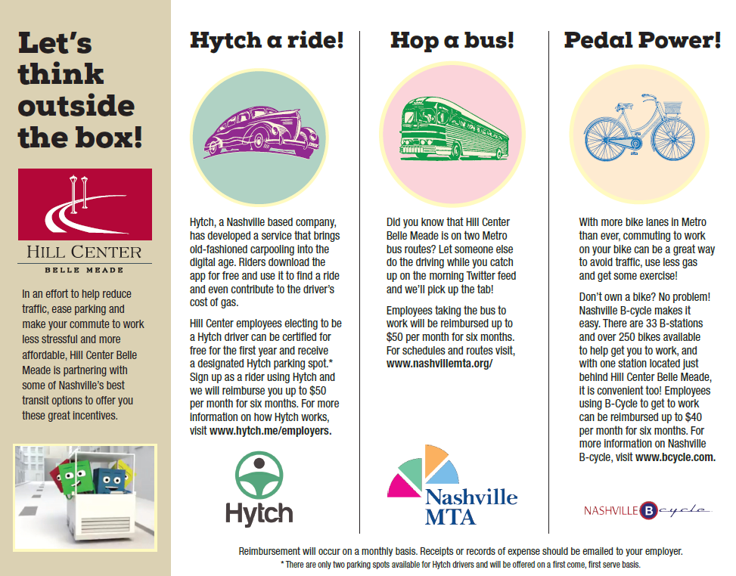
5. CONNECTED TRANSPORTATION
Nashville Complete Trips Program
Notes:
Metro Planning was awarded a grant by the Tennessee Department of Transportation to develop a Transportation Demand Management program called Nashville Complete Trips.
The Nashville Complete Trips program will promote ways to get around Nashville by connecting employers and commuters to information about transportation options, such as:
how to use the bus system,
how to bike,
the benefits of flex-scheduling and telecommuting,
where to find bike parking and shower facilities,
where to find a park-and-ride,
and more.
Above is an example of travel demand management that the Hill Center in Belle Meade sent out to their tenants.
(Go to next slide)

Slide 38
5. CONNECTED TRANSPORTATION
Action Highlights
Ensure Optimal Use of Our Streets
Nashville Complete Trips
Expand Innovative Transportation Options
Notes:
Expanding innovative transportation options means expanding car-sharing opportunities, developing closer partnerships with transportation network companies, and piloting mobility-on-demand services.
(Go to next slide)

Slide 39
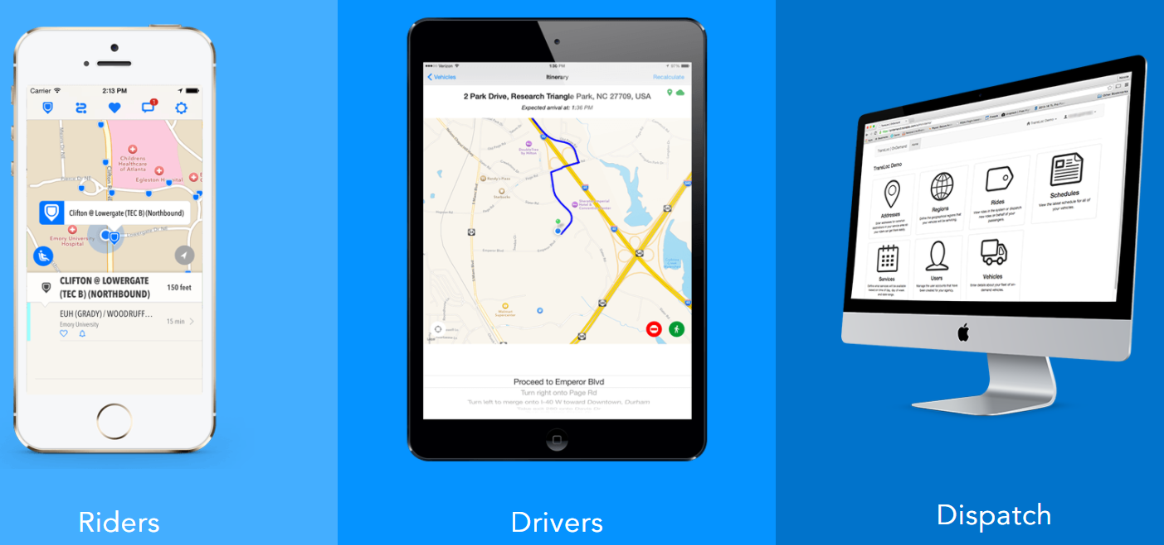
5. CONNECTED TRANSPORTATION
MTA Mobility-on-Demand Pilots
Notes:
The Nashville MTA plans to launch our mobility-on-demand program later this year. This will allow MTA buses to respond to demand in a certain area or run hybrid routes that will have both scheduled stops and improvised stops for on-demand pickups and drop-offs. We expect this project to launch in October.
(Go to next slide)

Slide 40
6. GETTING IT DONE
Action Highlights
Rally Around a Common Vision
Growth Doesn’t Equal Gridlock
Deliver Outstanding Roadways
Passing a Transit Funding Referendum in 2018
Notes:
And finally, Getting It Done.
We’re paving. We’re reorienting for more short-term projects. We’re pushing more transit-oriented development. And, just in case you didn’t hear me the first time, we’ll be going to the voters with a transit funding referendum next year.
Rally Around a Common Vision - To support all of the goals outlined in this action agenda, I’ll establish a new Division of Transportation within Metro Public Works to expand our ability to implement and innovate—and especially to move more quickly while working hand-in-hand with citizens, neighborhoods, and businesses.
(Go to next slide)

Slide 41
6. GETTING IT DONE
Action Highlights
Rally Around a Common Vision
Growth Doesn’t Equal Gridlock
Deliver Outstanding Roadways
Passing a Transit Funding Referendum in 2018
Notes:
Growth Doesn’t Equal Gridlock - Nashville is experiencing and will continue to experience rapid growth for decades to come. That’s why it’s so important for land-use decisions to be closely connected to transportation investments, and vice-versa. NashvilleNext, our 25-year comprehensive general plan that incorporated input from over 18,000 citizens, was an enormous step forward for accommodating additional population and jobs in a sustainable way.
(Go to next slide)

Slide 42
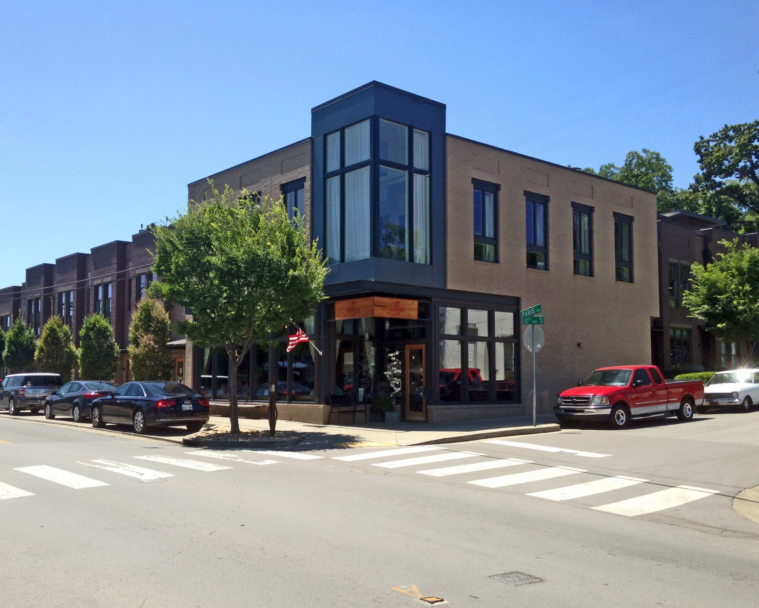
6. GETTING IT DONE
Growth Doesn’t Equal Gridlock
Notes:
The nMotion strategic transit plan was then overlaid with the NashvilleNext land-use scenario to align transit investments in the urban core and along key growth corridors. While good planning is critical, we also have to have the appropriate policies and tools to ensure new growth is focused along key corridors.
This will help to ensure that our unique neighborhoods retain their character; that growth doesn’t equal traffic gridlock; and that residents along these corridors will have multiple options for getting around without having to own a car. With the passage of state legislation this year, Metro has new tools to encourage transit-oriented development.
(Go to next slide)

Slide 43
6. GETTING IT DONE
Action Highlights
Rally Around a Common Vision
Growth Doesn’t Equal Gridlock
Deliver Outstanding Roadways
Passing a Transit Funding Referendum in 2018
Notes:
Deliver Outstanding Roadways - This year we are dedicating $35M for paving to increase the percentage of our roads in good condition to 70%, up from 66% last year.
(Go to next slide)

Slide 44
6. GETTING IT DONE
Action Highlights
Rally Around a Common Vision
Growth Doesn’t Equal Gridlock
Deliver Outstanding Roadways
Passing a Transit Funding Referendum in 2018
Notes:
Passing a Transit Funding Referendum -
Last month the Tennessee General Assembly also passed the IMPROVE Act, which will fund bridge and highway maintenance statewide, including Nashville’s I-440. Nashville drivers, you and your tires can go ahead and clap for that one!
Most importantly, the IMPROVE Act gives voters in Tennessee’s urban areas the chance to vote for creating dedicated revenue to fund transit investments.
(Go to next slide)

Slide 45
6. GETTING IT DONE
Transit Funding Referendum in 2018
Notes:
This Action Plan lays the groundwork for Nashville’s near-term transportation improvements. But to build out our full transit vision, we’ll need much bigger levels of investment. Attempting to fund transit capital and operations through our normal Metro budgeting process and revenues is limiting our capacity to grow with intention. Only dedicated local revenues will sustain a long-term investment in a comprehensive transit system.
National research shows that transit funding referendums are successful 71% of the time. We hope that trend continues here in Nashville.
I know our voters are going to be ready, because we’ve always been ready when the time came to make big decisions about Nashville’s growth. We’ve always been ready to embrace our future, and we will be again.

Slide 46
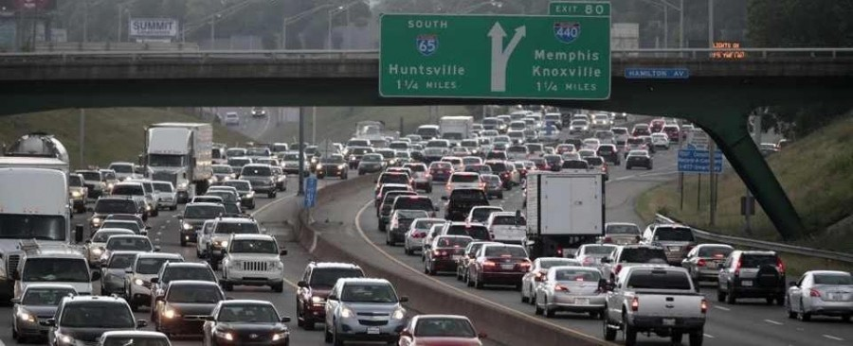
Questions?

