Slide 1
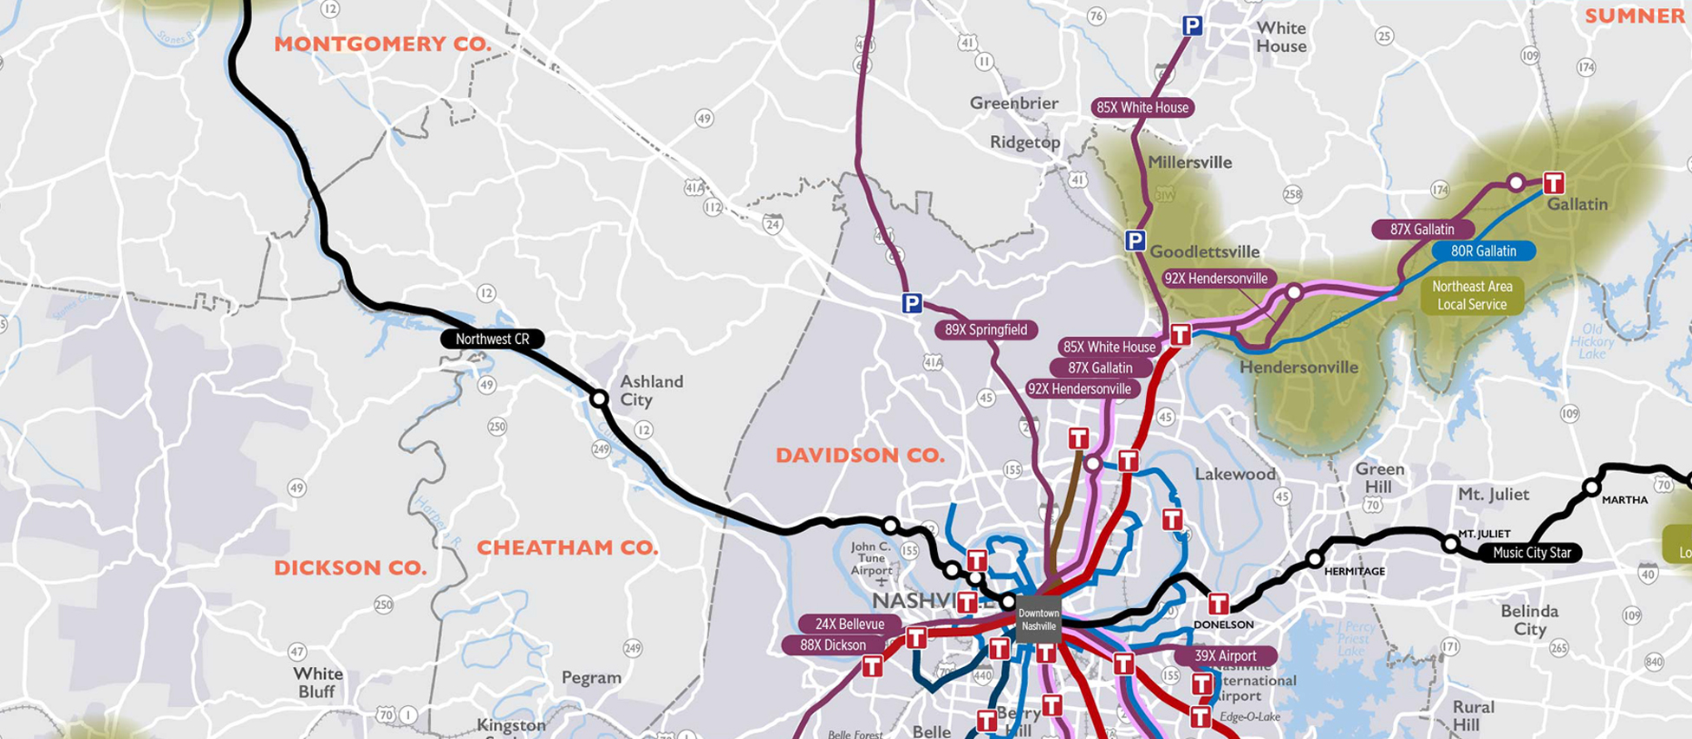
Public Transportation in Middle Tennessee

Slide 2
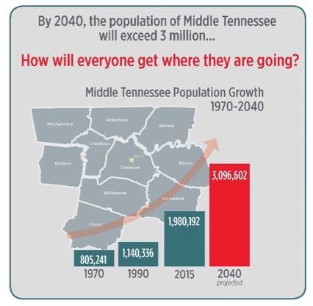
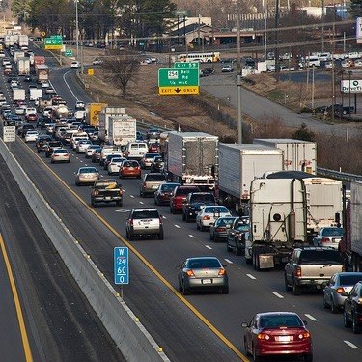
Our Challenge & Opportunity: Growth & Congestion
Image: The Tennessean
Image: TDOT
Notes:
“People, it seems, find it hard to believe that the cure for congestion is not more facilities for congestion.”
Lewis Mumford, New Yorker, 1955
Down's Law of Peak-Hour Traffic Congestion
"This Law states that on urban commuter expressways, peak-hour traffic congestion rises to meet maximum capacity.“
A. Downs, Traffic Quarterly, Eno Transportation Foundation, 1962

Slide 3
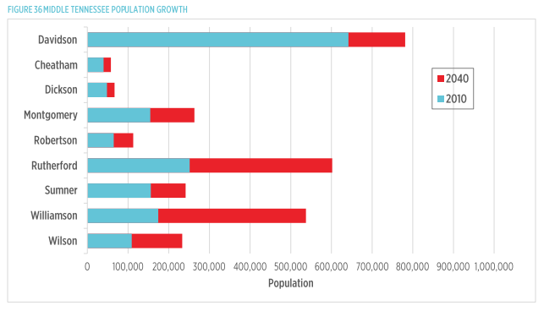
Clarksville Area Population to Exceed 308,000 by 2040
Image: The Tennessean
Montgomery
*2015 census compared to 2040 Woods and Poole forecast
Notes:
Clarksville’s growth has been in the news recently. The city is the 5th largest in the state. The 2016 Woods & Poole projects that by 2040, Clarksville/Montgomery will have more than 308,000 people—that’s an increase of more than 135,452 people or 78% since 2010.
Also to impact congestion is the robust employment market of Montgomery jobs from 2010 to 2040

Slide 4
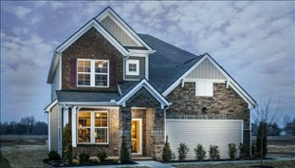
What Determines Affordability?
Housing Costs + Cost of Commute
Notes:
Our community is blessed with low housing costs and a good quality of life. In fact, Clarksville recently was just named as one of the top 25 places to build your “FOREVER HOME” because of this. But a new, compounded metric is becoming more popular for analyzing an area’s affordability: the cost of housing PLUS THE AVERAGE COST OF A COMMUTE. We want to be affordable overall.

Slide 5
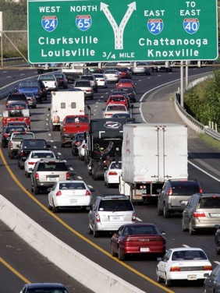
Traffic is Affecting Most Everyone
Vital Signs 2017, Greater Nashville Chamber of Commerce
Notes:
If you’ve noticed you are spending more time in traffic these days, you are not alone. The Greater Nashville Chamber just released their 2017 Vital Signs report, which tells us that 78% of the region’s residents reported they are experiencing more traffic now than a year ago. That’s sharply up from the 62% that were asked this question last year.

Slide 6
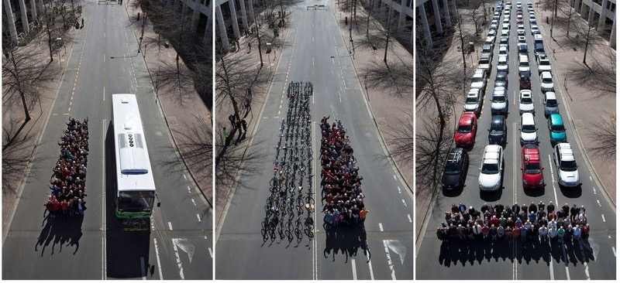
Our Challenge & Opportunity: Making it Fit
Credit: Australian Cycling Promotion Fund
Notes:
We can’t pave our way out of congestion, even if we could afford to do that. The real opportunity is to fit more commuters in less space. Different modes transport different numbers of people in the same space. In one hour, One Lane of a Road Can Carry:
600-1600 people, if they are commuting by car
1,000-2800 if part of that road’s traffic is mixed with frequent buses;
Up to 8,000 people if there is a dedicated transit lane.
Even more, A high capacity fixed guideway can take up to 25,000 on that same area as the one lane of road.
Cars: 600-1600
Mixed traffic with frequent buses: 1,000 – 2,800
Dedicated transit lane: 4,000-8,000
High Capacity Fixed Guideway: 10,000-25,000
Source NACTO Transit Street Design Guide

Slide 7
Density Will Increase In Clarksville
2010
2040
Notes:
With the explosion of new jobs and the population growth expected, density is projected to increase in Clarksville/Montgomery Co and the areas that feed into it. With density, comes congestion, but with density comes opportunity for developing more effective public transportation systems.

Slide 8
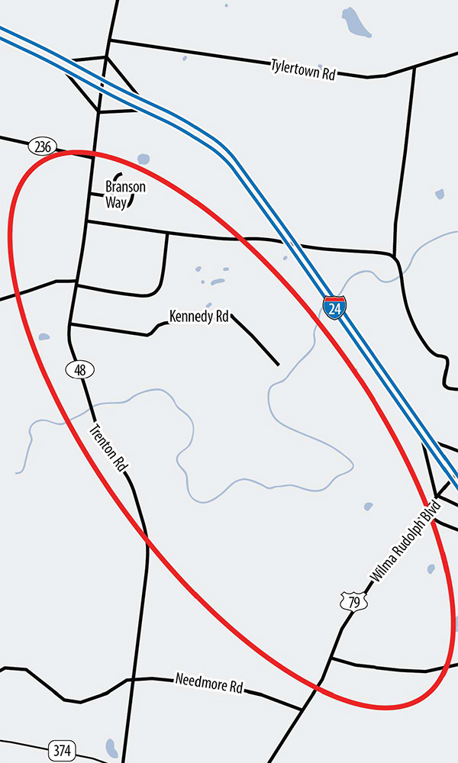
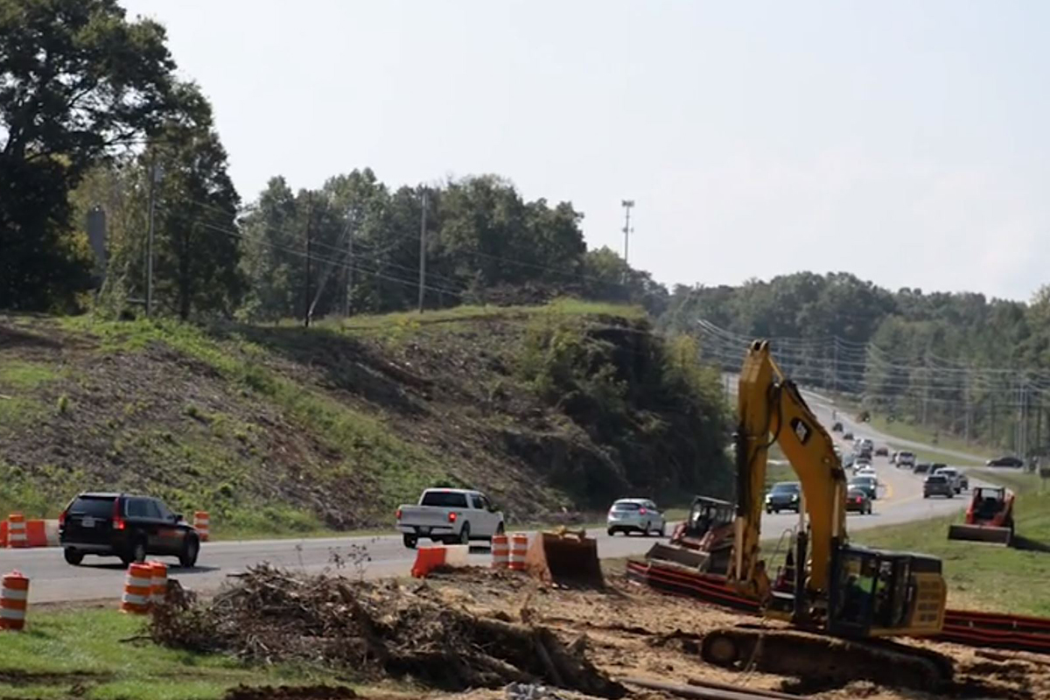
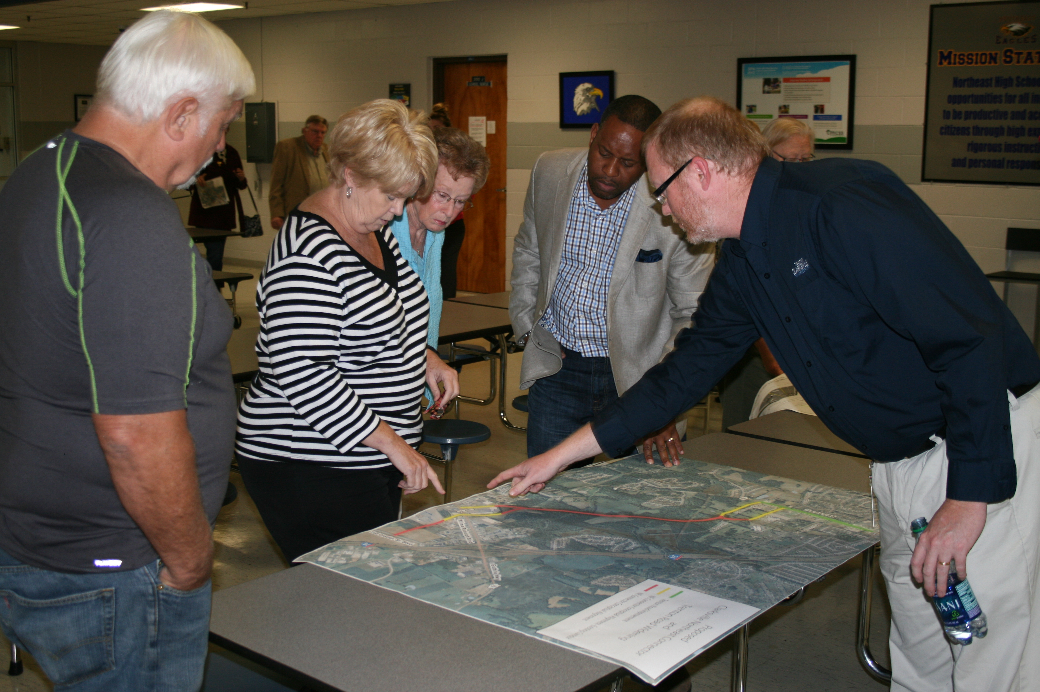
Partnership – TDOT/Clarksville
Local investment sparks state department funding
Notes:
It’s no accident that Clarksville is faring well in getting toward the top of TDOT’s list of road projects.
The city has taken a proactive approach to addressing congestion in several key road improvement projects. Residents
gave input on congestion issues in Northeast Clarksville, and improvements are underway for Warfield Boulevard and Trenton Road.

Slide 9
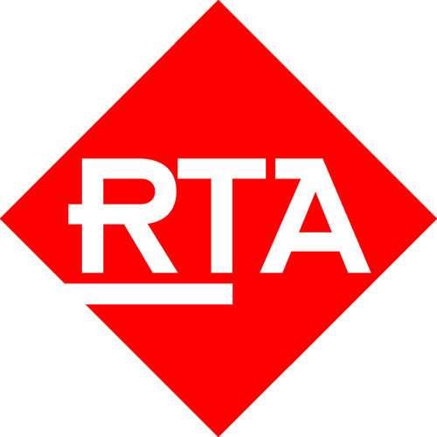
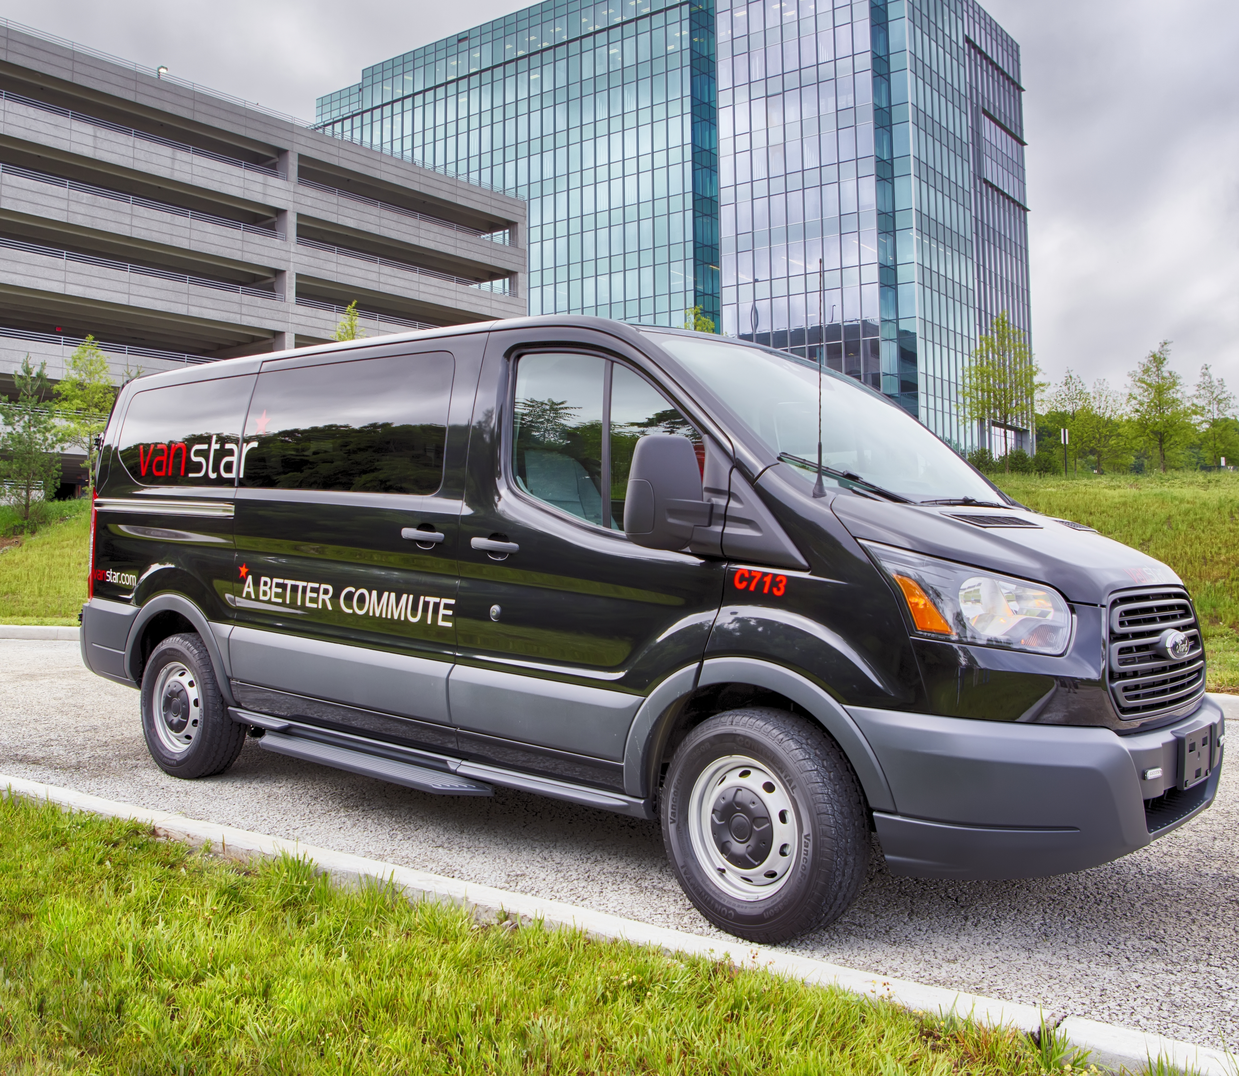
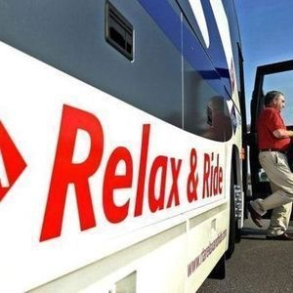
Staying Connected: Local-Regional Partnerships
Notes:
Partnerships don’t end with just TDOT….to help our residents with longer commutes, additional options are integrated into Clarksville’s transit system. The Van Star program provides affordable vanpool options. providing the vehicles for vanpool commuters. There are 19 of these running daily. And RTA’s Relax and Ride system has given those commuting into Nashville the chance to be more productive during their ride.

Slide 10
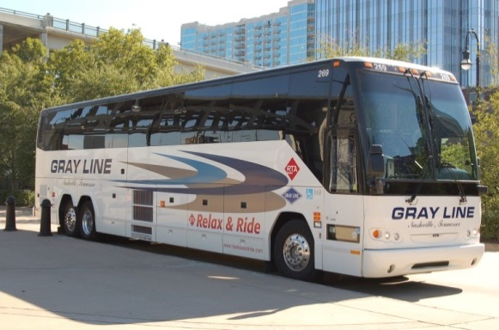
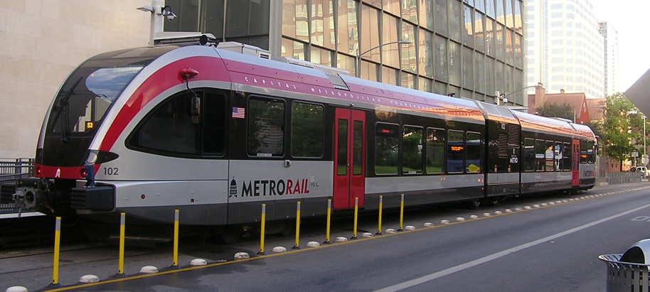
nMotion Plan Possibilities
Bus on Shoulder
Streamlined Bus Service
Expanded Express Bus Service
Enhanced Local Service
Commuter Rail Potential
Notes:
Recognizing that we needed to have a better plan to address our future mobility, the RTA got input about people’s needs and desires from more than 20,000 engagements across the 10-county area. Coupled with strong technical advice, we created and adopted a general plan for transit for the region. The plan’s been adopted, but the needed funding mechanism is not in place. What did the plan see as great possibilities for Clarksville? Having streamlined bus services & more frequent and longer service hours for transit are clearly opportunities. Better connections locally enables more who would like to take transit, if it were more convenient.
People were excited about the idea of train service, if it could be economically feasible, something that is being taken into consideration.

Slide 11
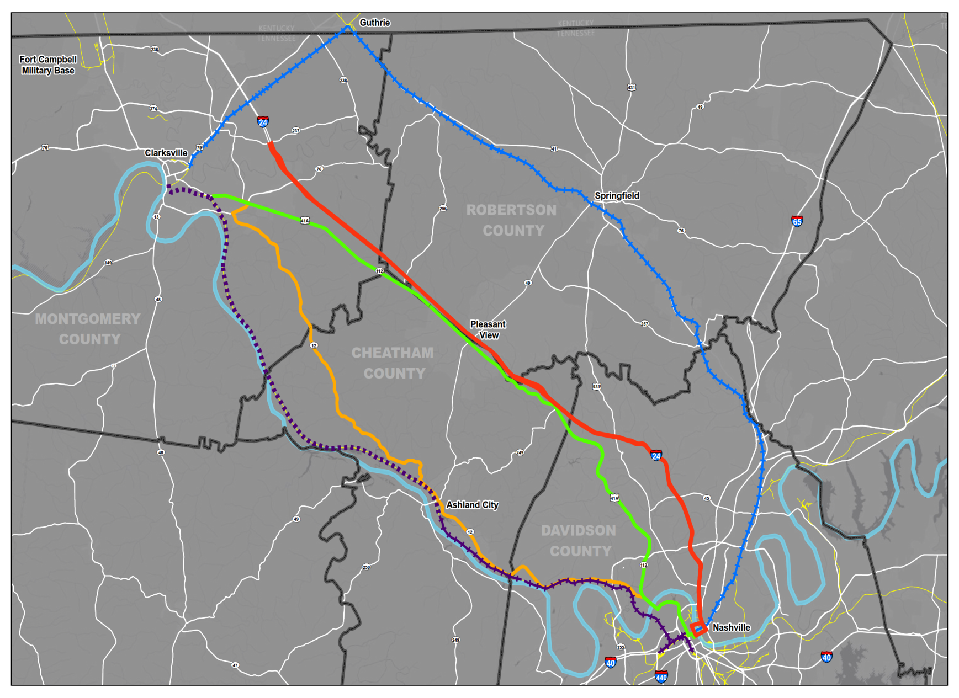
Study Corridors
Interstate 24
SR-12 –Ashland City Highway
CSX/RJ Corman Railroad
Nashville and Western Railroad
SR-112/US-41A
1
3
4
2
5
Notes:
The Study looked at many alternatives,learned locally preferred alternative is using #4,
Nashville & Western bed between Nashville & Ashland City but there isn’t a good connection to Clarksville, and to get the right of way would be $$$$$

Slide 12
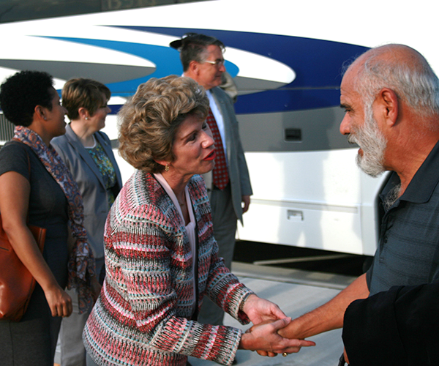
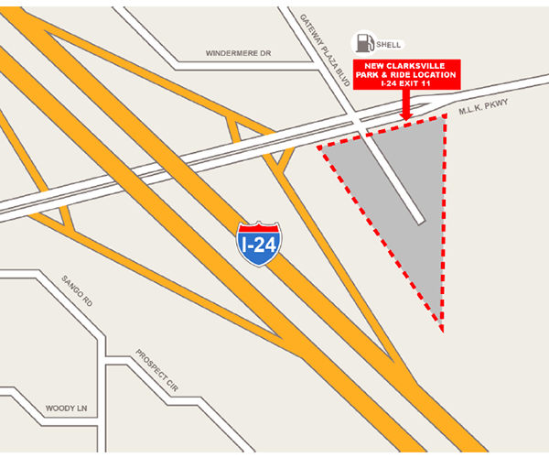
Park and Ride Success
Notes:
Clarksville’s Park and Ride program has been a great success, with as many as 300 riders using it daily since it opened last year—more than 5,000 passenger trips per month. The growth of riders since the new location has increased by 13%

Slide 13
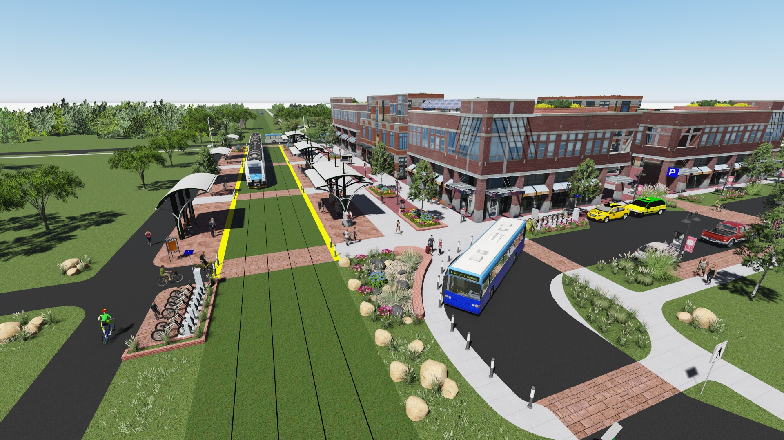
Conceptual Transit Oriented Development
Notes:
Communities with strong transit are starting to leverage their Park & Rides with new privately-funded developments, transforming the areas into a Transit Oriented Developments, with mixed use commercial and residential that appeal to those who like the convenience….Here’s a conceptual drawing of one of these….think of it as a Park & Ride on Steroids

Slide 14
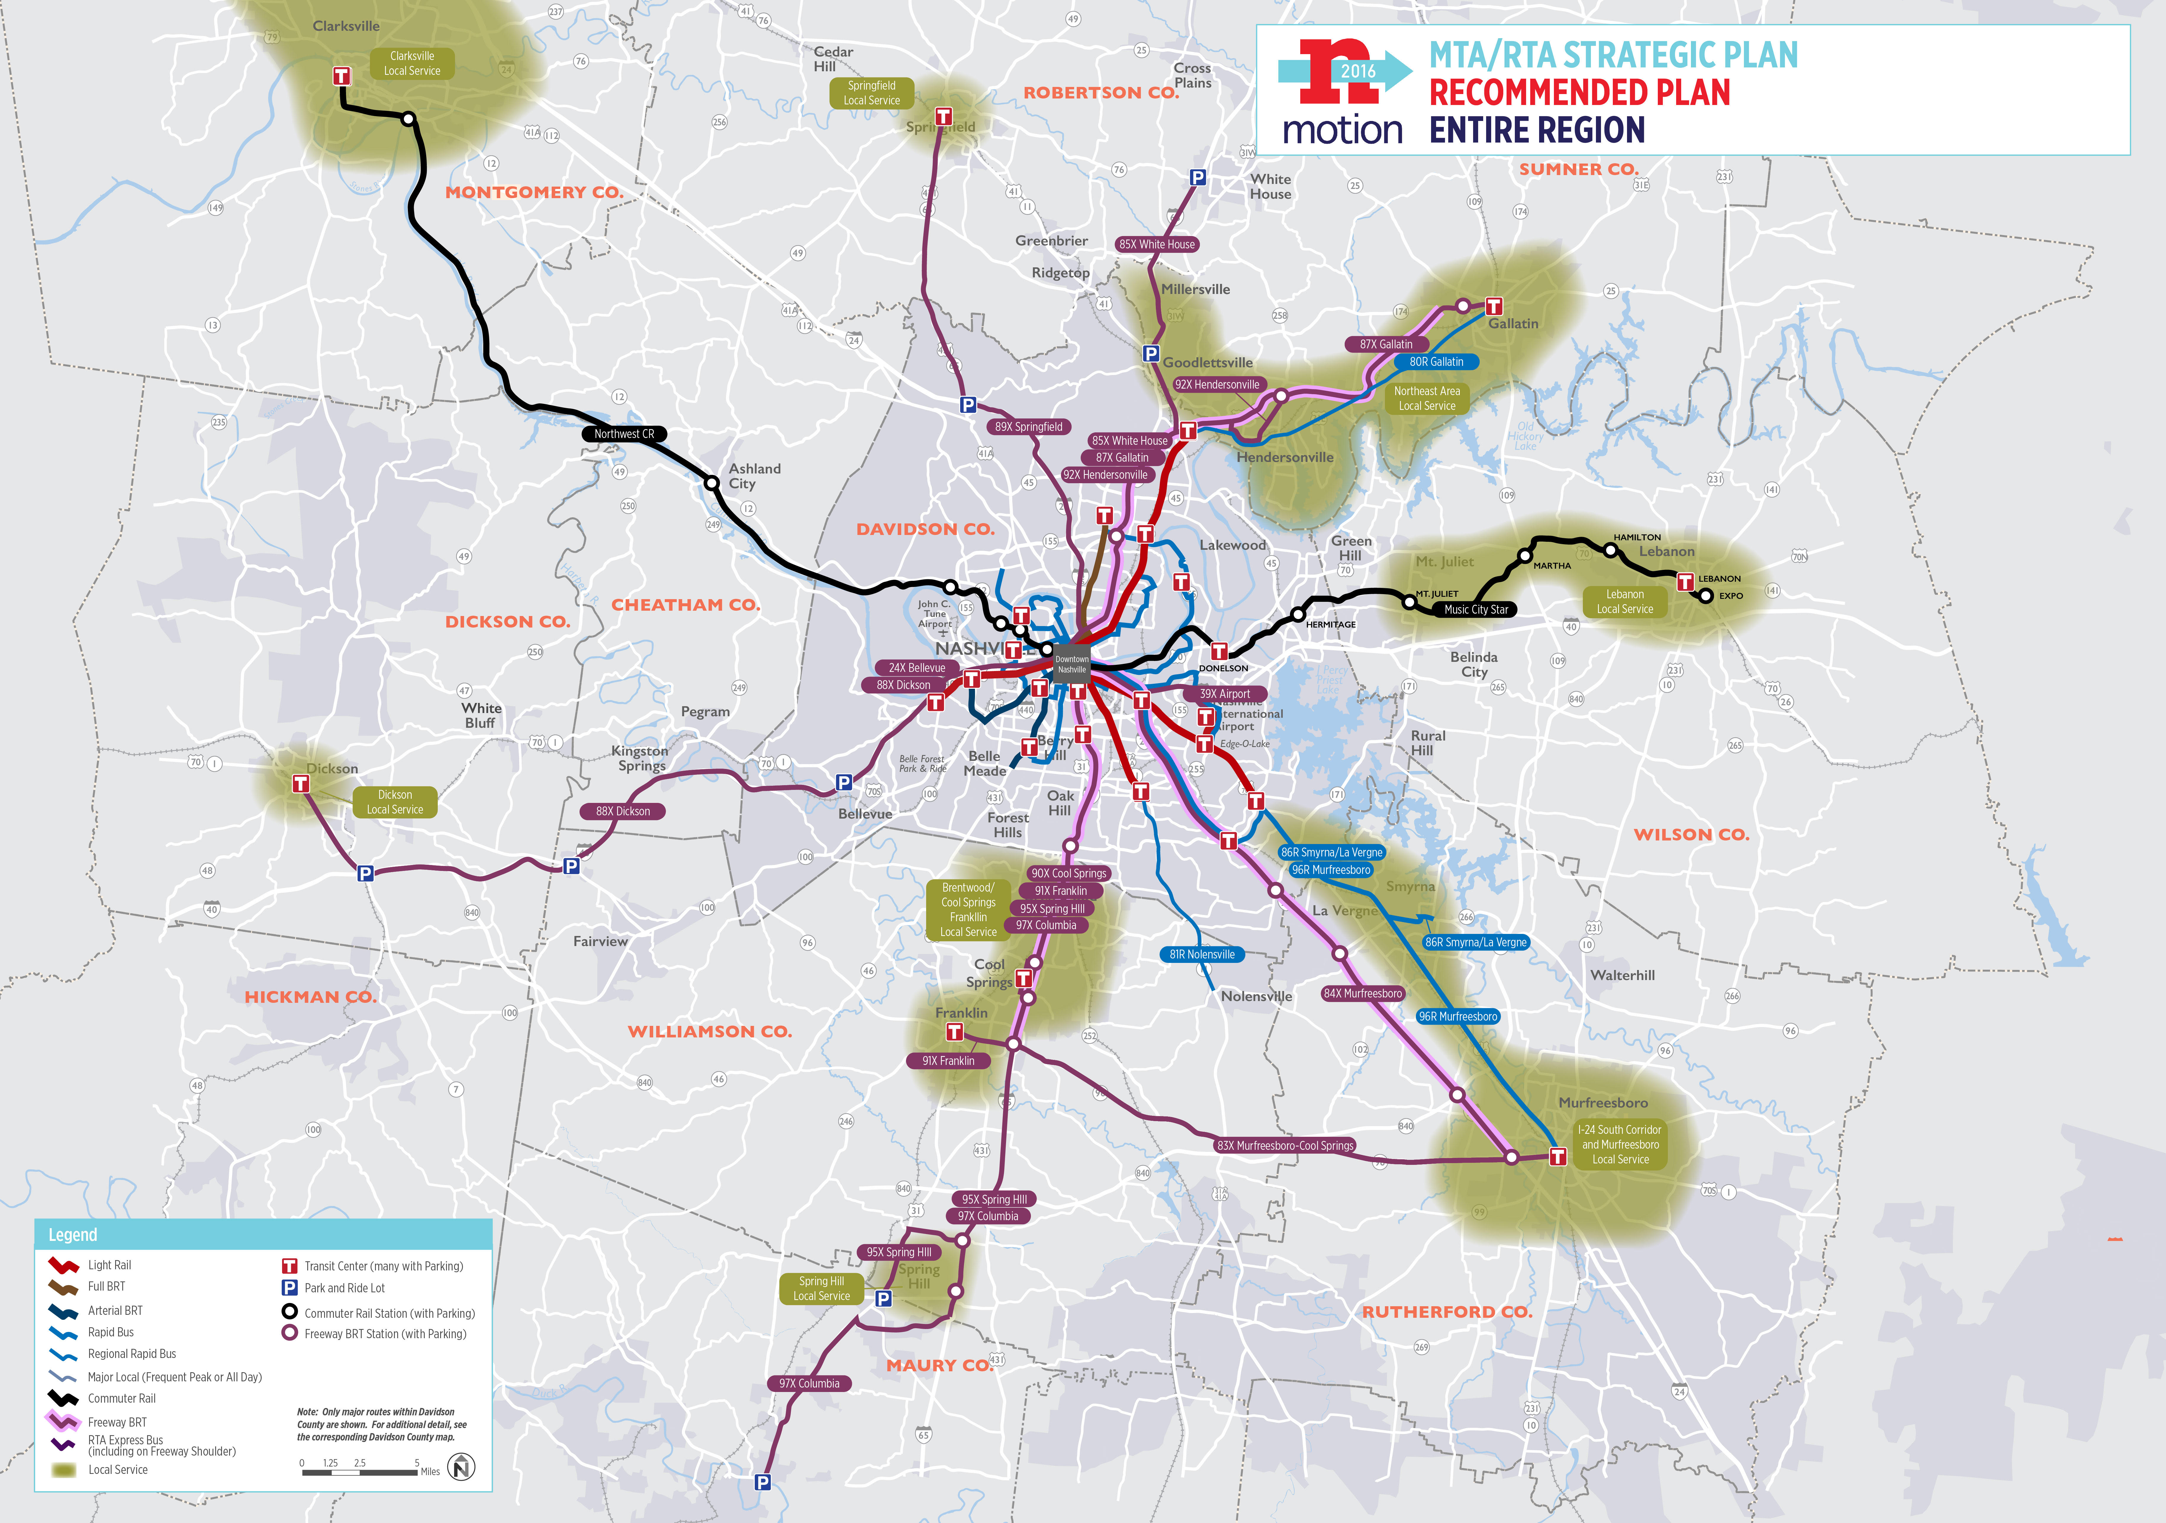
Future Improvements
Improve 94X Clarksville Express bus service
Incorporate North Nashville connections
Explore more Greenway opportunities
Bus on shoulder
Notes:
Key future improvement possibilities include:
Improve 94X Clarksville Express bus service—again, with more than 5,000 rides a month, we know it’s popular
Incorporate North Nashville connections
Explore more Greenway opportunities
Implement Bus on Shoulder to shorten the commute time

Slide 15
Next Steps
Help Us Continue the Conversation
What is the right direction for Clarksville?
Who are the people to lead that conversation?
What are the next steps?

Slide 16
Thank You!

