Slide 1
Transit Leadership Academy (MTTA)
Transit from the State
An update on the IMPROVE Act and Transit Initiatives at TDOT
March 21, 2018
TOKS OMISHAKIN, TDOT DEPUTY COMMISSIONER
Notes:
1 year ago Gov Haslam went on a 15 city listening tour to discuss transportation needs across the state.
TDOT has identified approximately $11 billion in needed projects
Governor is currently considering how we might fund those projects.
We are here today to continue the transportation conversation.
Part of that conversation: making sure you know exactly how we spend our money and the challenges we are face
We will show you how TDOT investments have directly impacted the state’s economy
Also look at some of our surrounding states – otherwise known as our competitors – are doing to raise revenue for transportation.
We want some time getting feedback from you.
I know you are all busy, and we appreciate you taking the time to join this conversation.
Most of you may know that TDOT’s budget is primarily made of federal and state gas taxes.
We first want to take a couple of minutes to show you exactly how and where our dollars are spent. (Video next)

Slide 2
IMPROVE Act: Transportation
All projects complete, under construction, or under contract by 2030
40% Increase for Local Transportation Needs
$35 M additional for cities
$70 M additional for counties
$245 M additional for state

Slide 3
IMPROVE Act: 962 Projects Improving 1,300 Miles of Tennessee Roads

Slide 4
IMPROVE Act FY 2018-20 – 3 Year Plan
IMPROVE Act: 962 Projects
3 Year Plan: 101 Projects
IMPROVE Act : 95 Counties
3 Year Plan : 40 Counties
IMPROVE Act : Urban vs. Rural (52%/48%)
3 Year Plan : Urban vs. Rural (67%/33%)
3 Year Plan
62 Backlog Project moving forward
38 New Start Projects
3 Year Plan(Miles per Region)
Region 1, 147.3 miles
Region 2, 159.7 miles
Region 3, 113.9 miles
Region 4, 81.7 miles

Slide 5
IMPROVE Act: Transportation
Transit Plan Details
Local Option – Referendum
12 counties in TN eligible
Limited to 6 taxes (sales tax, business tax, car rental tax, hotel/motel tax, residential development tax and wheel tax).
Comptroller Review/Approval
TDOT Transit Program – Proportional increase (33% increase in state transit dollars)
40% Increase for Local Transportation Needs

Slide 6
IMPROVE Act: Transportation
Transit Plan Details
Statewide Mobility Transit Grant
Capital in nature (Bus stops, transit stations/facilities, buses, ITS projects, dedicated transit ways, etc.)
Statewide Transportation Network
Regional Connectivity (multi-county impact)
Economic Development goals (access to employment)
Balanced investments – large urban, small urban, and rural transit systems
40% Increase for Local Transportation Needs

Slide 7
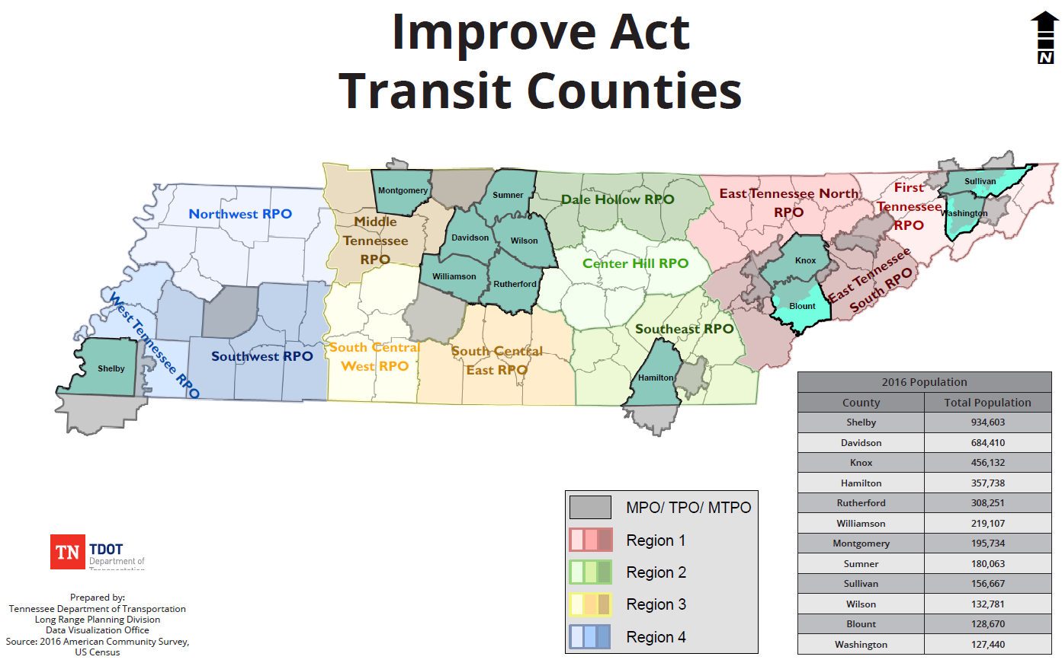
IMPROVE Act Local Option Opportunity

Slide 8
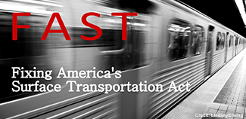
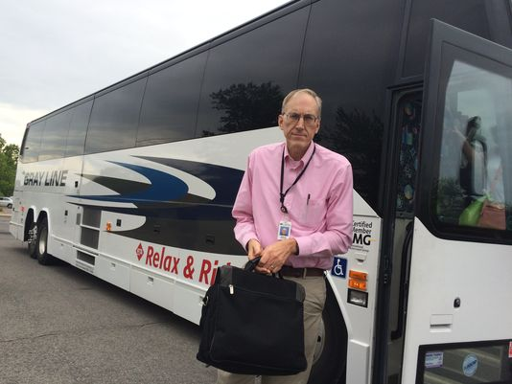
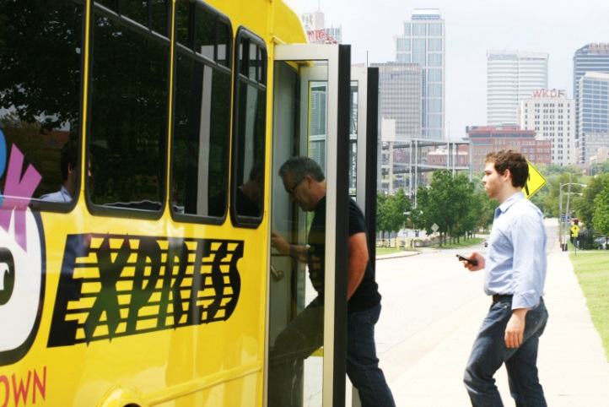
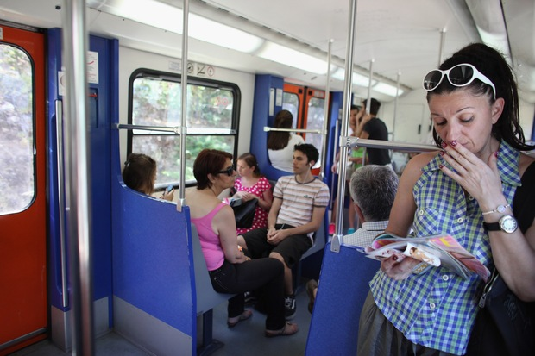
TDOT’s Role in Transit
Administer the Federal Program (FTA)
Partner in Funding (Federal and State)
Partner in Planning and Projects (Corridor Studies, Long Range Plans)
Lead Regional Transit programs (i.e. Swipe and Ride, Park and Ride)

Slide 9
IMPROVE ACT AWARDS SFY 2018
Applicant | Project Description
Murfreesboro: Transit Facility | Comprehensive transit facility for passengers.
Nashville MTA: Bus Replacement | Purchase of 7 hybrid 40ft buses to replace diesel buses.
NWTHRA: Transit Center | Transit facility for admin staff, dispatch, training, maintenance, and operations.
UCHRA: Transit Center | Comprehensive transit facility for passengers, admin staff, maintenance, and operations.
Nashville RTA: Rail Vehicles | Overhaul 1 locomotive and rebuild the trucks, replace the shocks and bushings, and remove rust on cars.
CARTA: Mobility as a Service Phase I | Neighborhood on-demand service using smaller vehicles with mobile ticketing system and real-time arrival technology.
MATA: Electronic Fare Collection | Upgrade 1992 cash fare collection system to digital mobile ticketing smart card technology.
Johnson City: Transit Facility Improvements | Replace 1985 HVAC system in the downtown transit terminal with new energy efficient HVAC system.
Knoxville: Bus Lift for Maintenance | Replace in-ground hydraulic bus lift systems.
Nashville RTA: Coach Buses | Purchase 5 coach buses to be operated by regional commuter bus operator.
Clarksville: Digital Radio Conversion | Replace short-range analog hand-held radios in all buses with vehicle-mounted long-range digital radios that allow multiple users at one time.
Jackson: Bus Camera System | Installation of safety and security digital cameras on all active buses with audio/visual features.

Slide 10
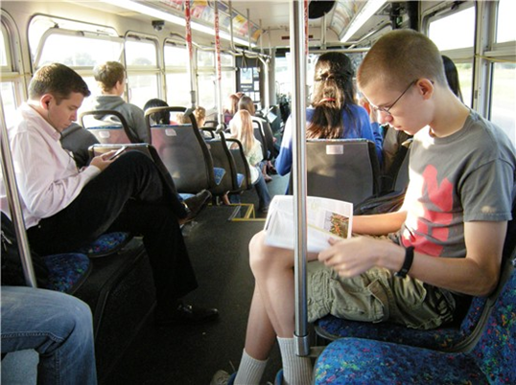
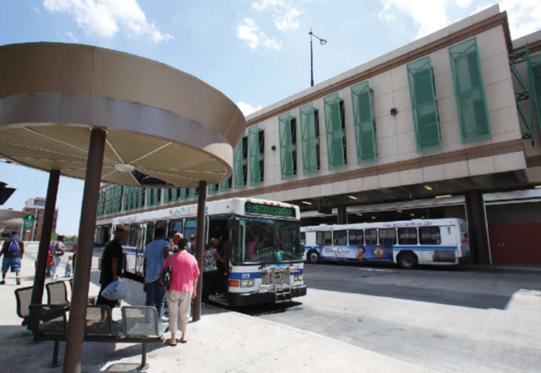
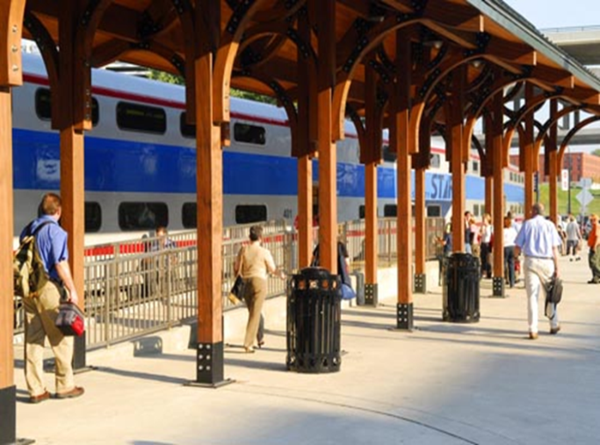
Moving Transit Forward
Regional Connectivity (Linkages to the major destinations, employment hubs)
2015 Tennessee Transit Study (Existing and Future needs, Performance Measures)
Supportive Transit Infrastructure (Design, Policy)

Slide 11
Tennessee Growth
INCREASE IN TOTAL JOB GROWTH BY REGION - 2015 TO 2040
Middle Tennessee
59%
Upper
Cu nd
Tri Cities
42%
Northwest
22%
mberla
34%
East Tennessee
44%
Delta
42%
Southwest
29%
South Central
29%
Southeast
28%
Increase in Job Growth
POPULATION GROWTH - 2015 TO 2040
IF NO CHANGES ARE MADE IN FUNDING, THE NUMBER OF TRANSIT TRIPS PER PERSON IN THE STATE OF TENNESSEE WILL BE CUT IN HALF BY THE YEAR 2035.
5

Slide 12
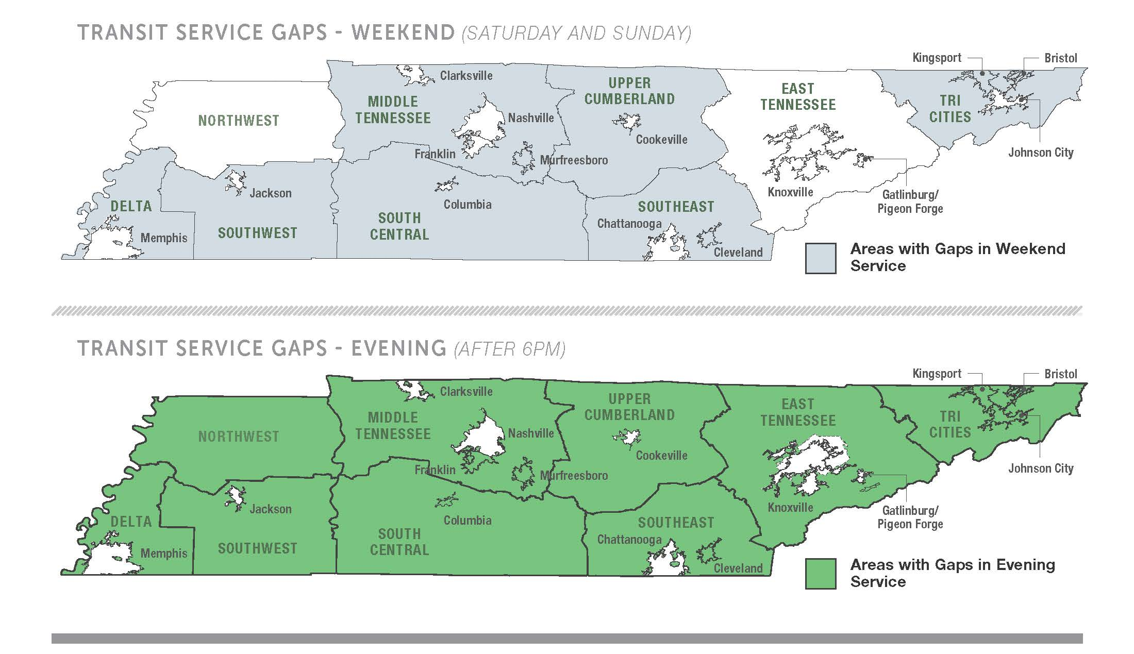
Tennessee TRANSIT Gaps

Slide 13
RURAL FOCUSED NEED
URBAN FOCUSED NEED
NASHVILLE
KNOXVILLE
CONGESTION IN TENNESSEE IN 2010
Congestion
CONGESTION IN TENNESSEE IN 2040
TRANSIT DEPENDENCY INDEX
Incomplete Data Low
Medium High
Congestion
MEMPHIS CHATTANOOGA
TRANSIT DEPENDENCY INDEX
The Transit Dependency Index considers demographic data and is most useful to assess “safety net” transportation need. Those needing those types of transportation services include the population over
65; carless households; population living in poverty; and population under 65 with a disability. It does not address where transit need is determined by other “push” factors, such as congestion, a wish for a community to improve or maintain its “quality of life” by introducing a robust transit system, or other environmental considerations.
TRANSPORTATION CAPACITY DEFICIENCY INDEX
The Transportation Capacity Deficiency Index addresses issues of congestion and pollution. Together, the combination of both indices highlight the need in both rural and urban areas to create more transit options for the citizens of Tennessee.
9

Slide 14
Top 5 Transportation Priorities for TN Over the Next 25 Years By Group
Rank
Residents
Partners
Elected Officials
Maintaining Existing
Maintaining Existing
Maintaining Existing
1
Highways
Highways
Highways
2
Relieving Congestion
Relieving Congestion
Building New Highways
Addressing Commercial Truck Traffic
Commercial Truck Traffic
Building New Highways
Relieving Congestion
3
Expanding Public
Expanding Public
Expanding Public
4
Transportation
Transportation
Transportation
Addressing Mobility Needs
Addressing Commercial Truck Traffic
5
for Seniors
Commercial Truck Traffic
Adding Shoulders
A total of 2,729 surveys were completed; response rate of nearly 35%
A total of 454 Partner surveys were completed; response rate of slightly over 50%
A total of 333 Elected Official surveys were completed; response rate of 62%
2013-2014 Statewide Customer Service Survey - TDOT

Slide 15
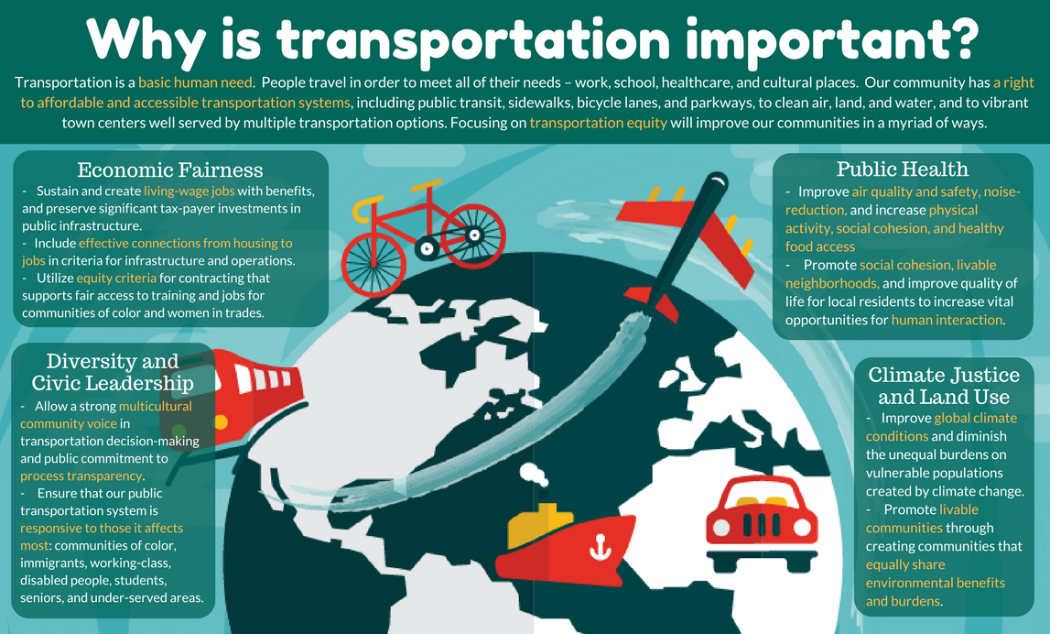

Slide 16
Transit Leadership Academy (MTTA)
Transit from the State
An update on the Improve Act and Transit Initiatives at TDOT
March 21, 2018
TOKS OMISHAKIN, TDOT DEPUTY COMMISSIONER
Notes:
1 year ago Gov Haslam went on a 15 city listening tour to discuss transportation needs across the state.
TDOT has identified approximately $11 billion in needed projects
Governor is currently considering how we might fund those projects.
We are here today to continue the transportation conversation.
Part of that conversation: making sure you know exactly how we spend our money and the challenges we are face
We will show you how TDOT investments have directly impacted the state’s economy
Also look at some of our surrounding states – otherwise known as our competitors – are doing to raise revenue for transportation.
We want some time getting feedback from you.
I know you are all busy, and we appreciate you taking the time to join this conversation.
Most of you may know that TDOT’s budget is primarily made of federal and state gas taxes.
We first want to take a couple of minutes to show you exactly how and where our dollars are spent. (Video next)

