Slide 1

Transit Citizen
Leadership Academy:
Federal Perspective
Pamela M. Kordenbrock
Federal Highway Administration – Tennessee Division
September 2018

Slide 2

USDOT
Office of the Secretary
Federal Aviation Administration
Office of Inspector General
Pipeline and Hazardous Materials Safety Administration
Federal Highway Administration
Federal Motor Carrier Safety Administration
Federal Railroad Administration
Federal Transit Administration
Maritime Administration
Saint Lawrence Seaway Development Corporation
Surface Transportation Board

Slide 3
USDOT
Office of the Secretary
Federal Aviation Administration
Office of Inspector General
Pipeline and Hazardous Materials Safety Administration
Federal Highway Administration
Federal Motor Carrier Safety Administration
Federal Railroad Administration
Federal Transit Administration
Maritime Administration
Saint Lawrence Seaway Development Corporation
Surface Transportation Board

Slide 4
USDOT
Office of the Secretary
Federal Aviation Administration
Office of Inspector General
Pipeline and Hazardous Materials Safety Administration
Federal Highway Administration
Federal Motor Carrier Safety Administration
Federal Railroad Administration
Federal Transit Administration
Maritime Administration
Saint Lawrence Seaway Development Corporation
Surface Transportation Board

Slide 5
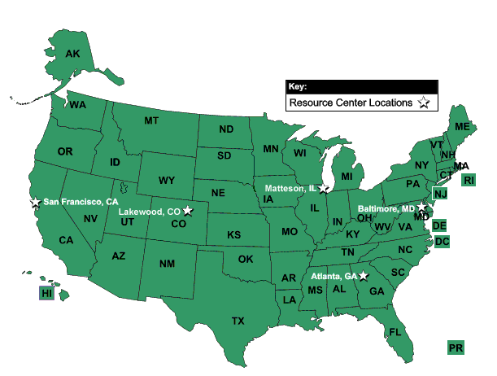
Federal Highway Administration Offices

Slide 6
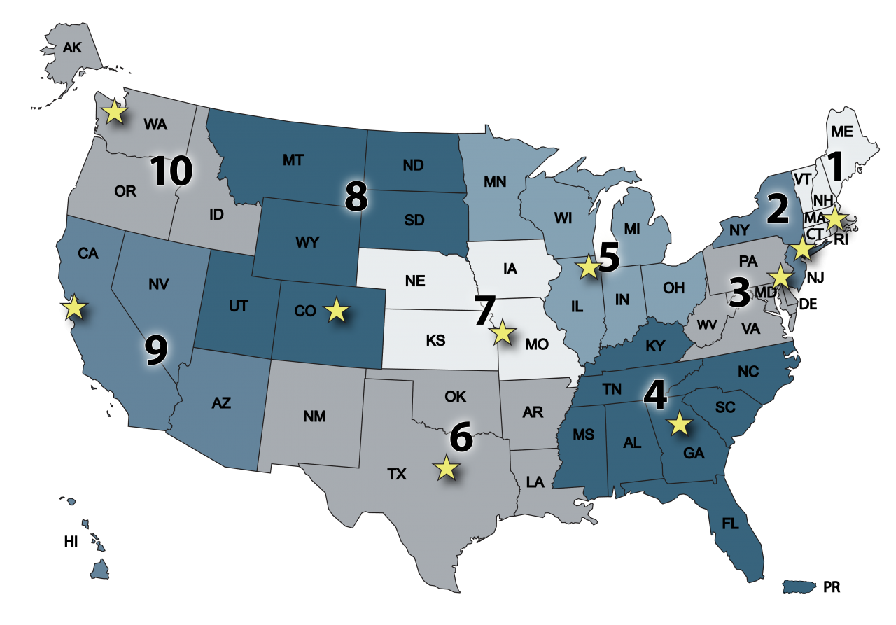
Federal Transit Administration Regions

Slide 7
Federal Transit Administration Regions

Slide 8
FHWA: Federally Assisted, State Administered
Federal Responsibilities
Review and approve State proposals
Develop regulations and guidance
Create and approve design standards
Provide technical assistance
Distribute funds
Reimburse States their eligible expenses
State and Local Responsibilities
Select projects for development
Plan, design, initiate and construct projects
Maintain and operate highways

Slide 9
FHWA: Federally Assisted, State Administered
Federal Responsibilities
Review and approve State proposals
Develop regulations and guidance
Create and approve design standards
Provide technical assistance
Distribute funds
Reimburse States their eligible expenses
State and Local Responsibilities
Select projects for development
Plan, design, initiate and construct projects
Maintain and operate highways

Slide 10

Federal/State Partnership
FHWA direct relationship with TDOT
All Federal funds flow through TDOT
If TDOT passes on Federal $$ to Metropolitan Planning Organizations (MPOs) or Local Agencies, TDOT has statutory obligation to ensure Federal and State requirements are satisfied
TDOT is the recipient and Local Agency is subrecipient
Federal Aid Highway Program is a reimbursable program

Slide 11
Federal Gas Tax?
OR

Slide 12

Federal Gasoline Tax
0.1 cent
18.4 cents
L.U.S.T. Trust Fund
15.44 cents
2.86 cents
Highway Account
Mass Transit Account
Effective October 1, 1993
Notes:
The last change to the gas tax rate was effective October 1, 1993.

Slide 13

Federal Diesel Tax
0.1 cent
24.4 cents
L.U.S.T. Trust Fund
21.44 cents
2.86 cents
Highway Account
Mass Transit Account
Effective October 1, 1993
Notes:
Note that the diesel tax is 6 cents higher than the gasoline tax.

Slide 14
Federal Diesel Tax
0.1 cent
24.4 cents
L.U.S.T. Trust Fund
+ 6 ¢
21.44 cents
2.86 cents
Highway Account
Mass Transit Account
Effective October 1, 1993
Notes:
Note that the diesel tax is 6 cents higher than the gasoline tax.

Slide 15
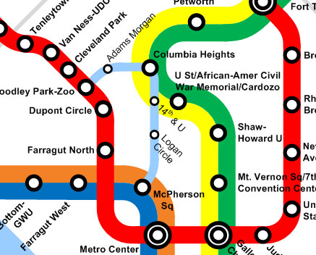
Flexible Funding: FHWA to FTA
TDOT requests FHWA to transfer highway funds to FTA
Eligible Projects, for instance:
  new transit service
  purchasing of new transit vehicles
  bicycle and pedestrian facilities
  bike storage/share programs
  park and ride
  bus stops
  multimodal transfer centers

Slide 16
Fund Transfers to FTA
FY 2017
Agency | Chattanooga | Knoxville | Memphis | Nashville
Federal Funds | $598,560.00 | $2,259,906.40 | $5,304,000.00 | $4,160,623.00
Total Statewide: $12,323,089.40
H
T
H
T
H
T

Slide 17
Fund Transfers to FTA
FY 2018 (so far)
Agency | Chattanooga | Knoxville | Memphis | Nashville
Federal Funds | $0.00 | $5,060,270.00 | $1,640,000.00 | $5,170,812.00
Total Statewide: $11,871,082.00
H
T
H
T
H
T

Slide 18
Thoughts for You Today and Moving Forward
Think Regionally
  You have some. I have some. Together we have a lot.
  We are attracting employers, employees and improving quality of life.
  As people move into the area, they may expect green space, trails, transit, etc. like their former locations.
Be Ready
  You never know when funding will become available.
  Projects and plans with political support and matching funds will be in a much better position to move forward.
Projects waiting for money,
not money waiting for projects.

Slide 19
Questions and Contact Info
Pamela Kordenbrock
Pamela.Kordenbrock@dot.gov
615-781-5770

